Slide 1
Catalog Manager Supplier
Para los proveedores (Estándar) en Español

Slide 2
Agenda
Bienvenidos a su capacitación catálogo organizado por Hubwoo
Durante esta capacitación, les explicaremos:
El flujo del trabajo de Catalog Manager
Conectarse al portal Hubwoo
Descargar la plantilla modelo del catálogo
Llenar la plantilla para crear el catálogo
Crear un archivo anexo de: imágenes, fotos, documentos PDF
Cargar la plantilla y el archivo, después de haber sido comprimidos
Verificar y corregir los errores
Publicar el catálogo

Slide 3
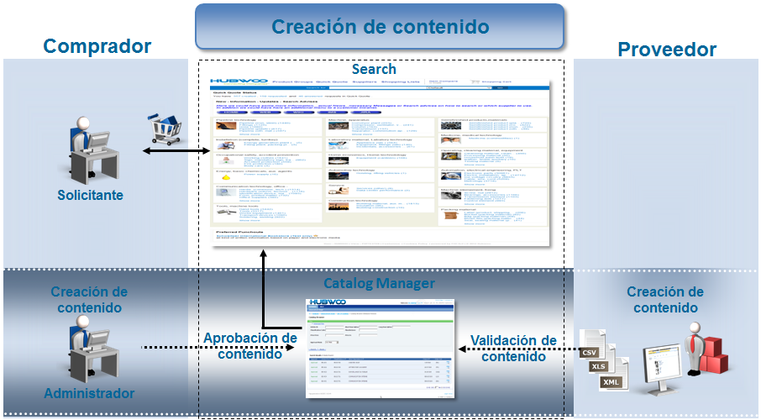
Flujo del trabajo de Catalog Manager

Slide 4


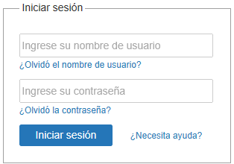
Conectar al portal
Van a recibir un correo electrónico por parte de CustomerCare@hubwoo.com el cual va a contener su nombre de usuario (User name) y una contraseña temporaria (Password).
Asegúrese de que esté conectado al internet, haga clic en el lazo que se le ha proporcionado en el correo electrónico, o conéctese en https://portal.hubwoo.com

Slide 5
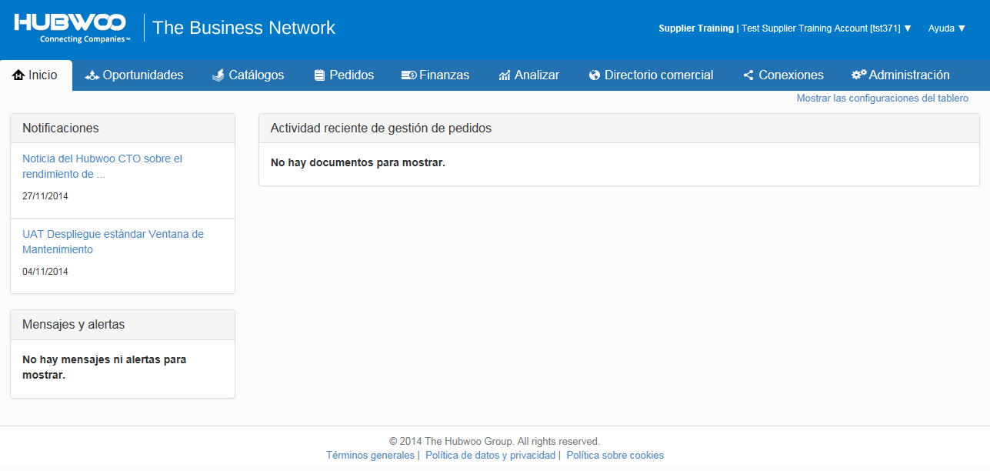
Conectar al portal
Cuando uno se conecta por primera vez, automáticamente el sistema le va a pedir de cambiar la contraseña temporaria.
Después de su primera conexión, cada vez que se conecte usted vera la página de bienvenida.

Slide 6
Descargar la plantilla SCF del catálogo
Usted debe de descargar la plantilla desde el portal, con el fin de obtener automáticamente el “Número de Identificación del Proveedor”; este aparecerá en la hoja de cabecera de la plantilla.

Slide 7
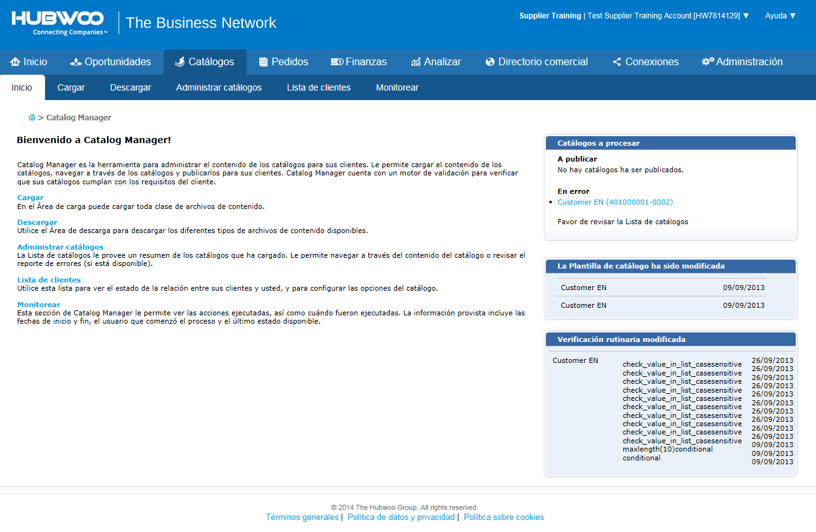
Área de Descargar
1. Haga clic en la pestaña Catálogos.
2. Una vez en la pagina de bienvenida haga clic en «Área de Descargar»

Slide 8
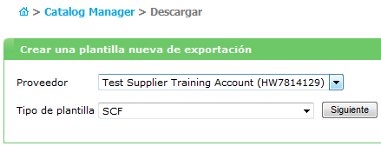
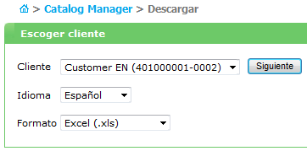
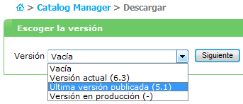
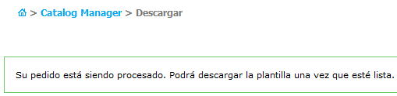
Área de Descargar
1. En la ventana proveedor seleccione su cuenta, para el tipo de plantilla precise SCF; finalmente, haga clic en Siguiente.
2. Seleccione como cliente, español como idioma, escoja el tipo de formato de la plantilla; finalmente; haga clic en Siguiente.
3. Seleccione la última versión disponible y a continuación haga clic en Siguiente.
4. Cuando vea este mensaje de estado, esto significa que la solicitud ha sido enviada y está siendo procesada, esto tomará alrededor de 2 a 3 minutos.

Slide 9
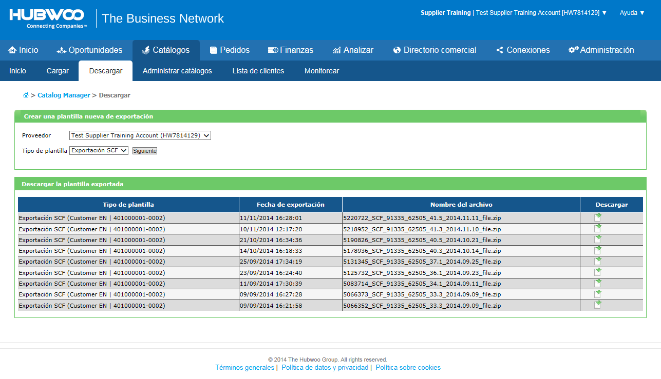
Área de Descargar
Vuelva a la página Catálogo y haga clic en "Área de descarga".
En la página de descarga de software, bajo los resultados de la búsqueda, la primera entrada que tenga el nombre con SCF de exportación será el archivo correcto para descargar. Para descargar, haga clic en el botón de descarga a la derecha. Después de hacer clic en Descargar, se le pedirá que guarde el archivo.

Slide 10
Llenar la plantilla para crear el catálogo

Slide 11
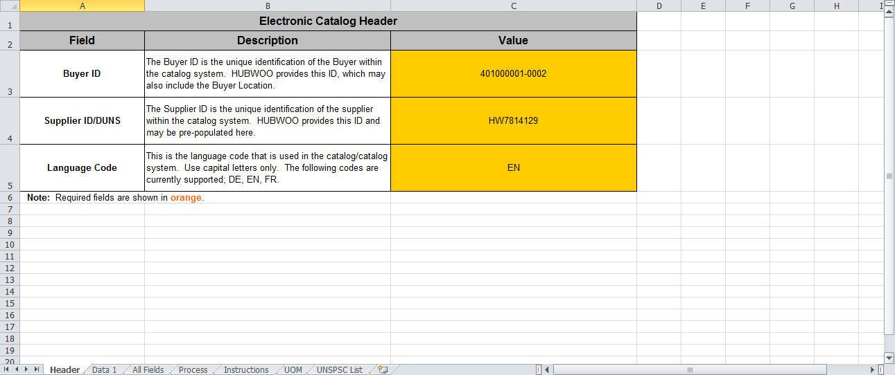
Header tab (Encabezado)
La primera página del tablero Excel «Encabezado» para crear el Catálogo.
Esta hoja contiene las identificaciones del Comprador y del Proveedor y por último, el código del idioma. Los campos en naranja son obligatorios.

Slide 12
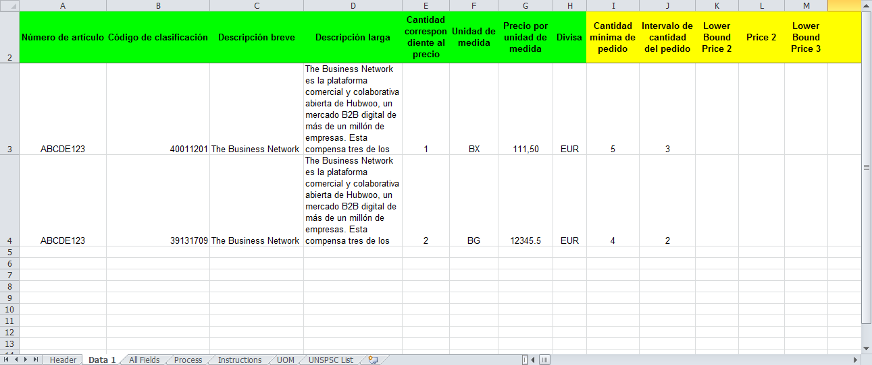
Data 1
La ficha de datos contiene toda la información para la creación del catálogo que va a cargar y publicar en el portal de . Vamos a detallar este formulario más adelante en la presentación.

Slide 13
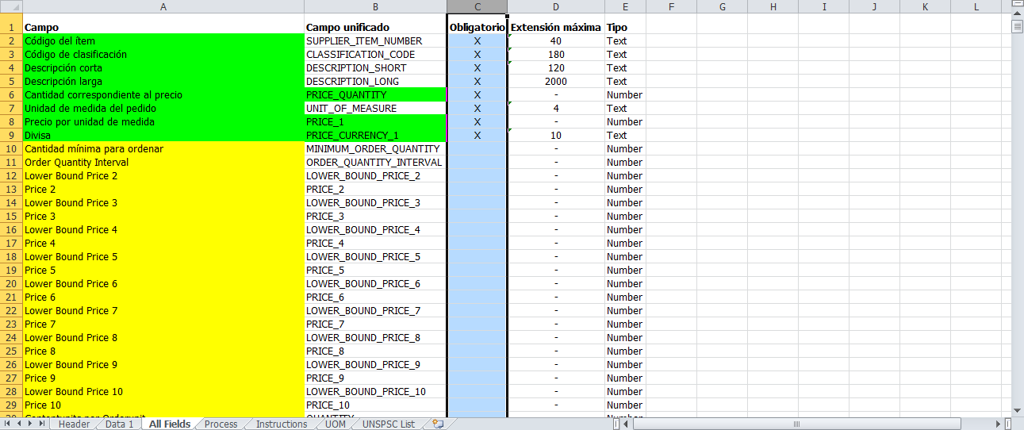
All Fields (Todos los campos)
All Fields - donde se puede encontrar toda la información del catálogo en resumen con algunas indicaciones como la máxima cantidad de caracteres, o si es un campo obligatorio u opcional.

Slide 14
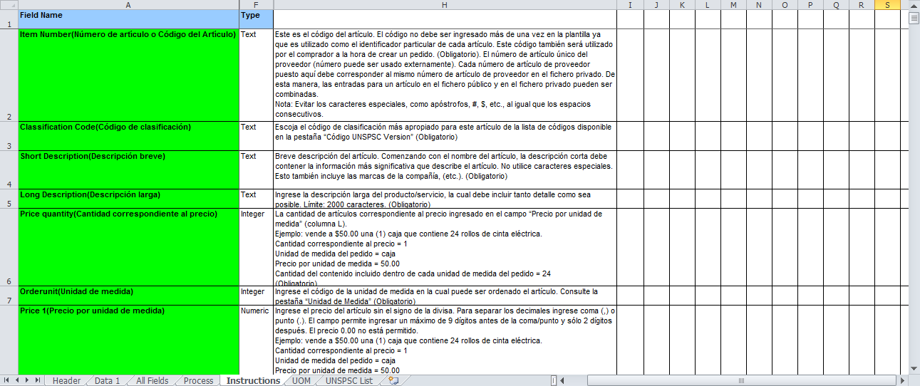
Instructions (Instrucciones)
La pestaña «Instrucciones» le proporciona: Información detallada sobre cada una de las columnas. Los pasos para cargar la plantilla en catálogo y su publicación.

Slide 15
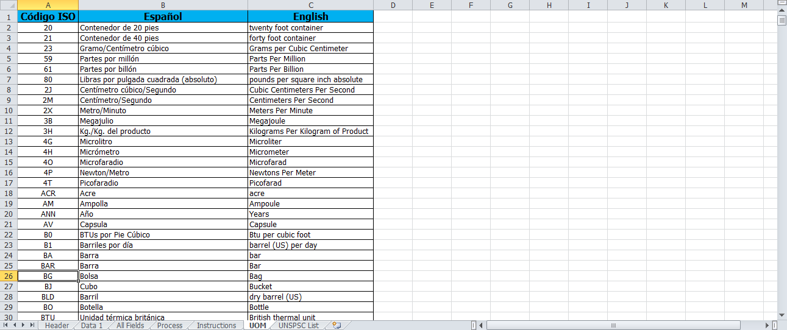
UOM(Unidad de Medida)
La pestaña «Unidad de Medida» contiene todas la Unidades de Medidas aceptadas.

Slide 16
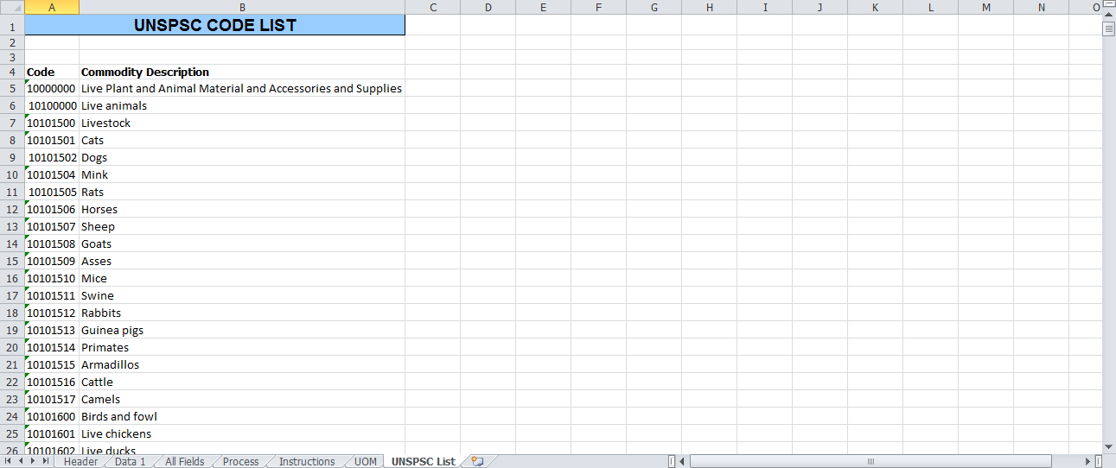
UNSPC
Código de clasificaciones: Escoja el código de clasificación más apropiado para este artículo de la lista de códigos disponible en la pestaña “Código UNSPSC Versión”.

Slide 17
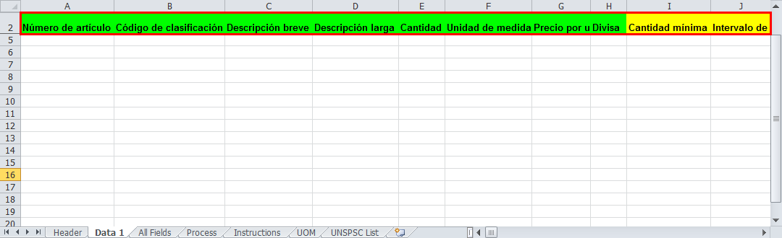
Campos Verdes y Amarillos
Cuando usted mira la plantilla que se le ha enviado, usted se dará cuenta de que algunos campos están resaltadas en verde y otros se resaltan en amarillo. Campos de color verde son obligatorios y en amarillo son los datos opcionales.

Slide 18
Crear un archivo anexo de: imágenes, fotos, documentos PDF

Slide 19
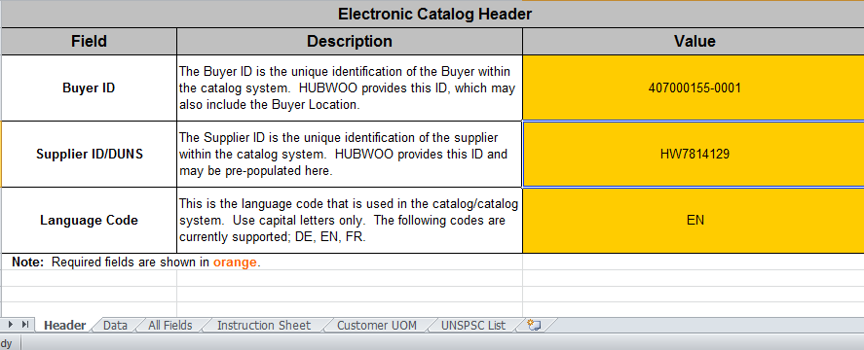
SCF Template – Header Tab
Catalog Header information – This sheet contains the Buyer and Suppler IDs and language code. Items in orange are mandatory fields.
If not pre-populated, please contact Hubwoo

Slide 20
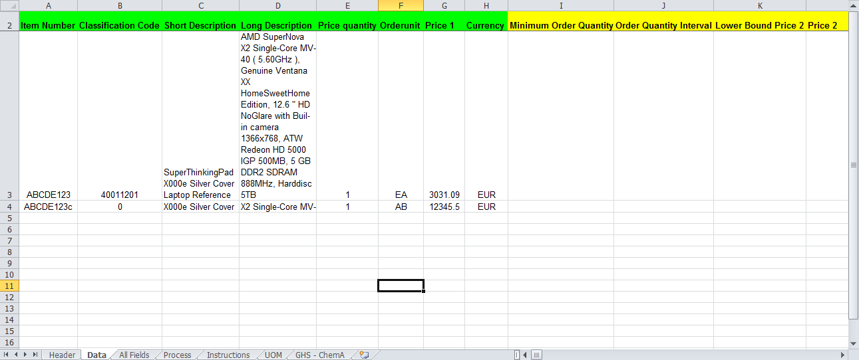
Data 1 Tab
The Data tab contains all the information for the catalog that you will upload and release to your buyer. We will go over this form in detail, later in the presentation.

Slide 21
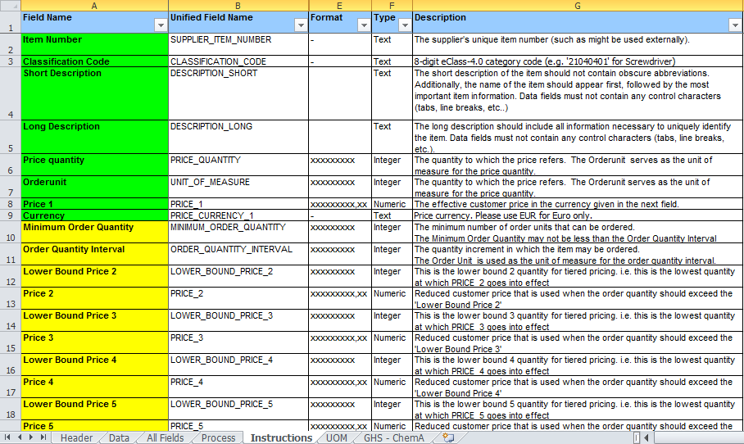
Instructions Sheet
The Instructions tab gives you information regarding each of the columns and the steps to upload the template into Catalog Manager Supplier.

Slide 22
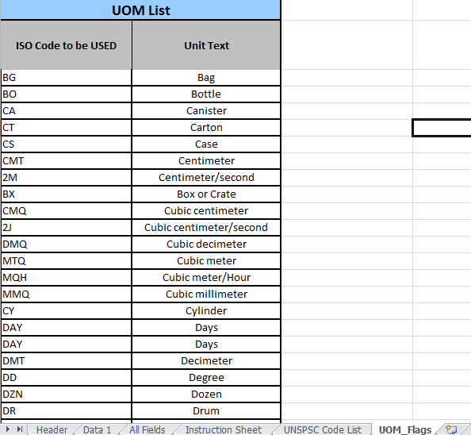
Unit of Measure Field
The UOM tab contains all the valid Units of Measure allowed by the buyer.

Slide 23
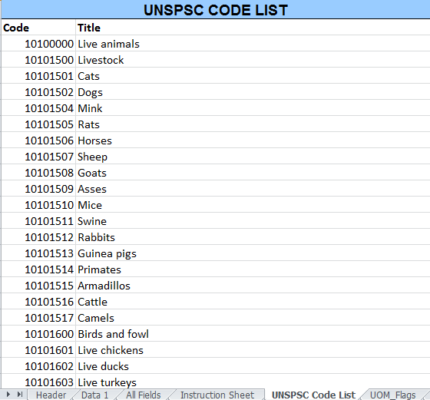
Classification Codes Tab
The Classification Codes tab contains all the valid UNSPSC or eClass codes allowed for your Buyer.
UNSPSC or eClass is the 8 digit Classification Code for the item.
If your Buyer requires UNSPSC/eClass Code, contact your buyer to obtain a list.

Slide 24
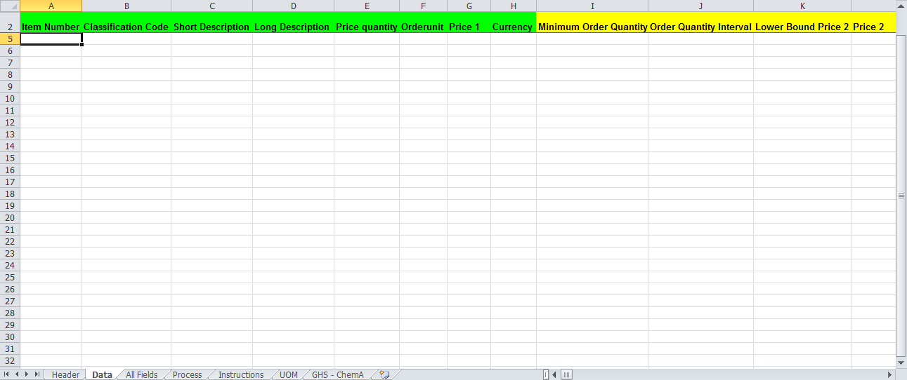
Filling in the Data 1 Tab
This section will show you how to fill out the fields in the data tab.

Slide 25
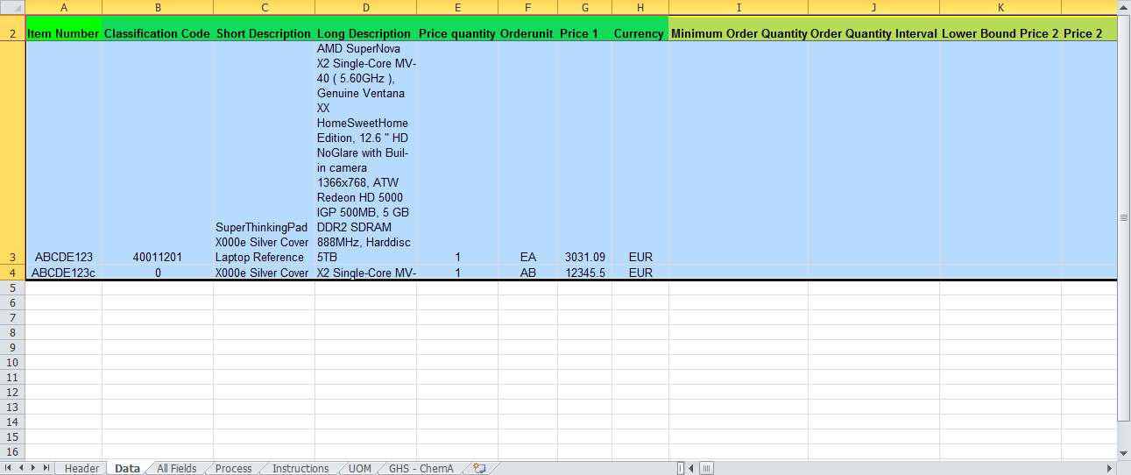
Mandatory and Optional Fields
Fields are highlighted in green and yellow.
Green fields are mandatory and yellow fields are for optional data.

Slide 26
Uploading Files

Slide 27
Uploading your Catalog
Before uploading any files, you must make sure they have been saved, in order to upload.
The SCF or Content file doesn’t need to be compressed into one zip (.zip) file, before it is uploaded. However, you must choose a dedicated file type for the uploaded files.
The following file types are selectable from the drop down menu:
    Content files (xlsx, xls, txt)
    Attachment files (any file types)
Attachment files have to be compressed to a zip file.
All content file names must contain “_SCF_” in the middle of the filename, for example, BuyerName_SCF_DDMMYYYY

Slide 28

Uploading your Catalog
Start the upload process by clicking on the “Upload Files” chevron, second from the left. Select the type of file to be uploaded, remembering to upload your Attachments, or images, first.
Note: Upon selecting the file, click “Upload” when uploading your catalog.
Click “Upload Files”
Select the file, by clicking “Browse”

Slide 29
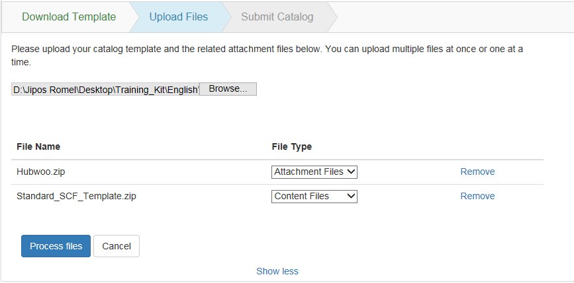

Uploading your Catalog
Once the file has been uploaded, you will see it listed under the type selected.
Catalog file types

Slide 30
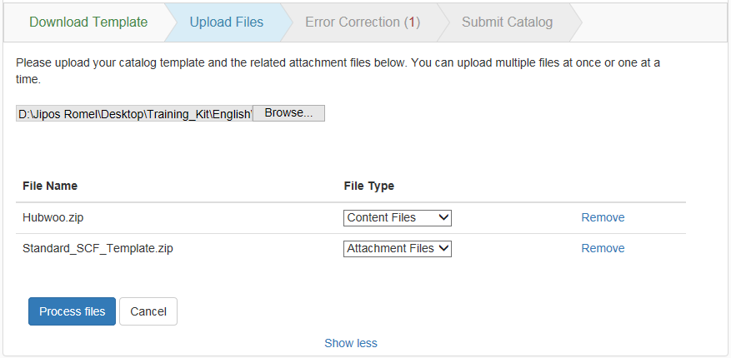
Uploading your Catalog
Lastly, click on “Process Files” to proceed in uploading your catalog.
Click “Process Files”

Slide 31
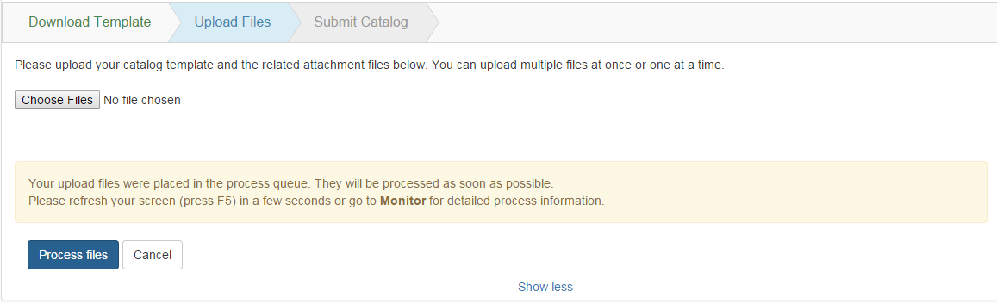
Uploading your Catalog
A confirmation message will be shown on the Upload Files Chevron after you clicked the “Process files” button.
Either you click “F5” or go to the “Monitor” page.

Slide 32
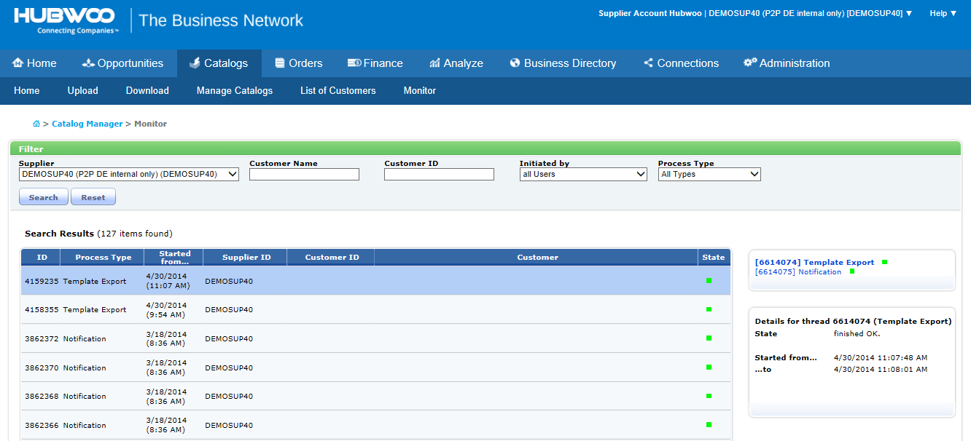
Monitoring your Catalog
After uploading your catalog, you may click the “Monitoring” tab and review if the uploaded file has been processed without any issues.
  A Grey box indicates the process has started.
  A Blue box indicates the process is in progress.
  A Green box indicates the process is complete.
  A Red box indicates that the process is complete but contains errors.
Status Indicator
Click “Monitor”

Slide 33
Error Correction

Slide 34
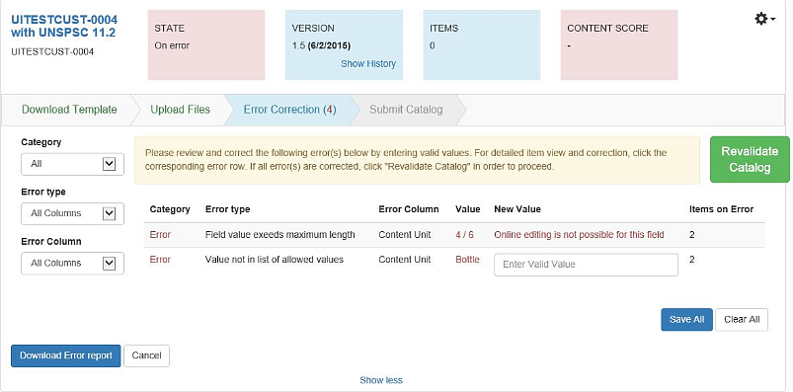
Error Correction
After uploading, Catalog Manager validates the catalog file. If there are incorrect item values, Catalog Manager displays the number of errors beside the "Error Correction" chevron. These errors must be corrected before the upload process can be finished.
The number of errors in the catalog files will also appear in brackets within the chevron.

Slide 35
Error Correction
The errors will be grouped in a table by Category, Error Type, Error Column and Value.
The number of items with errors will be shown per group.
Once all error values are corrected, the "Revalidate Catalog" button will be activated and the corrected catalog can be reprocessed.
You are able to correct multiple errors for each error group by entering new values for all grouped items and clicking "Save All".

Slide 36



Error Correction
For those errors which cannot be corrected online, you have to correct the dedicated fields directly in the catalog template.
Note: if you have multiple errors and online edit is not possible for all, you must correct the errors within the template, first. After re-uploading, you may use online edit for the remaining errors.
It is possible to filter the list by Category (Error, Warning, Corrected), Error Type, Error Column and Value.
There is also an option to download an Error Report below the error table.

Slide 37
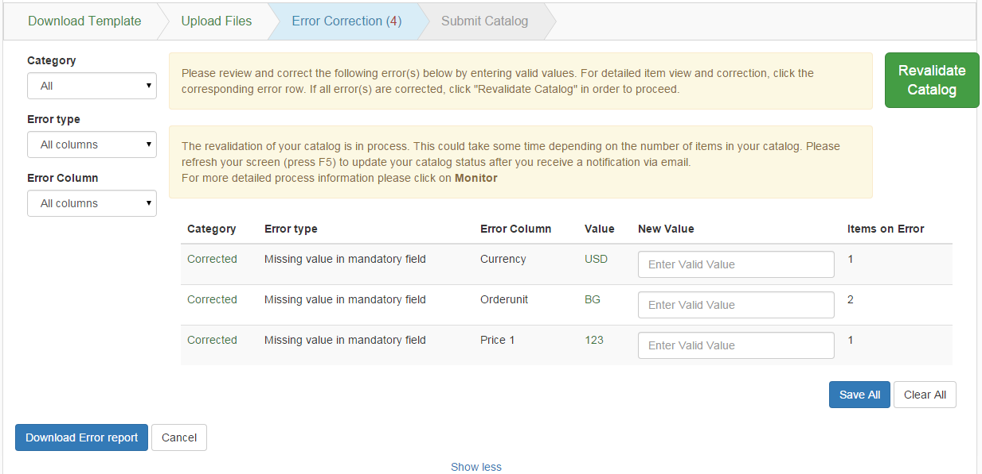
Error Correction
A confirmation message will be shown in the second box on the Error Correction Chevron.
Press F5 to update the catalog status or you may go to the Monitor page

Slide 38
Submit Catalog

Slide 39
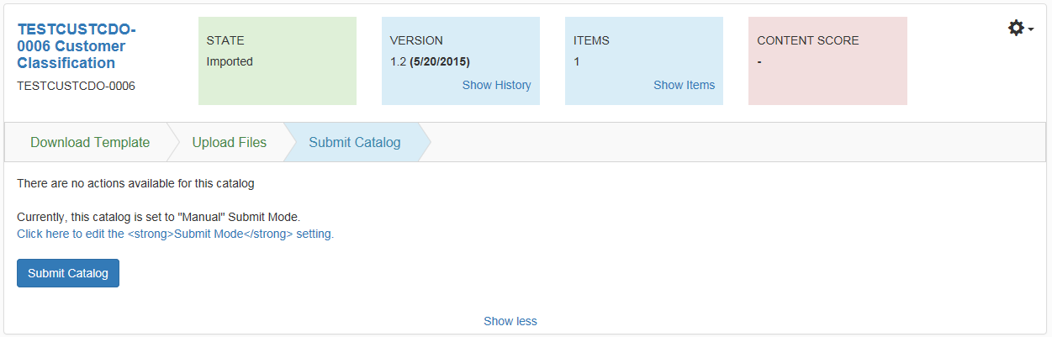
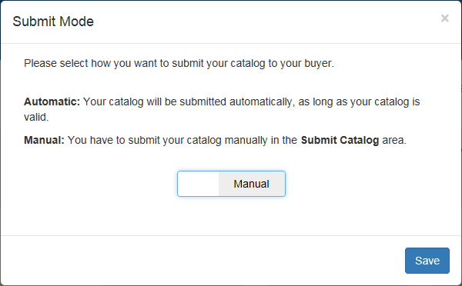
Submit Catalog
The final step in the process is to submit the valid catalog to your customer. This step is located as the last chevron, where you will be able to click the Submit Catalog button to publish the catalog. On this page, you have the option to choose a release mode (manual or automatic), which are described below.
Click “Submit Catalog”

Slide 40
Submit Catalog
Once the catalog is successfully released, its State changes from Imported, to Releasing, to Released.
Upon releasing your catalog, the system transfers it directly to the Catalog Manager Buyer application, where your buyer can then review and approve your catalog.

Slide 41
Advanced Functionalities

Slide 42
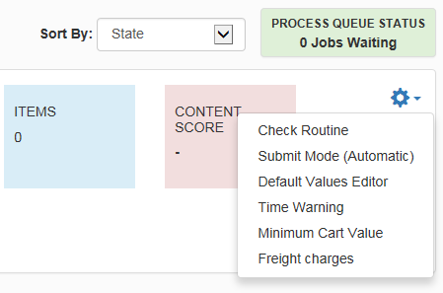
Gear Wheel Menu: Advanced Functionalities
The Gear Wheel Menu groups every other feature for the related catalog, which doesn’t change with every catalog version. This area is used when advanced features are utilized with your customer.
Click the icon to open the Menu

Slide 43
Best Practices
Catalog Templates are buyer specific. Thus it is advisable to download a new template for each buyer.
Always check if a newer version of the catalog template of the specific customer is available, especially if there was a check routine change to ensure you have the latest catalog template in use.
Make sure that all mandatory fields are filled-out as indicated in the Instruction Sheet. Allowable values, as well as maximum character length for a field in the Data Sheet can also be found in the Instruction Sheet.
Make sure to enter the correct supplier catalog ID and Buyer catalog ID in the Header sheet for SCF import files. Buyer and Suppler IDs, as well as the language code are mandatory fields.
The content of the catalog must always be entered in the DATA 1 Sheet. Do not rename the sheet.
In the DATA 1 sheet, always check if the column fields in rows 1 and 2 are correctly written and complete. Blank columns, especially in row 1 (Unified Fields within the SCF template) will result in an error during import.
Always check that there are no empty rows in the middle of the catalog content.
If attachments are to be added in the SCF import file, the physical file must be uploaded first as Attachment and use maintain the exact filename in the SCF import file.

Slide 44
Best Practices
Attachment files like jpeg and others must be in a separate file and in zip format and there must be no subfolders.
Always zip the attachment files and content files before uploading them.
Always select the correct file type. Attachment is for uploading pictures and documents. Content are for uploading catalog contents. The maximum zip-file size for attachments is 512 MB.
Attachment files must be uploaded once and can be loaded incremental. Meaning you do not have to load all attachments every time only then when you have changed the reference in the catalog or you have new pictures to be loaded as new items have been added.
Attachment files must be uploaded once and can be loaded incremental. Meaning you do not have to load all attachments every time only then when you have changed the reference in the catalog or you have new pictures to be loaded as new items have been added.
Picture attachments must be in *.jpg, *.jpeg, *.gif. Images should be a minimum of 300x300 pixels in size, in RGB color format, and not CMYK, which browsers do not support. The color depth should not be greater than 24 bit. Animated gif images are also not accepted.
If there are changes in the content file, all items in the catalogs, including the new one, must be uploaded all at once.
In case you have to correct errors in the SCF because they are not editable online, then you have to reload the complete catalog
In case you have a mix of error correction types (online editable and not possible for online edit) then the best practice is to correct all errors in the catalog template and re-upload the entire catalog.

Slide 45
Support Resources
Global Customer Care Team
http://www.proactis.com/uk/hubwoo/
Notes:
45

