Slide 1
Services Procurement: Order Management
Supplier Standard Training

Slide 2
Agenda
Welcome to the Services Procurement: Order Management Supplier Standard Training
This training session will cover the following topics:
Introduction
  Session Objectives
  Overview
Login and Overview
Reviewing, Accepting or Rejecting a Purchase Order
Creating a Service Entry Sheet
Invoicing
Additional Resources and Information

Slide 3
Session Objectives
This session will cover some features and functionalities of the Order Management system for a standard Services Procurement cycle
It will provide you with step-by-step instructions on processing Purchase Orders, Service Entry Sheets and Invoices
At the end of this Training tutorial, you will be able to retrieve, review, and respond to Purchase Orders via the Order Management tool.

Slide 4
Overview
Hubwoo provides The Business Network to help you and your customers to automate the ordering and invoicing business processes to decrease your days sales outstanding.
For all transactions from Buyer received through the Hubwoo Portal, the responses and subsequent transactions must also be through the Hubwoo Portal.
Order Management is a dynamic tool that is compatible to many business processes. This training will cover the Services Procurement cycle using Order Management to illustrate its functionality
in action.
Please note: Hubwoo’s Order Management system is dynamic and has been configured to support a Buyer’s individual requirements, as well as, regional order management regulatory requirements. Your interaction with Order Management may differ between clients and/or regions.
Notes:
JS: Please change the first bullet to
- Hubwoo provides The Business Network to help you and your customers to automate the ordering and invoicing business processes to decrease your days sales outstanding. Done

Slide 5
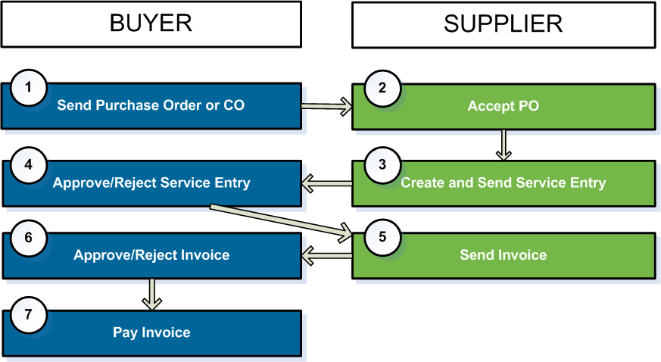
Document Workflow

Slide 6
Overview
3-step process
1. Review, Accept, or Reject PO
2. Create Service Entry Sheet (SES)
3. Submit electronic invoice
(e-invoice)
Step 1: After the Buyer sends an Order to the Supplier’s Order Management Tool, the Supplier responds by sending a POR (Accept or Reject). POR is not mandatory for Limit Orders. This is a buyer dependent setting.
Step 2: The supplier then creates a Service Entry Sheet (SES) from a PO. Suppliers can create more than one SES from a single PO.
Step 3: The supplier then submits an Invoice from the approved SES to the Buyer via the Order Management tool.
SES is created based on the PO or the latest CO. If SES configuration is enabled, all PO/CO are flipped into SES first and go through a predefined work flow before the Invoice creation.
Document Route
PO / CO
SES
SESR
Invoice
Notes:
JS: use SES instead of ES

Slide 7
Login and Overview

Slide 8
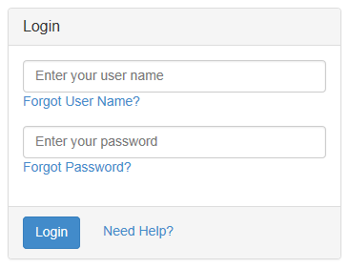
Login Page
You will receive an e-mail from customercare@proactis.com with your Login credentials.
Make sure you are connected to the internet, and click on the link provided in the email, or go to https://portal.hubwoo.com
Then enter your User Name and Password, and click on Login.
Notes:
DT: Changed text from:
“You will receive an e-mail from customercare@hubwoo.com your Login credentials. Make sure you are connected to the internet, click on the link provided in the email or go to https://portal.hubwoo.com
Then enter your User Name and Password, and click on Sign-in.”

Slide 9
Landing Page
To use the Order Management tool you can click on Orders Tab from the Menu Bar.

Slide 10
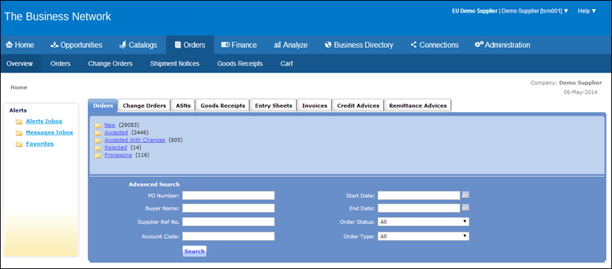
Order Page
After you have Clicked on Orders from either option the following screen will appear.
Search provides the capability to look for a particular PO, by PO number, Supplier Reference number, Start and End Date, Status, or Account Code.
Notes:
DT: Changed content from “Search provides the capability to look for a particular PO, by PO number, Start or End Date, Status or Account Code.”

Slide 11
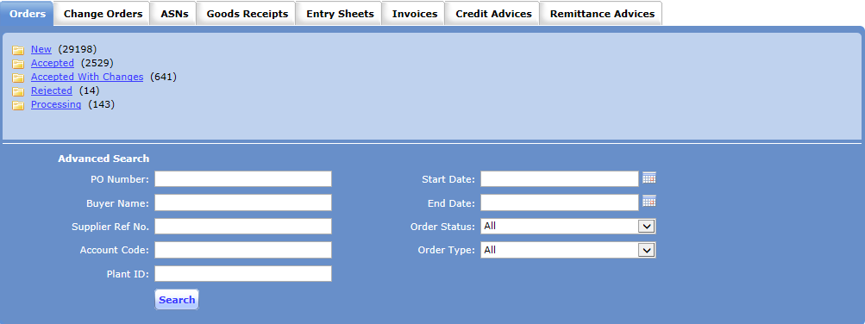
Folders
As New Orders are delivered, they are posted in the New Order folder. Click on New Orders to view these orders.
Notes:
DT: image ratio should be to scaled
RJ: Changed SC

Slide 12
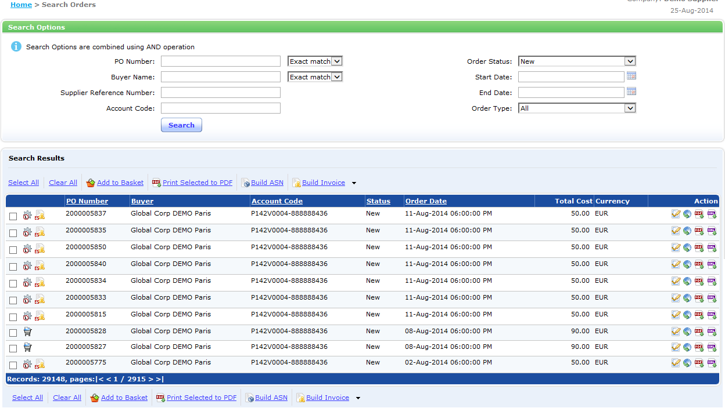
Search Orders
Various search criteria may be entered at the top of the page to locate a specific PO. Page numbers or arrows at the bottom of the page may also be used to scroll or select pages.

Slide 13
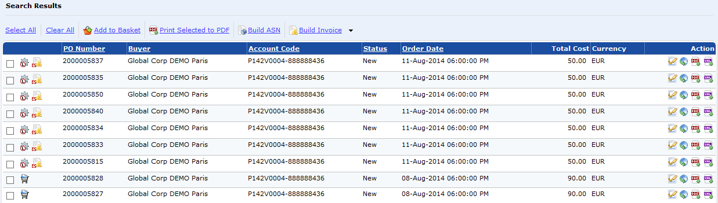
Icons
POs can be identified by the PO number, Buyer, Account Code and Order Date. To the right are the Action icons which are related to the PO and will be reviewed in detail in this presentation.

Slide 14
Review and Accept a PO

Slide 15
Review and Accept a PO
3 Main Steps for the Supplier
1
Accept or Reject the Purchase Order
Create Service Entry Sheet (SES)
Submit e-invoice
2
3

Slide 16
Quick Steps – Review and Accept PO
1
Open the PO
2
Enter Supplier Ref. No.
3
Click Save and Send

Slide 17
Review and Accept PO
Open the PO
  On Orders Tab click on the New Folder.
Notes:
DT: image ratio should be to scale
RJ: Done scaling the image

Slide 18


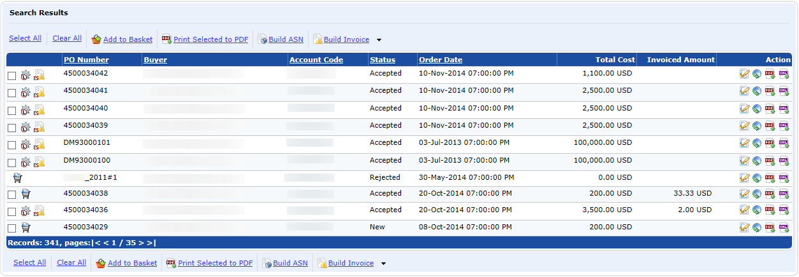
Review and Accept PO
:Icons to identify Services PO. The second icon suggests that a
Service Entry Sheet can be created.
: Icon to identify a Material PO
: Icon to indicate attachments are available in the PO
On ‘Action’ column, Click to ‘Open PO’

Slide 19
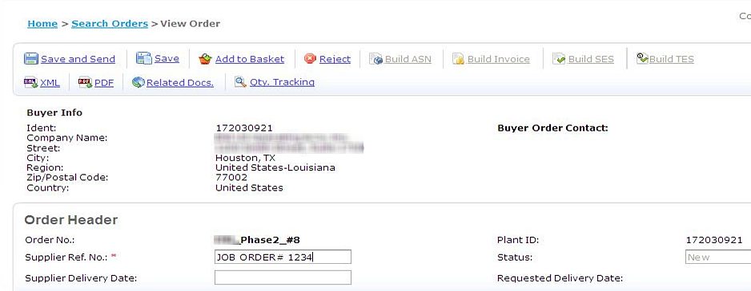
Quick Steps – Review and Accept PO
Enter ‘Supplier Ref. No’
  “Supplier-Determined” internal control number (e.g. job number, quotation number, etc. )

Slide 20
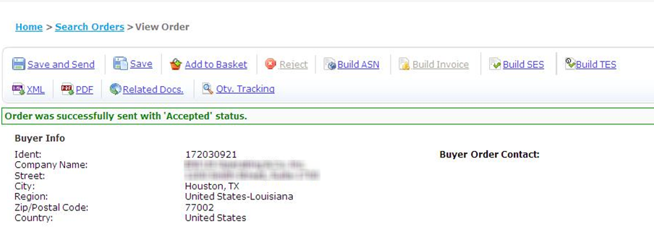
Quick Steps – Review and Accept PO
Click .

Slide 21
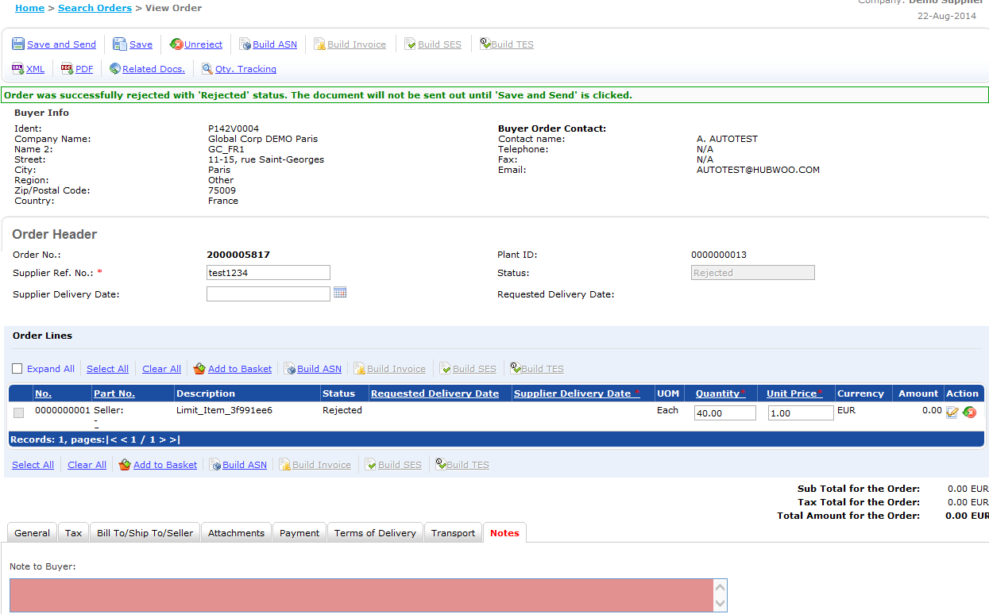
Quick Steps – Review and Reject PO
Click if PO cannot be accepted (e.g. amount not enough, cannot fulfill requested service)
In case of rejection the reason must be entered in the “Note to Buyer” fields (tab “Notes”).

Slide 22
Highlights of this chapter
PO: Purchase Order
  The request for goods or services (Some buyer might call the Service PO: “Call-Off”)
  Created by buyer and sent to supplier through Hubwoo
Supplier Reference Number:
  “Supplier-Determined” internal control number (e.g. job number, quotation number, etc. )
Service should be performed within PO validity period
Requested services should be within the contract provisions
Contact your Buyer Representative for any PO issues (e.g. insufficient funds, validity period incorrect, need additional information about the PO, etc).
Attachments can be sent by Buyer & and are available in the PO (Attachments tab )
Note To Buyer visible in the Notes tab.
Notes:
I like the “Highlights of this chapter” header
What does this mean?: “Notes from Buyer visible in the Header Note (Notes tab).”
RJ: Changed last bullet from “Notes from Buyer visible in the Header Note (Notes tab). To Note To Buyer is visible in the Notes tab.

Slide 23
Creating a Service Entry Sheet

Slide 24
Create Service Entry Sheet
3-step process
1
Accept or Reject the Purchase Order
Create Service Entry Sheet (SES)
Submit e-invoice
2
3

Slide 25

Overview
A Service Entry Sheet or Field Ticket is a detailed description of the services performed based on a Purchase Order. Those documents are used to get an approval from the customer on the performed services, so that those can be invoiced.
SES stands for Service entry sheet
Customers use the SES to break down the cost of sales into several components (i.e. raw materials, labor costs) of the PO Amount
Create an SES for Orders marked with the ( ) icon
SES is created from a single PO. If the PO line contains sub-lines then sub-lines are also flipped into the ES
Supplier Company needs to be setup to be able to use SES. All requests from the Buyer company will be sent to the Onboarding Team.
Notes:
“A Service Entry Sheet or Field Ticket is a detailed description of the services performed based on a Purchase Order. Those documents are used to get an approval from the customer on the performed services, so that those can be invoiced.” Done

Slide 26
Quick Steps – Create Service Entry Sheet
1
Open Approved PO
2
Build SES
3
Select SES line items from catalog
4
Attach invoice and supporting documents
5
Click Save and Send
6
Check SES Status

Slide 27
Create Service Entry Sheets
Open Accepted PO
Go to ‘Orders’ tab,
Click ‘Accepted’ folder
Notes:
DT: image ratio should be to scale
RJ: Done re-scaling image.

Slide 28
Create Service Entry Sheets
Click to ‘Open PO’.
Notes:
JS: no tick required to open PO. Done

Slide 29
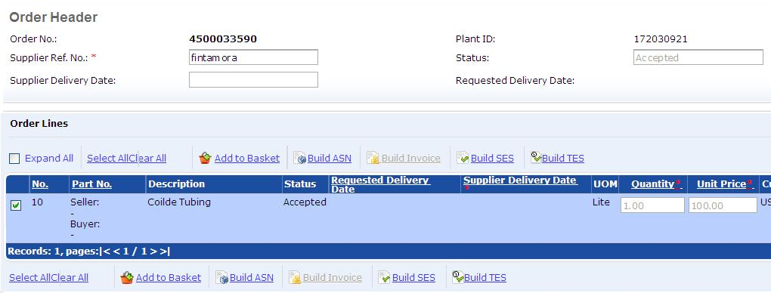
Create Service Entry Sheets
2. Build SES
Tick PO Item checkbox
Click
Service PO can have several Items :
Select only one item to create the SES.
Multi PO item SES will be automatically rejected by Buyer
Notes:
JS: here is the only place a selection /tick of the line item is required

Slide 30
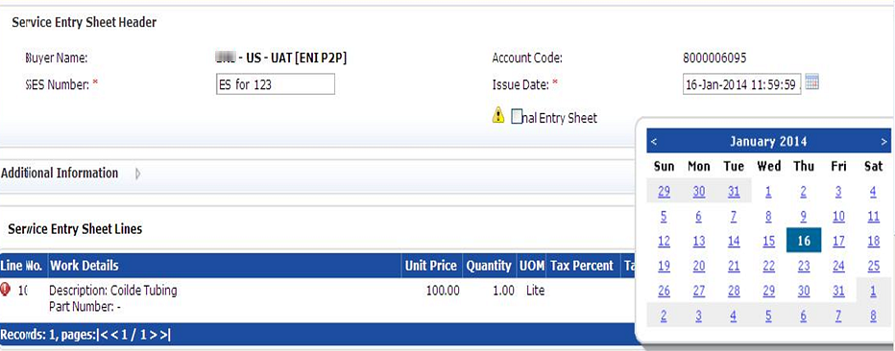
Create Service Entry Sheets
Enter “SES Number” (Internal Field ticket Number)
Enter “Issue Date” (Field Ticket Issue Date) – click on Calendar
If the SES you are entering will be the last one related to the scope of work covered by the particular PO, please mark as “Final Entry Sheet”

Slide 31
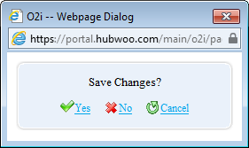
Create Service Entry Sheets
Click ‘View Entry Sheet Line’
Save Changes – click
Notes:
DT: image ratio should be to scale

Slide 32
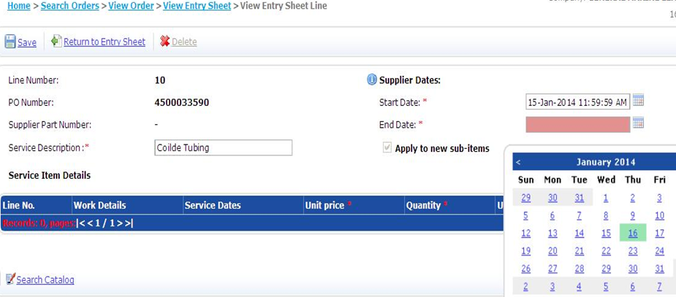
Create Service Entry Sheets
3. Select SES items from catalog
Enter Supplier Start and End Date (click on Calendar) – date range services are provided
Click

Slide 33
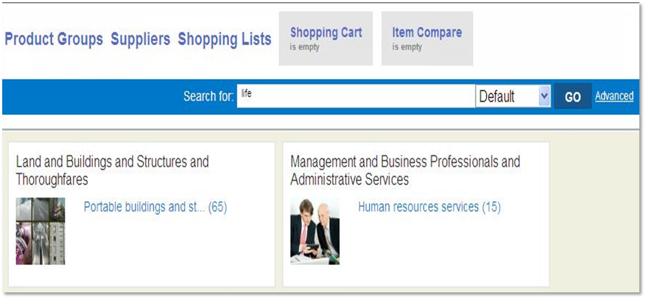
Create Service Entry Sheets
Select item(s) from the ‘Category Selection” or use Search function

Slide 34
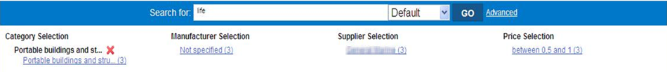
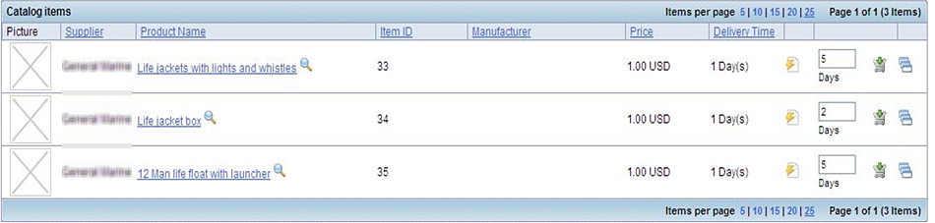
Create Service Entry Sheets
Enter item Quantity and click ‘Add to Cart’
Do not enter fractional quantity at this point, see previous slide.
Use “Misc Services” primarily for tax, transportation and miscellaneous 3rd party charges
Use “Misc Goods” for minor items associated with primary goods/services acquired
If item is missing in the catalog or price is incorrect, please contact your buyer

Slide 35
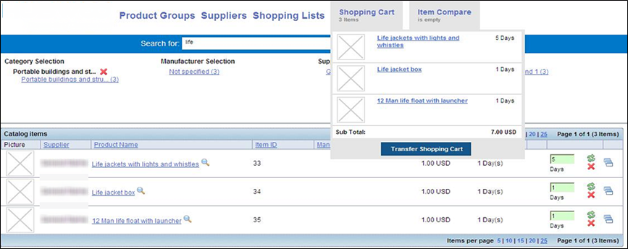
Create Service Entry Sheets
When done entering all invoice items, hover mouse to ‘Shopping Cart’
Validate Sub Total Amount is correct
Click ‘Transfer Shopping Cart’
Note: User can create shopping lists to create favorites for future use, especially if the same service is provided for multiple PO’s within months. For more details see section Shopping Lists

Slide 36
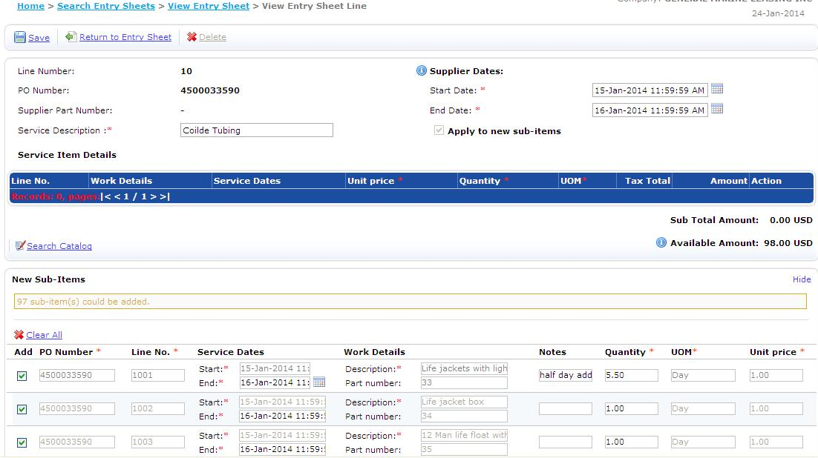
Create Service Entry Sheets
Validate line items, enter item notes, and change quantity if necessary
Limit fractional quantity to 2 decimal places
Click

Slide 37
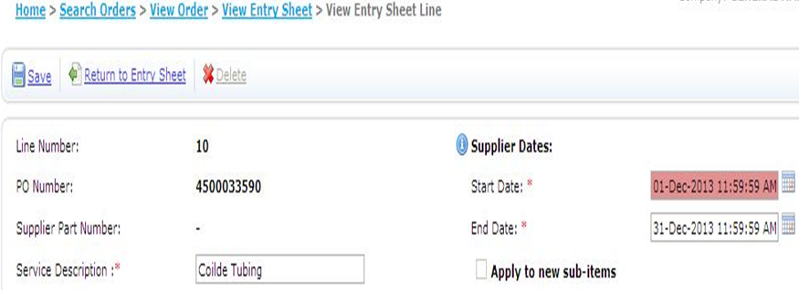
Create Service Entry Sheets
Click .
Notes:
DT: image ratio should be to scale

Slide 38
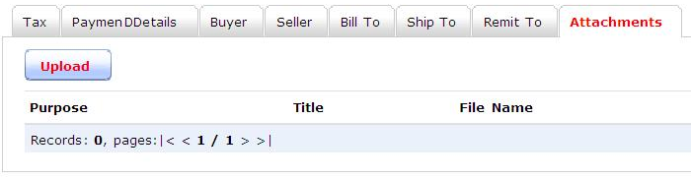
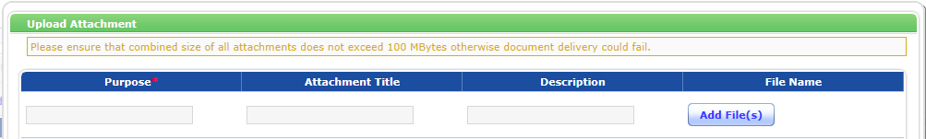
Create Service Entry Sheets
4. Attach Invoice and supporting documents
Click “Attachments” tab. Limit of attachment size is 25MB
Click “Upload”
Click “Add File(s)”
Notes:
JS: Limit of attachment size of 25MB should be named. Done

Slide 39
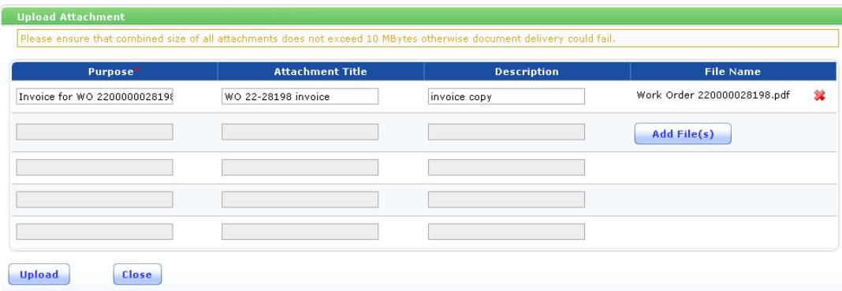
Create Service Entry Sheets
Enter text in “Purpose” field
Click

Slide 40

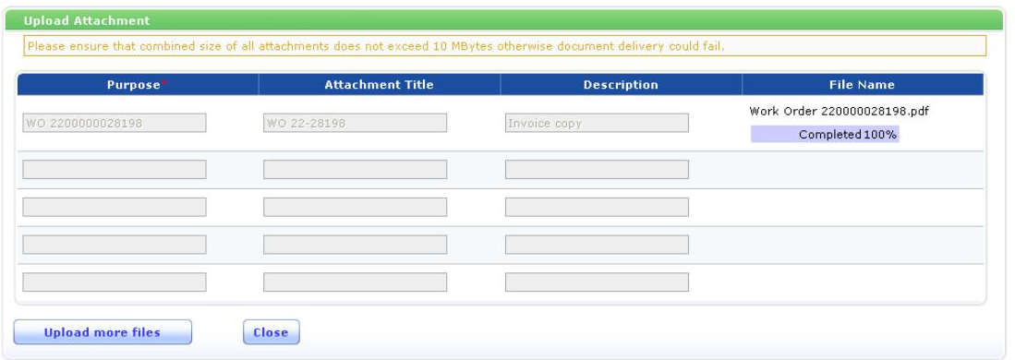
Create Service Entry Sheets
Click .

Slide 41
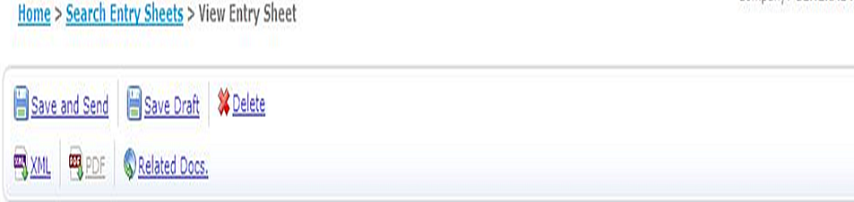
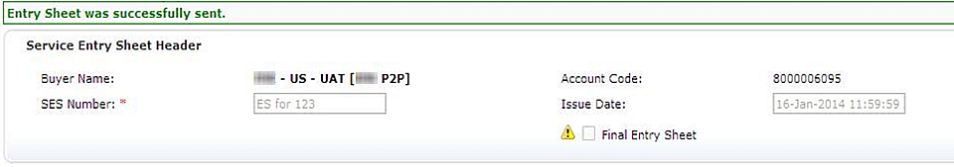
Create Service Entry Sheets
5. Click .
Notes:
DT: image ratio should be to scale

Slide 42
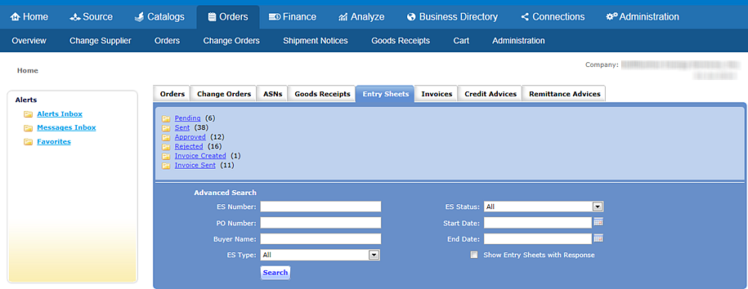
Create Service Entry Sheets
6. Check SES status
    Click ‘Entry Sheets’ tab
    SES are grouped per status

Slide 43
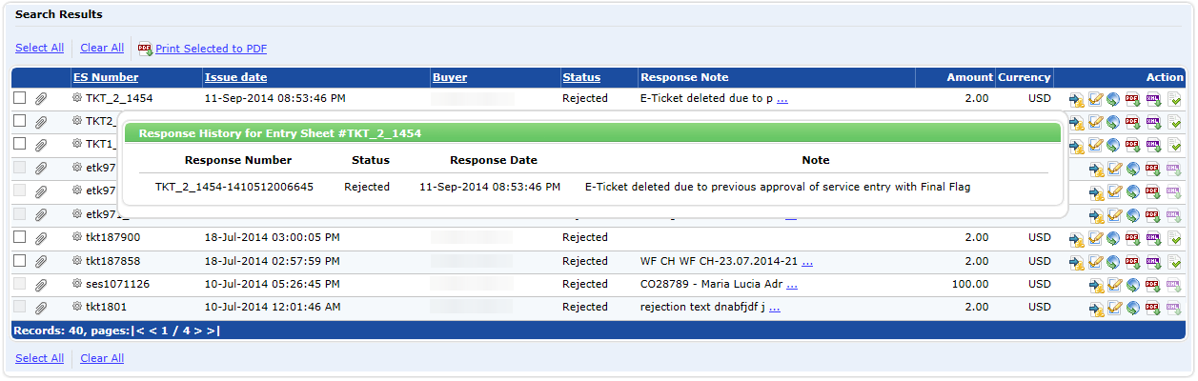
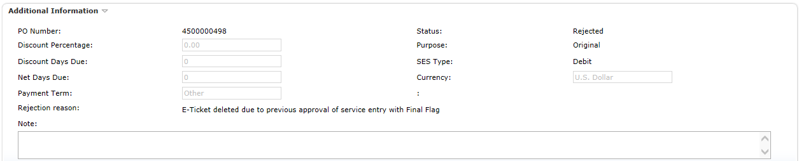
Check Service Entry Sheets Statuses
In case of rejection, the reason is displayed on the Response Note column and when clicking on “ES response history”
It’s also available in the SES details

Slide 44
Highlights of this chapter
SES – Service Entry Sheet
  Detail of services provided
  Supporting documentation scanned into system & attached to SES in Hubwoo
  Created and submitted by supplier in Hubwoo for routing to Buyer contract manager who will review, confirm & approve services provided
SES Number
  Same as your internal field ticket number
SES Issue Date
  Same as your internal field ticket date
SES Supplier Start and End Date
  Range of date services are provided

Slide 45
Points to remember on SES
Submit SES after services/goods are delivered
SES Number = internal field ticket number
Issue Date = internal field ticket issue date
If the SES you are entering will be the last one related to the scope of work covered by the particular PO, please mark as “Final Entry Sheet” (checkbox in SES screen, see slide).
Catalog Price list is based on the price list contained in the contract
  If item is not in the catalog or price is not correct, contact Buyer Support (reference Slide 50 for contact details)
For some buyers tax needs to be entered under ‘Misc Services’ or ‘Tax’ item in the catalog price list and not using ‘TAX’ tab. (Contact Buyer Support)
Notes:
JS: This should be located in the SES area. Done

Slide 46
Points to remember on SES
Your internally created “paper” invoice must match the Hubwoo SES total amount.
  There is no tolerance amount in the system.
  When rounding issue occurs, enter the balance amount as ‘Misc Services’ or ‘Misc Goods’
  To avoid rounding issue, the preferred method is to round the quantity to 2 decimal places.
  If your internally created “paper” invoice does not match the approved SES amount, the SES and Invoice will be rejected.
If SES is rejected, rejection reason is available in the SES details (Additional Information)
Submit only SES linked to only one PO item, or else it will be automatically rejected.
Notes:
JS: same

Slide 47
Points to remember on SES
You may enter multiple SES’s per PO with the following conditions:
  “1” SES = “1” Invoice - Each SES entered against a PO must be converted to an Invoice and the supplier internally generated invoice must be attached and match the SES for each one.
  Sufficient funds remain on the PO to cover the additional SES. The supplier has the ability to see the remaining funds for a PO in Hubwoo. Therefore, if you want to process an SES for $100 but only $75 remains on the PO, the SES should not be submitted as it will not be processed. In this case, please contact your Buyer representative so that an additional PO can be issued.
Supplier comment/Note can be entered “Additional Information”, “Note” section.

Slide 48
Points to Remember on SES
Points to Remember on SES
Depending on buyer requirement, the supplier might have to accept PO issued by buyer before creating the SES
The SES is approved or rejected by the buyer
  If approved, the supplier can then create an invoice from the SES
  If rejected, the supplier must create another (corrected) SES
    Rejection reason is available to the supplier
DO NOT submit hard copy invoices for work authorized via a PO created & accepted in Hubwoo; the invoice created will be electronic based on the approved SES. Supplier internally created “paper” invoice will be uploaded into Hubwoo upon converting the SES to an electronic invoice.

Slide 49
Invoicing

Slide 50
Submit Invoice
3-step process
1
Accept or Reject the Purchase Order
Create Service Entry Sheet (SES)
Submit e-invoice
2
3

Slide 51
Quick Steps – Submit Invoice
1
Open Approved SES
2
Enter Invoice Number
3
Attach invoice copy
4
Click Save and Send
5
Check Invoice Status

Slide 52
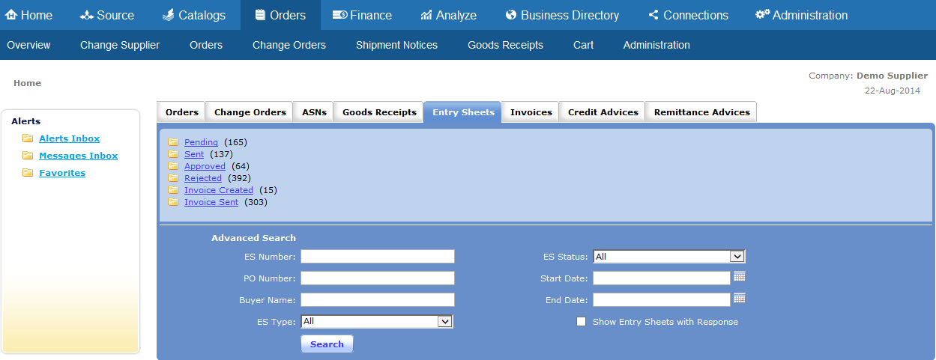
Submit Invoice
1. Open Approved SES
Click ‘Entry Sheets’ tab
Click ‘Approved’ folder

Slide 53
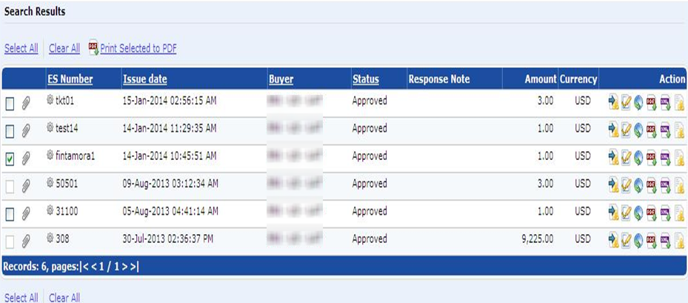
Submit Invoice
Click ‘Create Invoice from ES’

Slide 54
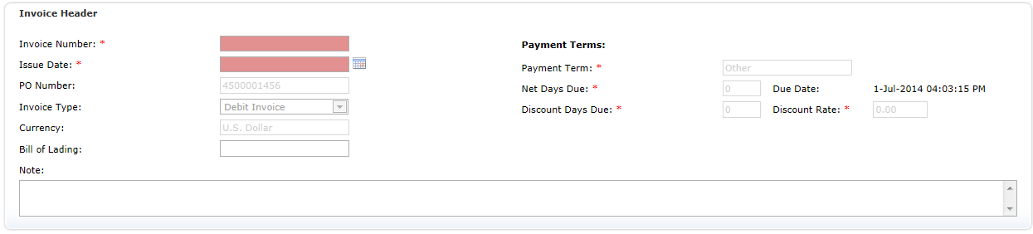
Submit Invoice
2. Enter Invoice number and Issue Date
Issue Date must be entered
“Note” field can be use to submit comment back to your Buyer.
Notes:
JS: this should be a generic training and therefore ENI should not be named. Done. Changed to Buyer.

Slide 55
Quick Steps – Submit Invoice
3. Attach Invoice copy
Click ‘Attachments’ tab
Click ‘Upload’
Click ‘Add Files’

Slide 56
Quick Steps – Submit Invoice
  Enter ‘Purpose’ text description
  Click

Slide 57
Quick Steps – Submit Invoice
Click .

Slide 58

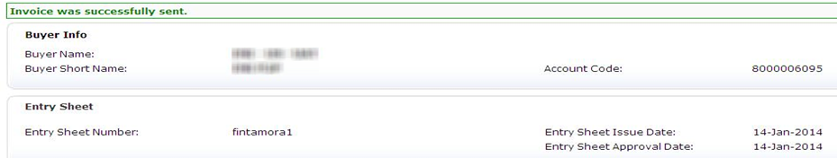
Quick Steps – Submit Invoice
Click .
Notes:
DT: the top image ratio should be to scale

Slide 59
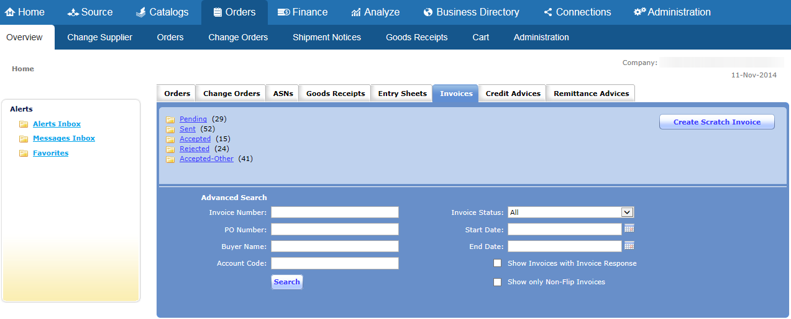
Quick Steps – Submit Invoice
4. Check Invoice status
Click ‘Invoices’ tab
Invoices are grouped per status

Slide 60
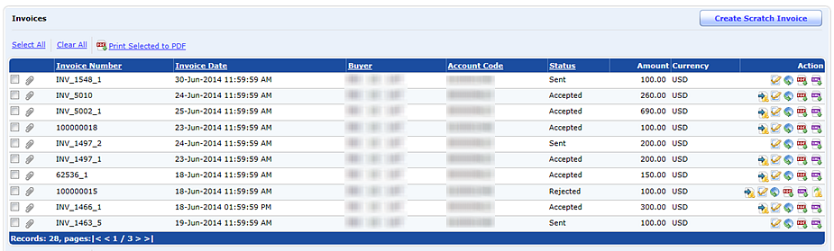
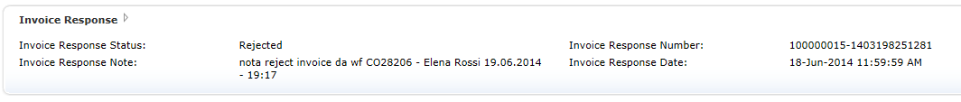
Quick Steps – Submit Invoice
Status is updated according to Buyer approval steps and rejection reason can be displayed clicking on “Show Invoice response history”
It’s also available in the Invoice details

Slide 61
Points to Remember on Order Management
Points to Remember on Order Management
Hubwoo works with Internet Explorer browser ONLY
Notifications in Hubwoo - By default, all notification flags are “enabled” for every vendor. If you should want to “disable” any of these notifications, please contact the Hubwoo Customer Care for assistance (reference slide for contact details)

Slide 62
Points to remember on Invoice
Invoice Number is your internal field ticket number and must be unique
Hubwoo invoice number and amount should match with the attached copy of the paper invoice.
Invoice Issue date must be entered when creating the invoice.
Pdf file name should not contain character ‘#’.
Invoice is electronically received & approved by buyer Accounts Payable
Invoice status will change to “Accepted” when approved
Contact Buyer Accounts Payable if Invoice is “rejected”

Slide 63
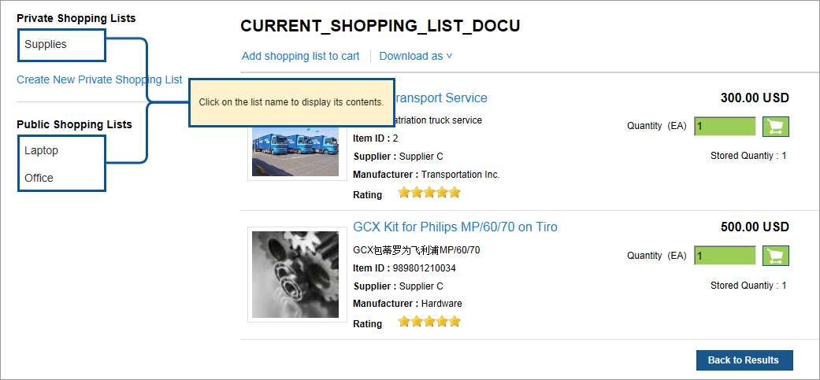
Shopping Lists
Shopping lists enable you to save shopping carts for future purchases. Using shopping lists will help you to easily re-order items which had been previously ordered.
Click Shopping List from the main menu to display your shopping lists.
The Shopping Lists screen is displayed.

Slide 64

Shopping Lists
On the previous screen you should have seen a list of Private Shopping Lists (shopping lists created by you), and a list of Public
Shopping Lists (standard shopping lists available for every user).
The following actions are available when working with Shopping Lists:
Button | Action
 | Click on this link to add the list to the shopping cart.
 | Select from the drop-down list to download the shopping list to an excel file or to a text file.
 | Click on this link to create a new Private Shopping List. This feature allows you to upload shopping lists using a template.
 | Click to go back to the search results.

Slide 65
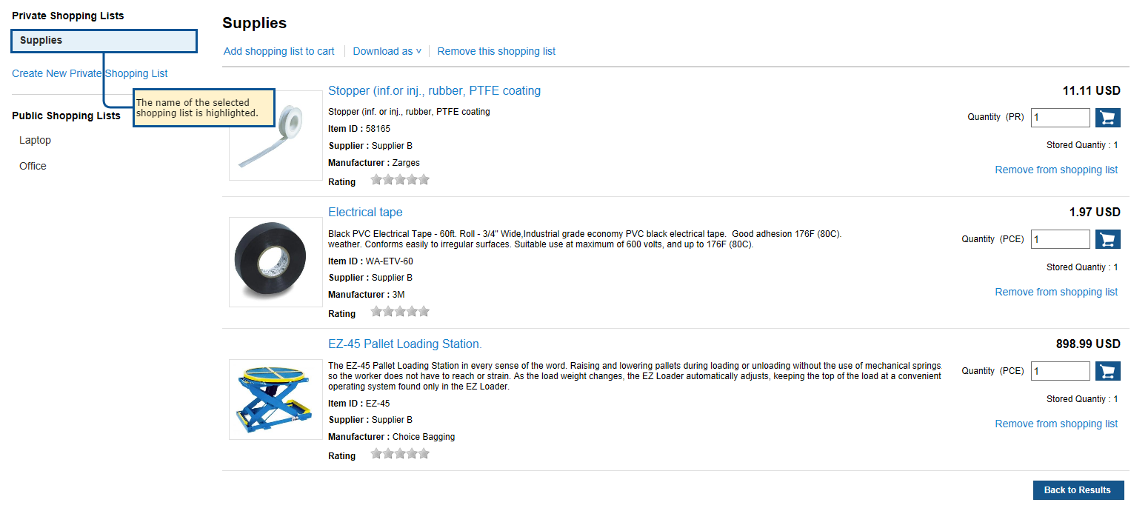
Shopping Lists
Selected shopping lists display at the bottom of the screen. The name of the selected shopping list is highlighted in the list.

Slide 66

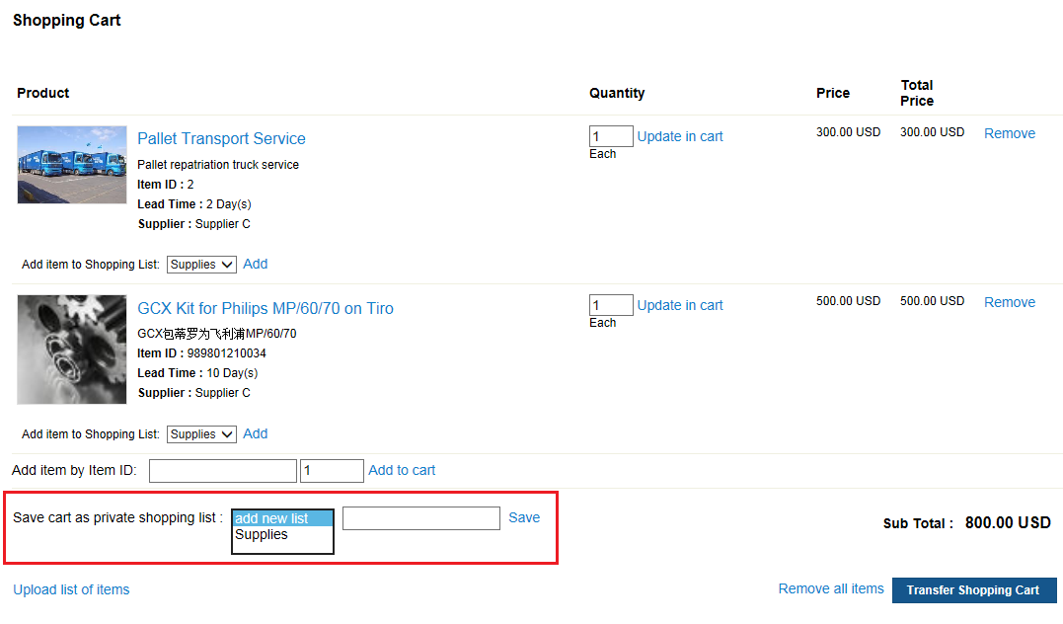
Creating Shopping Lists
To create a new shopping list:
    Search for one or more products to put in the list, and transfer them to the shopping cart.
    Go to the Shopping Cart.
    Select “add new list” from the drop-down list
    Type a name in the section “Save cart as private shopping list:”
    Click on

Slide 67

Creating Shopping Lists
Private shopping lists are only visible to the user who created it.
If the Shopping List contains items from punch-outs, these will not be saved to the shopping list and the following warning message will be displayed:

Slide 68
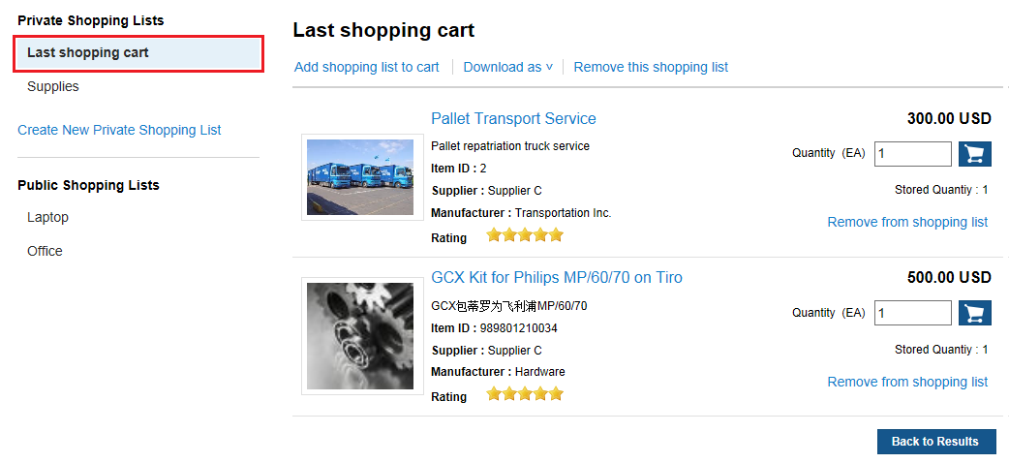
Automatic Shopping List-Last Shopping Cart
Automatic shopping list is created based on the last shopping cart that has been created and transferred.
To access this feature click Shopping Lists from the main menu.
The Shopping Lists screen opens displaying the Last shopping cart list. You can view/change the shopping list content.

Slide 69
Automatic Shopping List-Last Shopping Cart
The following actions are available:
Automatic shopping list is also created if there are items in the shopping cart at the moment you click on “Cancel” from the main menu.
Button | Action
 | Click on this link to add the list to the shopping cart.
 | Select from the drop-down list to download the shopping list to an excel file or to a text file.
 | Click on this link to remove the shopping list.
 | Click on this link to create a new Private Shopping List. This feature allows you to upload shopping lists using a template.
 | Click to go back to the search results.

Slide 70
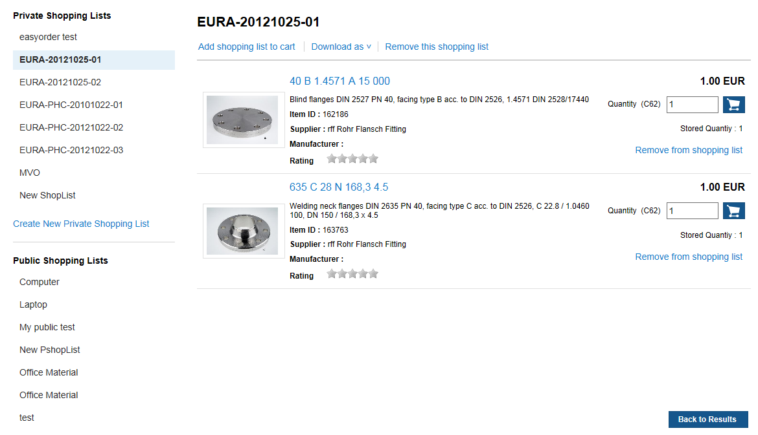
Automatic Updates of Shopping Lists
The shopping lists are automatically updated after release of a new content catalog.

Slide 71
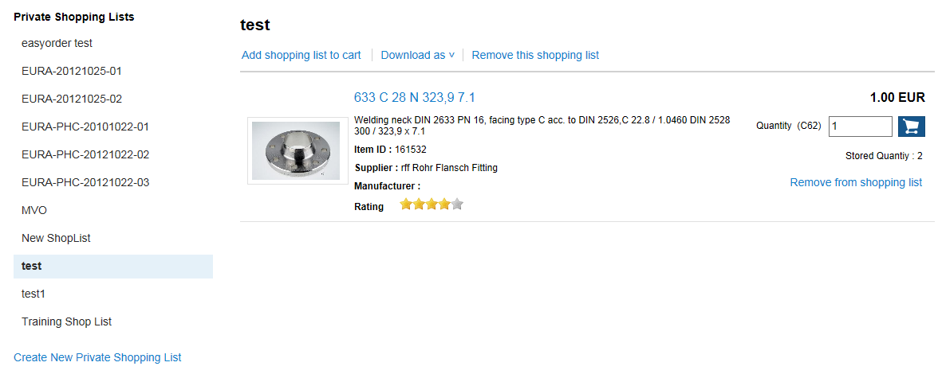
Automatic Updates of Shopping Lists
Once the new catalog is released, the information on the shopping lists is automatically updated.

Slide 72
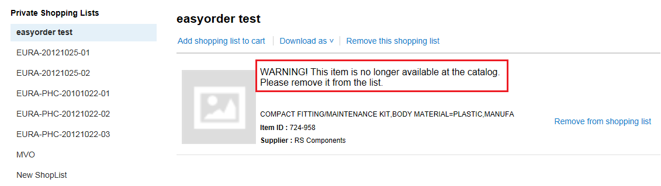
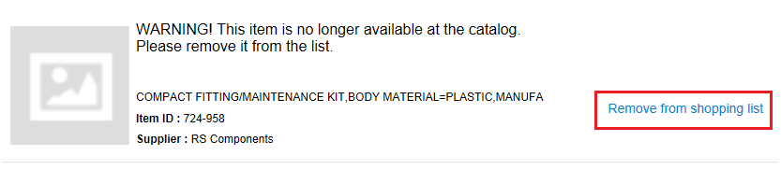
Automatic Updates of Shopping Lists
A warning message is also displayed for those items that are no longer available in the catalog.
Click on to remove from the shopping list the item that is no longer available.

Slide 73
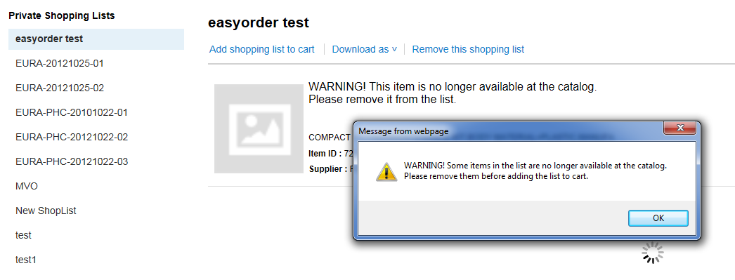
Automatic Updates of Shopping Lists
The “no longer available” items must be removed from the shopping list in order to add it to the shopping cart; otherwise a warning message will be displayed when attempting to do so.

Slide 74
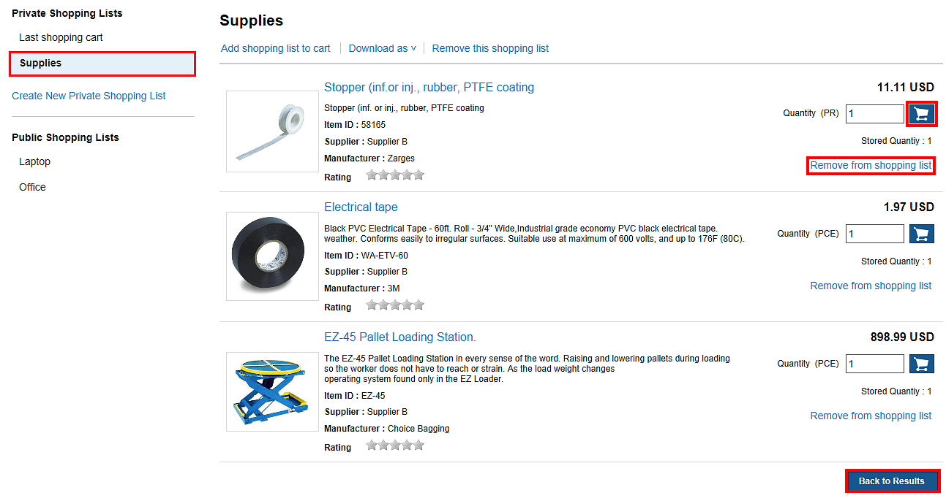
Maintaining Shopping Lists
To manage your shopping lists, click on Shopping Lists from the main menu.
By clicking the name of the shopping list its contents is displayed.
  To change the quantity of the items, type the number in the Cart Quantity field and click on .
  To remove items from the shopping list, click on at the line item.
  Click to close the shopping list screen and go to the landing page.

Slide 75
  Hubwoo Global Customer Services
+1 866 446 8203 (US Toll Free)
customercare@proactis.com

