Slide 1
Order Management
Supplier Standard Training

Slide 2
Agenda
Welcome to the Order Management Supplier Standard Training
During this presentation you will learn:
  Order Management Overview
  Login to Portal and Overview
  How to retrieve and review Purchase Orders
  How to respond to the PO (POR) - Accept
  How to reject a Purchase Order
  Change Orders
  Advanced Shipment Notices
  Invoicing

Slide 3

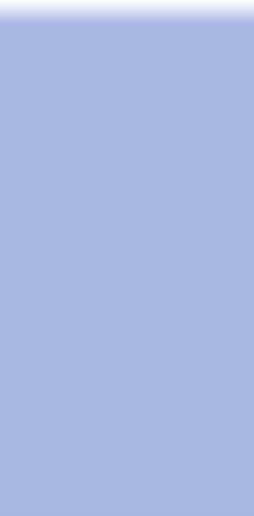
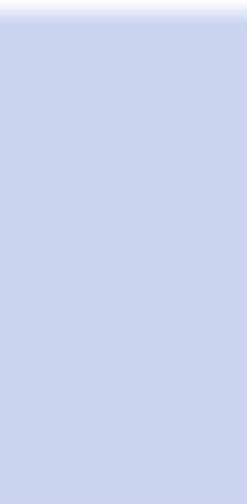

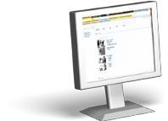





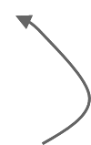



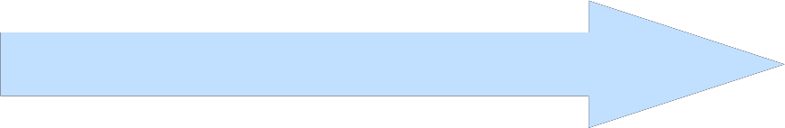




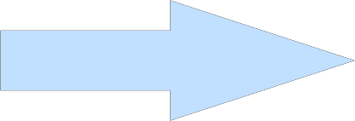





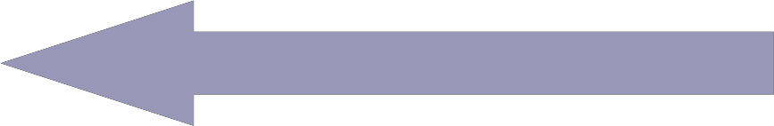


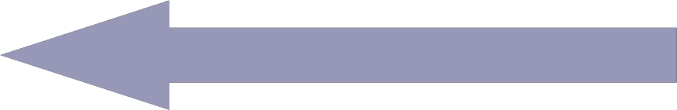

Order Management Overview
Hubwoo
Purchase Order
BUYER
Search Catalog
Transfer to Shopping Cart
Approval
PO Creation
SUPPLIERS
Purchase Order Response
Change Order
Rejected Canceled
SRM
Advance Shipment Notice
ERP
Invoice

Slide 4
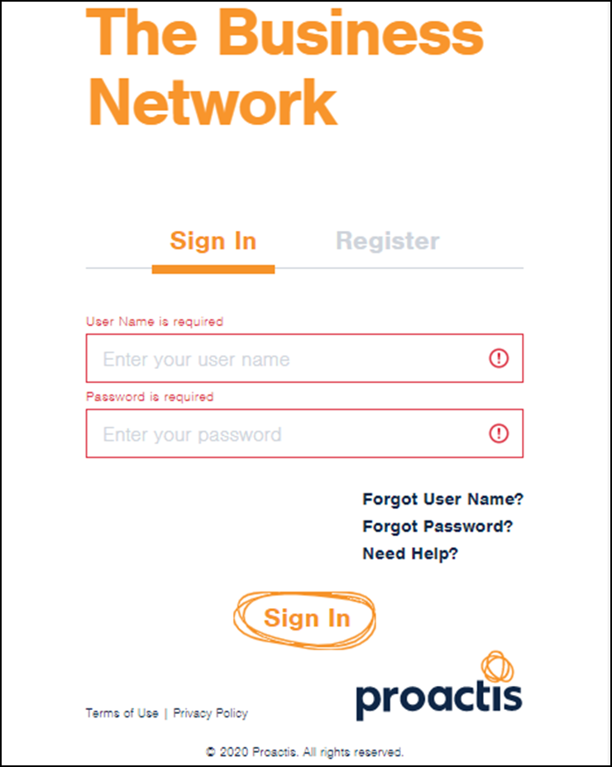
Login Page
You will receive an e-mail from customercare@proactis.com with your login credentials. Make sure you are connected to the internet, and click on the link provided in the email, or go to https://portal.hubwoo.com
Then enter your User Name and Password, and click on Login.

Slide 5
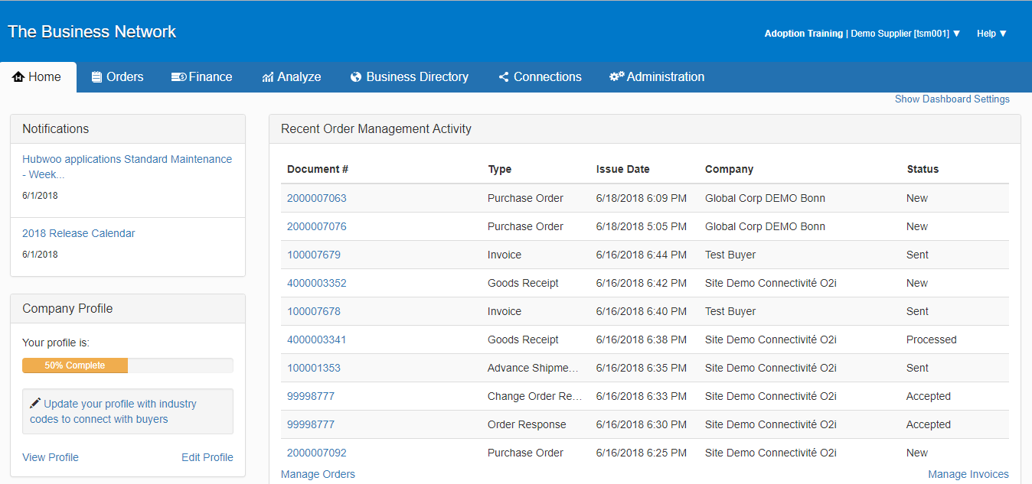
Orders Tab
To use the Order Management tool you can click on the Orders tab from the blue menu bar.
5

Slide 6
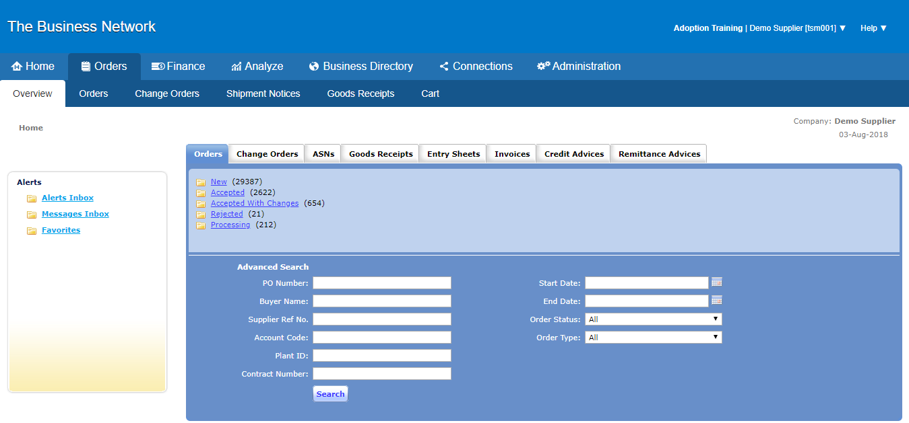
Order Page
After you have clicked on Orders from either option the following screen will appear.
Search: provides the capability to search for a particular PO, by PO number, Supplier Reference Number Start or End Date, Status, or Account Code

Slide 7

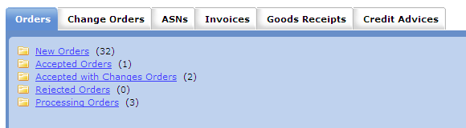
Folders
As New Orders are delivered, they are posted in the New Orders folder.
Click on New Orders to view those orders.

Slide 8

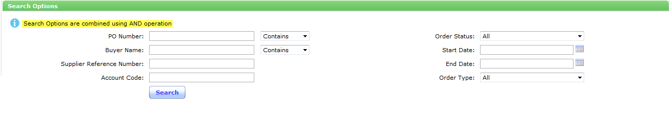

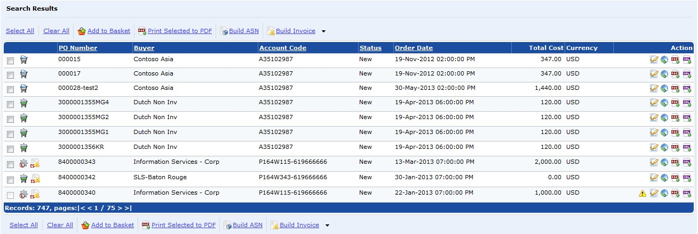
Search Orders
Search Orders
Various search criteria may be entered at the top of the page to locate a specific PO. Page numbers or arrows at the bottom of the page may also be used to scroll or select pages.

Slide 9

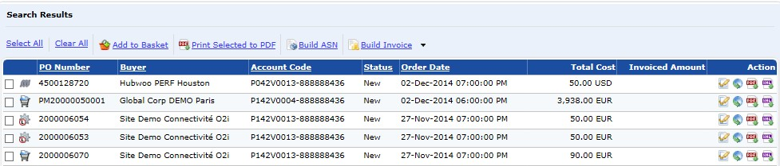


Icons
POs can be identified by the PO number, Buyer, Account Code and Order Date. To the right are the Action icons which are related to the PO and will be reviewed in detail in this presentation.

Slide 10
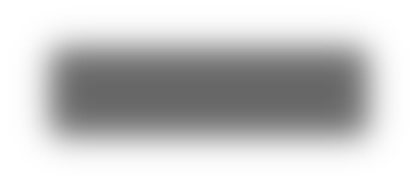
Reviewing and Accepting Order
Let’s review an order. You can choose to print the order first by clicking on the Download PDF icon located under the Action column. This allows you to view the details of this order in a PDF format.
Click on the “Download PDF” icon
10

Slide 11
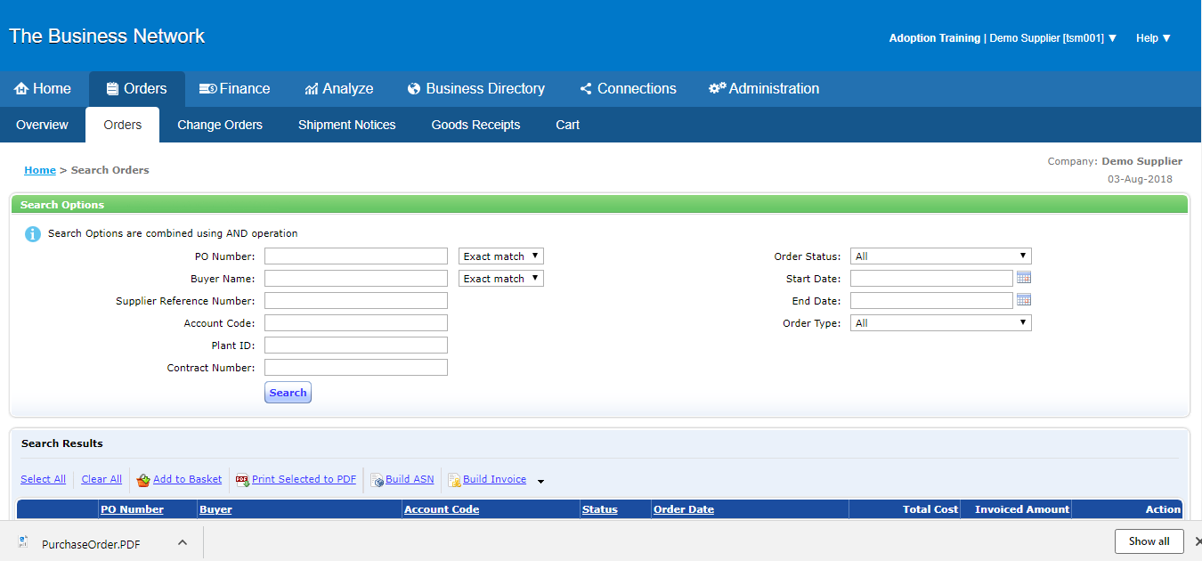
File Download Box
A File Download Box will appear. It gives you the option to Open or Save the document.

Slide 12

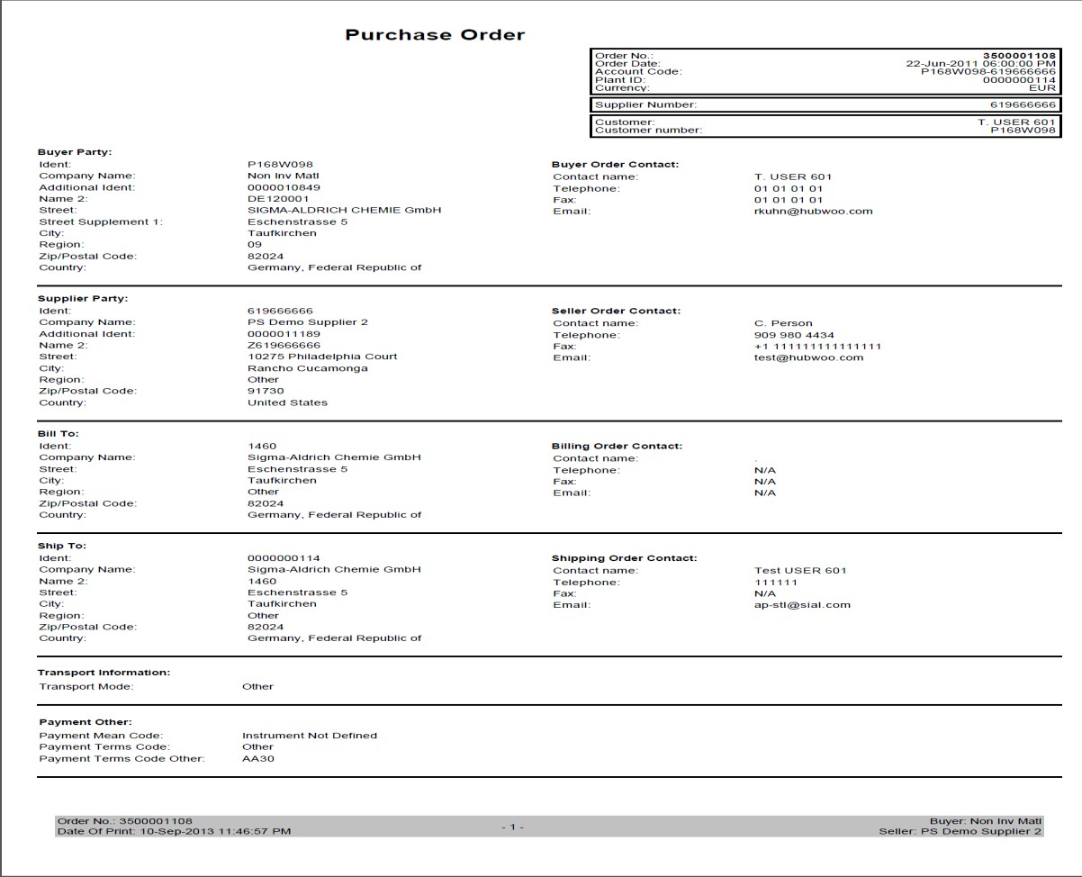
PO in PDF Format
PO in PDF Format
If you choose to open the file, Adobe Acrobat will pop up, and you can see the details of the purchase order. From Adobe you can choose to print the order.

Slide 13

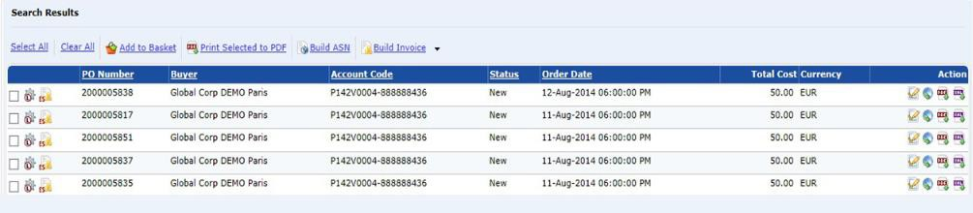
View Purchase Order
You can also view and process the purchase order by clicking on the Open PO icon located under the Action column. Click on this icon.
Open PO

Slide 14

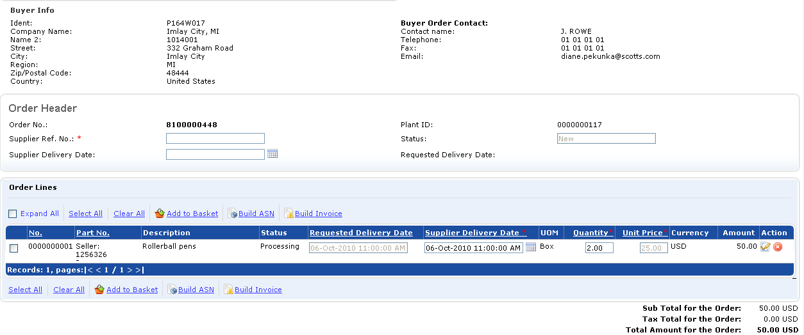
Order Details
This will bring you to the Order Details page. At the top of the page we have the buyer details and contact information; and below you will find the line items.

Slide 15

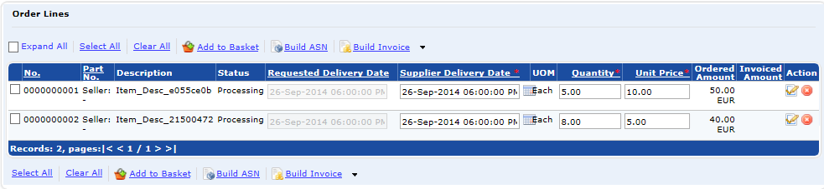
Order Lines
Each individual line item may be reviewed. Some Buyers will allow changes to the Delivery Date, Quantity, or Unit Price while others have restricted this functionality. The changes can be made by clicking in the appropriate box and modifying the data or by clicking on the calendar.
Use the calendar to modify the delivery date.
You can click in the Quantity and Price box to modify the amount.

Slide 16

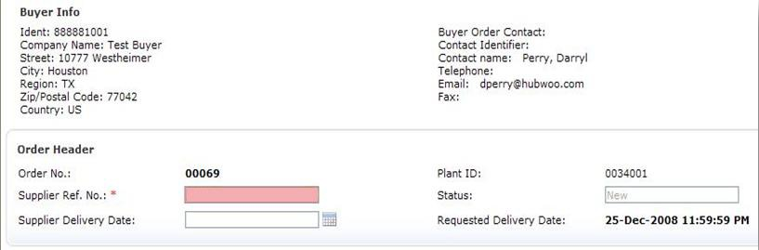
Supplier Reference Number
Once the order is reviewed and modified if necessary, you can send it back to the Buyer. Start by adding the Supplier Reference Number. This is a mandatory field.
Enter Supplier Reference Number to no more than 16 characters.

Slide 17

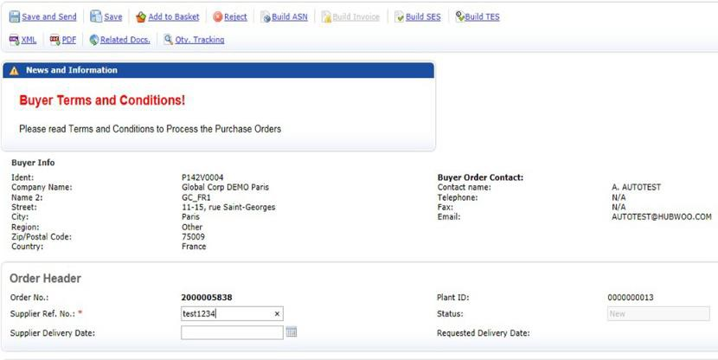
Save and Send
Next, click the Save and Send button to send the response back to the buyer. The status of the order will change depending on the modifications to the order.
Click Save and Send

Slide 18

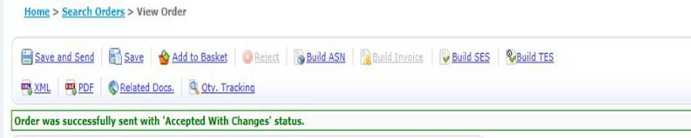
Save and Send
If you did not make any changes, you will then get the confirmation that the order was sent successfully as Accepted.
18

Slide 19

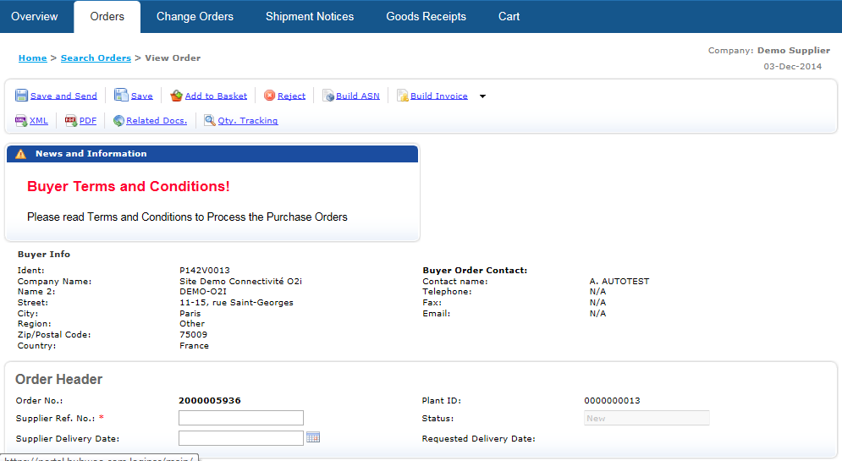
Rejecting an Order
Rejecting an order can happen for many reasons. The buyer may no longer need the part or maybe you don’t carry that particular part anymore. Start by opening the order.
To reject the entire PO click the Reject button

Slide 20

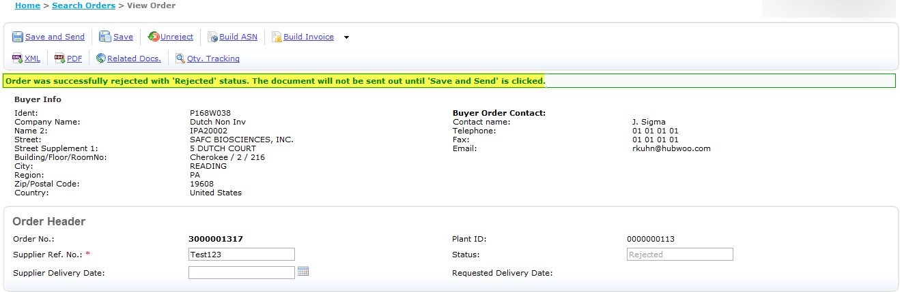
Rejecting an Order
If you reject the entire Order you will receive the confirmation Order was successfully rejected with “Rejected” status. The document will not be sent out until “Save and Send is clicked. After you have clicked “save and send” you will receive the message “Order was successfully sent with Rejected status”

Slide 21

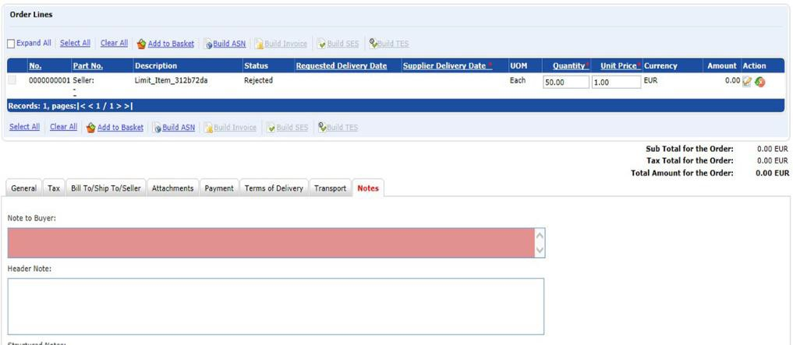
Rejecting an Order
Don’t forget to add notes explaining why you are rejecting the order.
Add note on why you rejected order here.

Slide 22

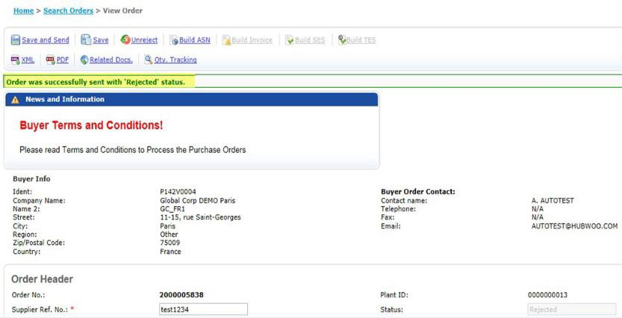
Rejecting an Order
Click the Save and Send button and you will get confirmation the order was sent with the Rejected status.

Slide 23
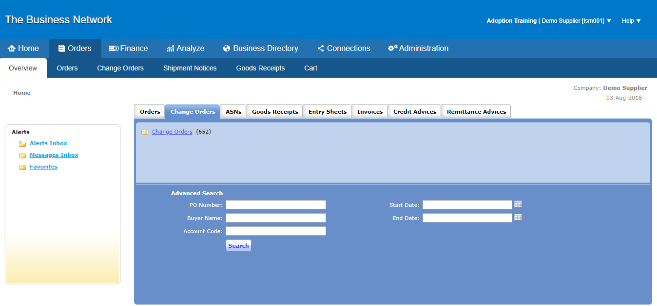
Change Order
To search for Change Orders: Click Orders > Change Orders on the main menu

Slide 24

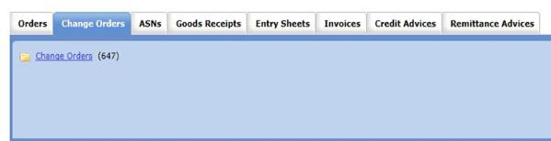
Change Order
To search for Change Orders:
Click Change Orders (CO) Tab under the Order Management section in the homepage or the Change Orders tab in the Order Management Overview page.

Slide 25

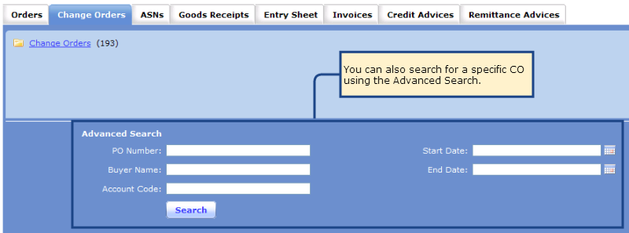
Change Order
To search for Change Orders:
Use Advanced Search in the Change Order Tab in the Main Menu

Slide 26
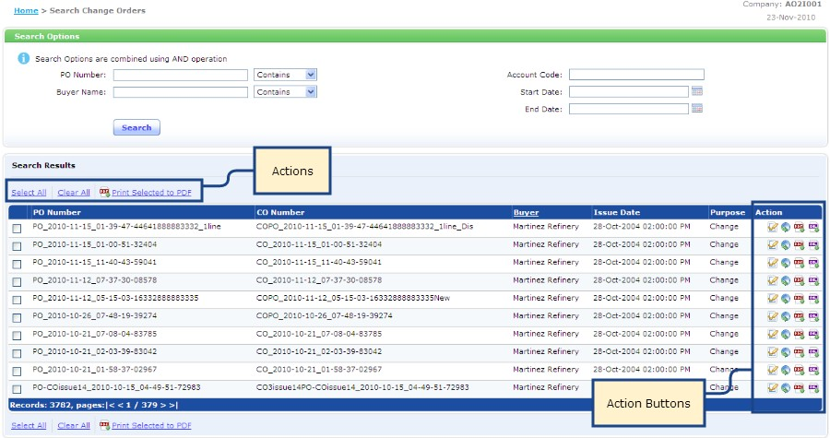
CO Search Result List
After triggering a query, the search results will be displayed below the Search Options
26
Export to .PDF file
Display related documents
Export to .xml file
Open PO

Slide 27
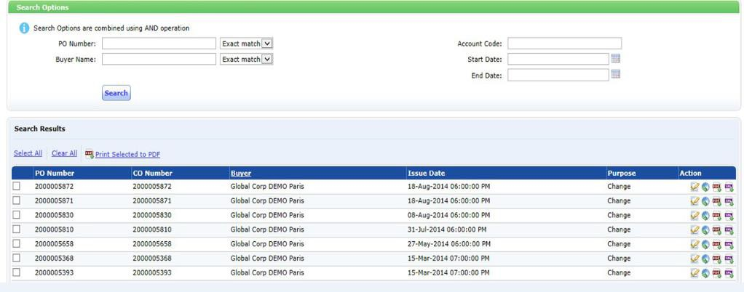
Change Order Details
Click to view the Change Order details

Slide 28

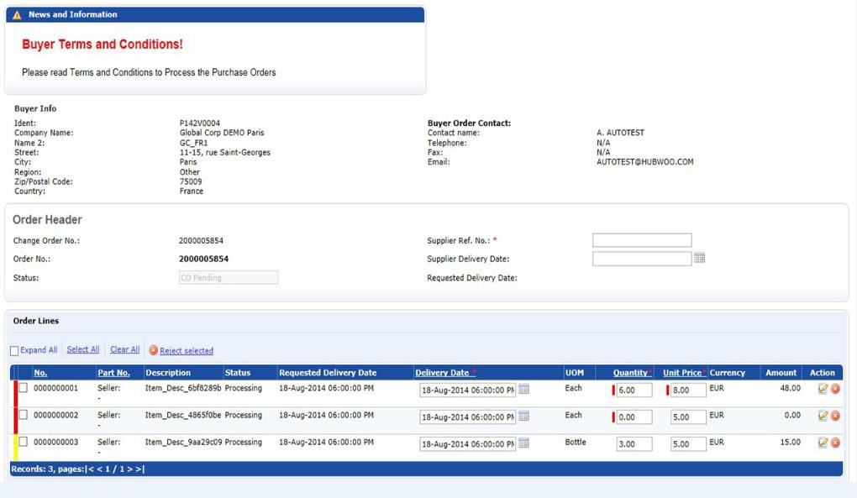
Change Order Details Page
If necessary, edit delivery date
Click to view detailed description of order line
Click to reject order line

Slide 29

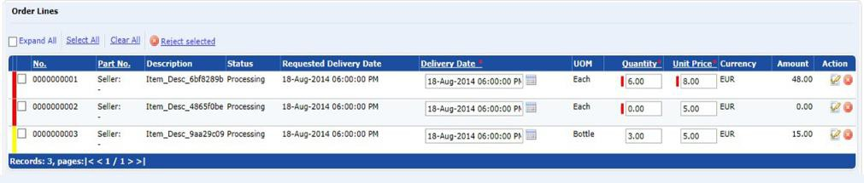
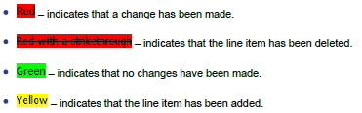
Modifying a CO
Select an order line and modify the following values:
Delivery Date, Quantity and Unit Price
Change Order line details are color coded to show changes compared to the original PO
2

Slide 30
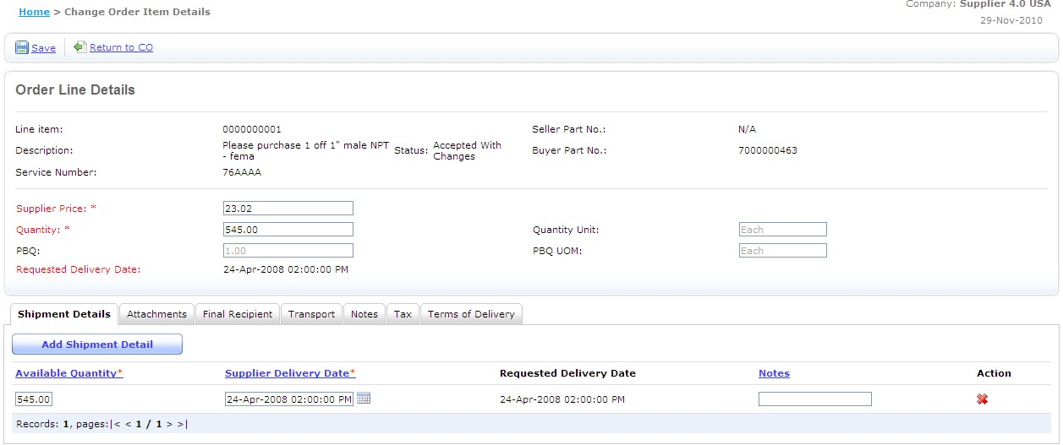
Modifying an Order Line
Enter price and quantity correspondingly

Slide 31


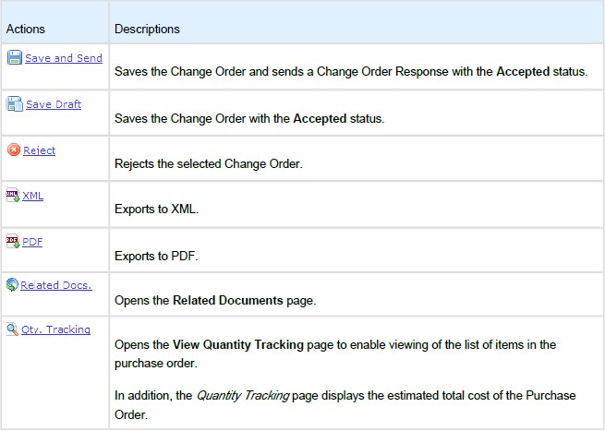
Change Order

Slide 32

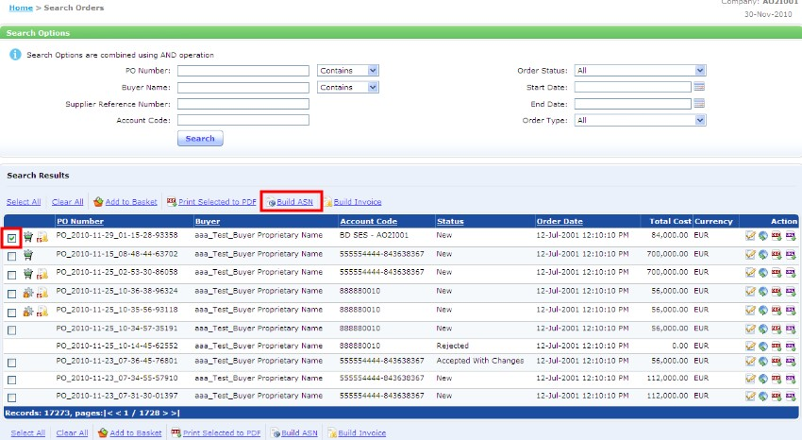
Advanced Shipment Notice
You can create an ASN using the following methods:
Create an ASN directly from Orders
Crate an ASN by line item
2. Click on Build ASN.
1. the checkbox of the PO for which you want to build an ASN
©

Slide 33

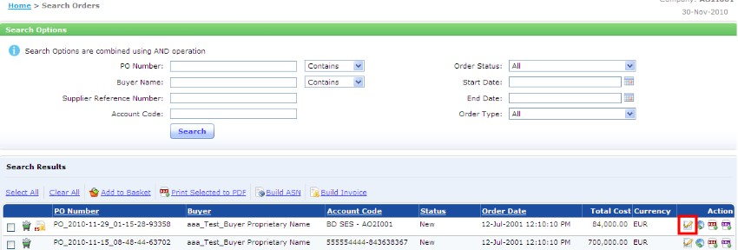
Advanced Shipment Notice
Create an ASN by line item
1. Open the PO for which you want to build an ASN for

Slide 34

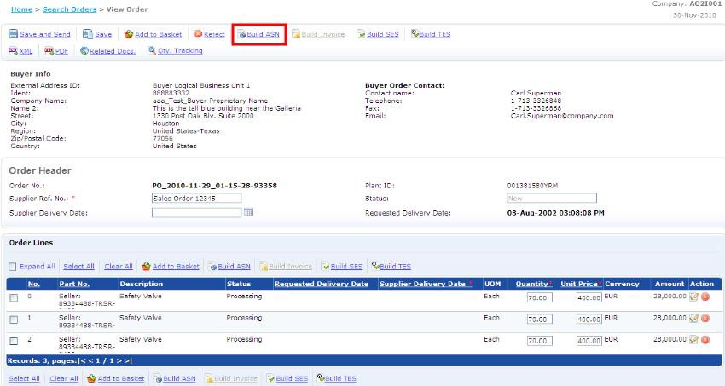
Advanced Shipment Notice
3. Click on Build ASN
2. Tick on the order lines for which you want to build an ASN

Slide 35
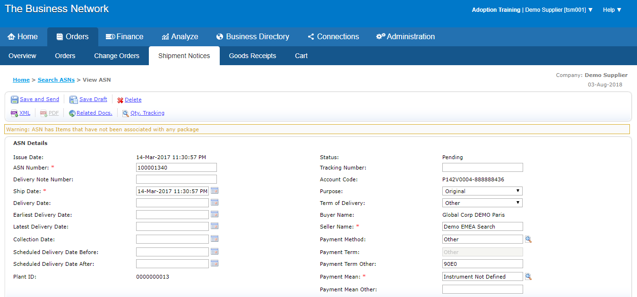




View ASN
Complete this section by entering the required information on the mandatory fields.
1. Fill out the
mandatory fields

Slide 36

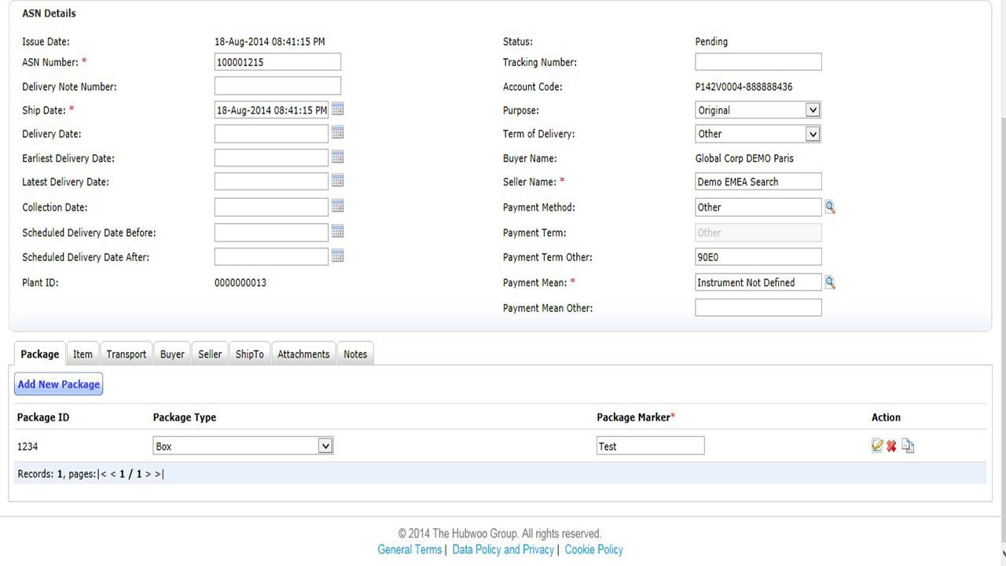
View ASN
Add a new package if the ASN is not associated with any packages yet.
Click on “Add New Package” to create a package.

Slide 37

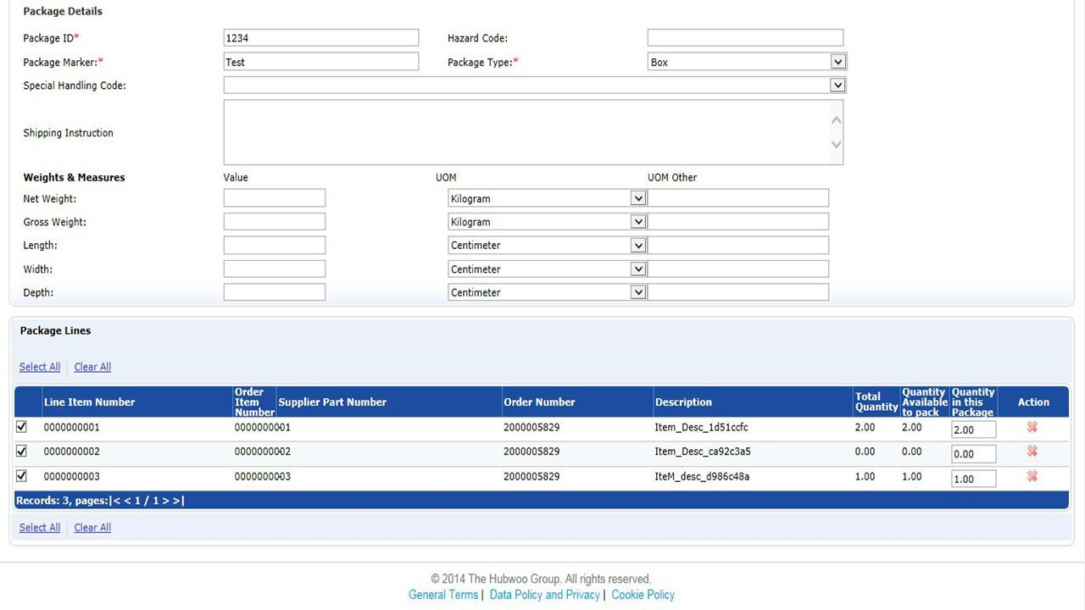
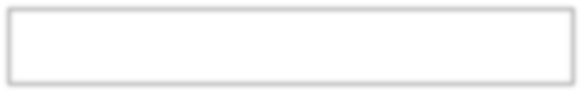

Package Details
Fill in Package Details, Marker & Type.

Slide 38



Package Details
In the Package Lines section, select the line item(s) and enter the amount of items you want to add to the package.

Slide 39
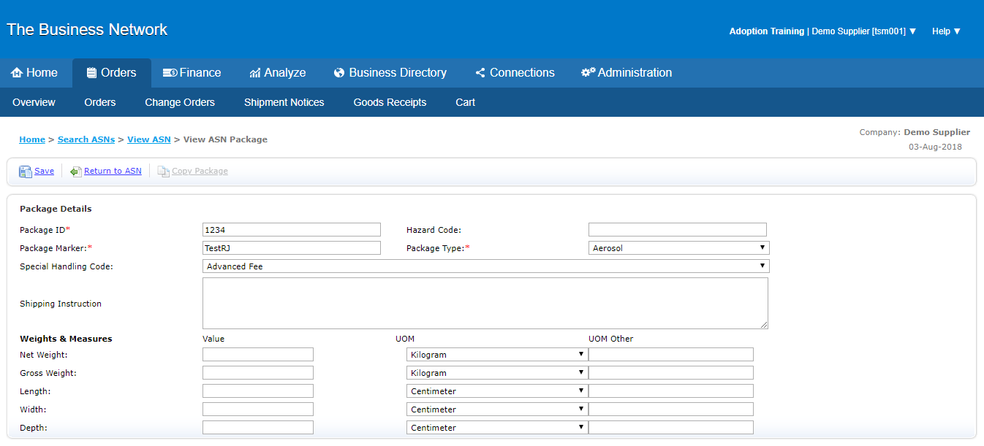
Package Details
Click on “Save” and “Return to ASN” to return to the View ASN page.

Slide 40
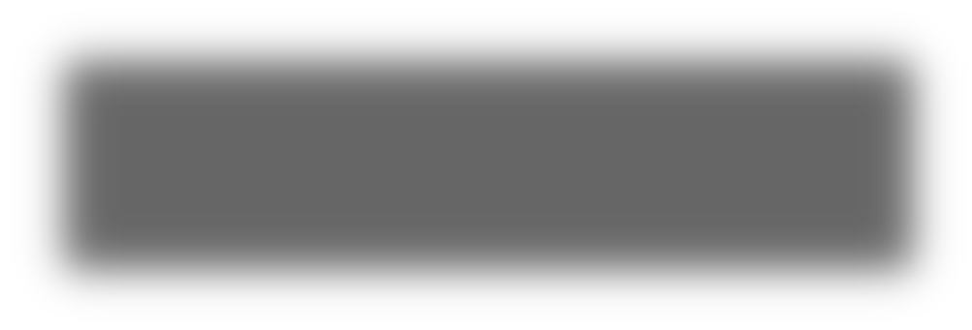

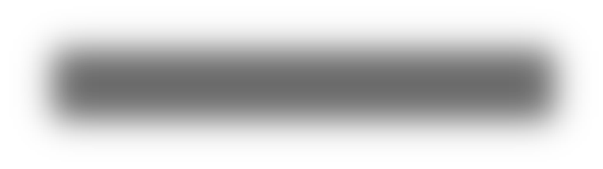

Package Details
To send the ASN click on the Save and Send link. The system will display a message confirming the Invoice was successfully sent
1. Click Save and Send
2. Confirmation message.

Slide 41

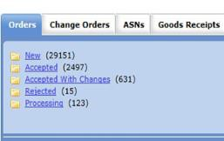
Invoicing
To begin invoicing from the POR, suppliers will need to go to the Order Management Home page and click on the “Accepted” folder.
Click on Accepted Orders

Slide 42

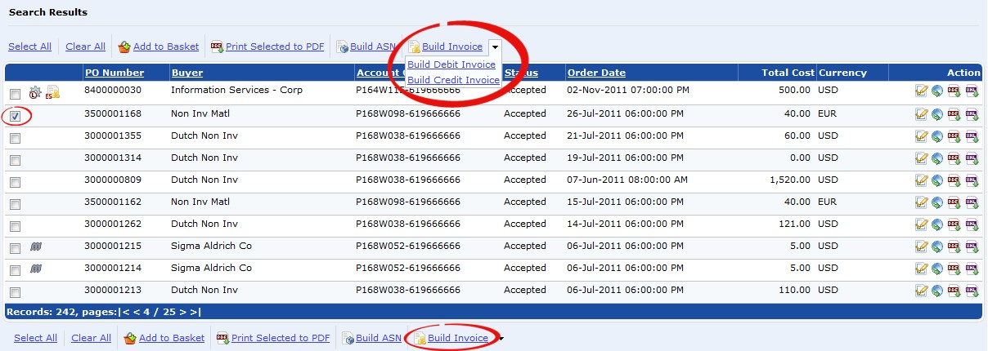
Invoicing
There are 2 ways to create the invoice. The first way is to find the PO you want to invoice. Then click the box to the left of the PO number and click on the Build Invoice link located above or below the PO’s.
2. Click on the Build Invoice link
1. Tick the box to select
the PO you want to create into an invoicec

Slide 43


Invoicing
The purchase order is created into an invoice and the invoice screen will appear.

Slide 44




Invoicing
The second option is to open the PO
Click icon to open the PO.
1. Tick the box to select the
lines to invoice.
From the View Invoice page choose the lines to be invoiced and then click on the Create Invoice link.
1. Tick the box to select the
lines to invoice.
2. Click on Build Invoice

Slide 45


Invoicing
Start by changing the invoice number and date. You will want this to match any internal invoicing system you may have.
1. Change the Invoice Number.

Slide 46


Invoicing
Below, you will find the invoice lines, their details and the total value of the invoice. Freight, Charge and Allowance may be modified.
2. Click Apply Tax to all line items
Include the summarized freight, charge or allowance if applicable.
Note: If you want to use amount, delete the 0.00 from the “Tax Percent” field
1. Add Tax percentage or
amount.
Lastly, add any taxes to be collected. You can add the percentage or amount. If you use amount, it will apply the same amount of tax to each line. Tax Percentage must be the total sum of all applicable taxes. When you have made the choices click the Apply Tax to all line items button.

Slide 47


Invoicing
For Exempt from Tax:
Tax Category must be “Exempt from Tax”
Reason Tax Exempt should be “Yes – Tax Exempt”
When you have made the choices click the ApplyTax to all line items button.
1. Select Exempt from Tax
3. Click here to apply tax details
2. Select Yes-Tax Exempt

Slide 48


Invoicing
Invoicing
You will then receive the confirmation that the invoice was saved with a Pending status.

Slide 49


Invoicing
Invoicing
Scroll down to the tax area and you will see that each line has the added taxes and the totals have been recalculated.

Slide 50


Invoicing
To send the invoice click on the Save and Send link. The system will display a message confirming the Invoice was successfully sent.
1. Click Save and Send
2. Confirmation message.

Slide 51


Quantity Tracking
To track line item quantity, open the related Invoice and click on “Qty. Tracking” which stands for Quantity Tracking. This feature allows you to
1) compare the PO quantity to the quantity included in the Invoice you created and
2) to track the remaining quantity left to invoice for.

Slide 52
Global Customer Care Team Hubwoo
+1 866 446 8203 - US Toll Free
+1 281 404 2095 - US Local
+33 1 77 62 56 20 - France
+49 308 967 794 11 - Germany
+34 911 88 00 64 - Spain
+44 2033 555021 - UK
customercare@proactis.com

