Slide 1
Quick Quote
Supplier Standard Training

Slide 2
Agenda
Welcome to the Quick Quote Standard Supplier training
During this presentation you will be oriented on:
  Quick Quote Workflow
  How to login
  Using the landing page
  Handling requests
  Create/edit offers/requests
  Change Requests
© 2014 Hubwoo. All rights reserved. | www.hubwoo.com
2

Slide 3
Quick Quote Workflow
Buyer/Requester
  Select Quick Quote in Customer Search (When no appropriated catalog item was found in supplier hosted catalogs)
  Create a free-text request
  Select one or more approved suppliers based on category list
Supplier
  Receive an Email and log into Quick Quote
  Supplier reply with structured offer on item level
Buyer/Requester
  Requester choose one of the offered items and create an order based on the process for Catalog items.
  Question and Answer process available if offers don‘t fit.
3

Slide 4

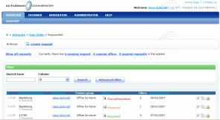
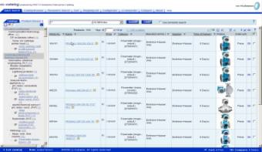

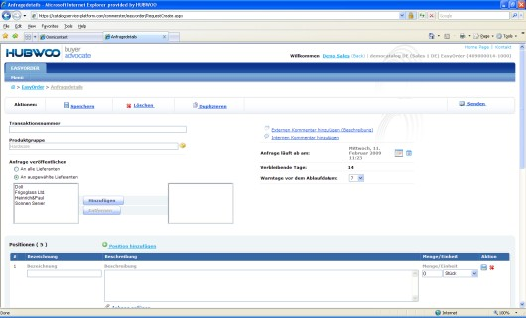


Quick Quote Workflow
Buyer
Hubwoo Quick Quote Tool
Supplier
Approval of Suppliers
per category
Category Manager
Select Quick Quote in Customer Search
Request
Description
Send Request to
and Supplier
selected suppliers
Selection
BUYER
Supplier creates an offer
Comparison and
in Quick Quote
Selection of offers
Transfer to Shopping Cart

Slide 5
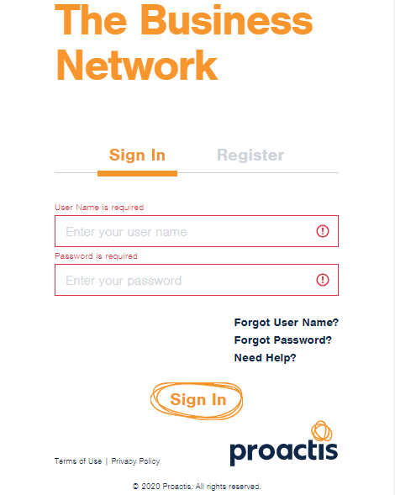
Log-in
You will receive an email from the Customer Care Team with your username, password and the URL to login to the Hubwoo Portal Supplier site.
You will receive an email from the Customer Care Team with your username, password and the URL to login to the Hubwoo Portal Supplier site.
Login with the credentials supplied to you.
1. Type in your User Name (your email address)
2. Type in your Password
3. Click “Login”

Slide 6
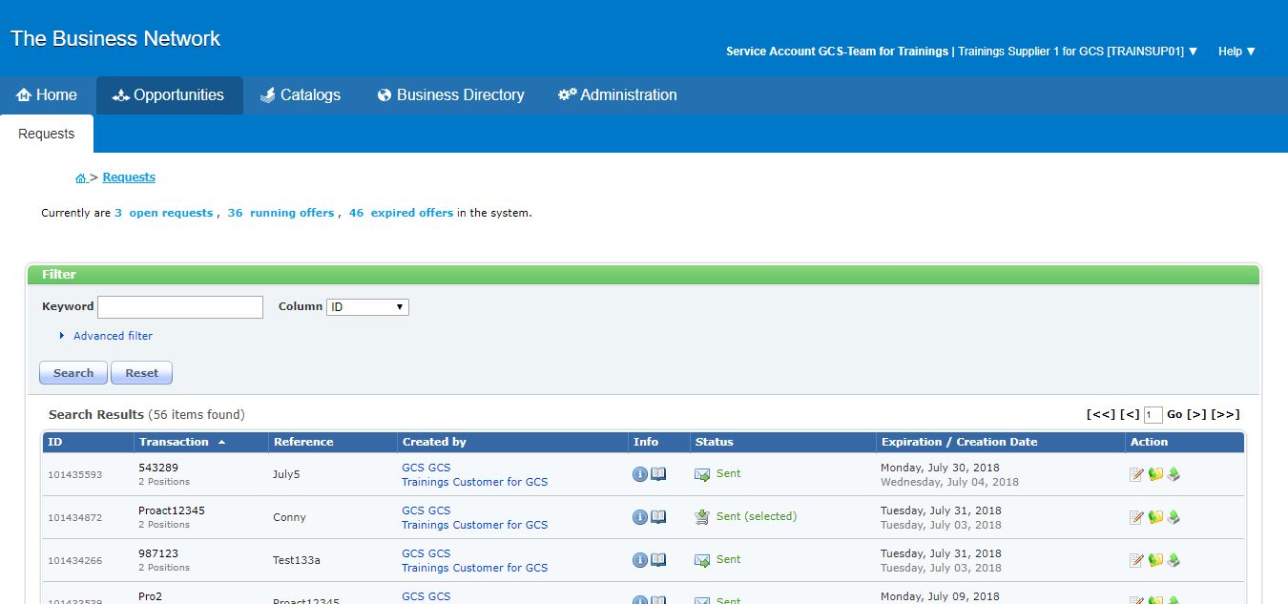

Quick Quote Landing Page

Slide 7

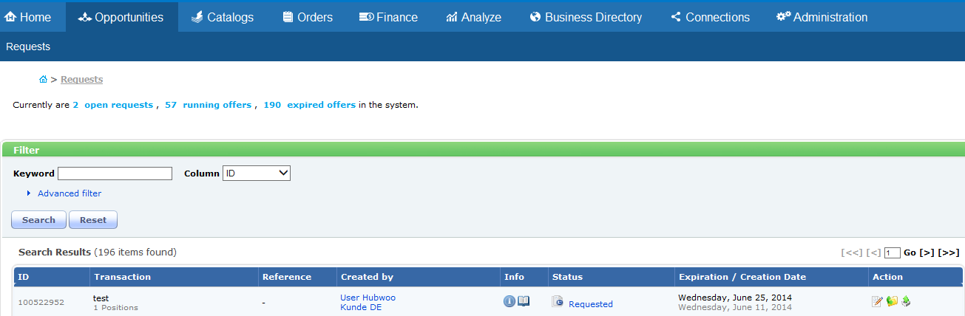
Requests Page
When you click the Opportunities Tab, you will get to the Quick Quote homepage, where you can view new and previous requests and search for requests.
Current Order status
Basic and advanced filter

Slide 8
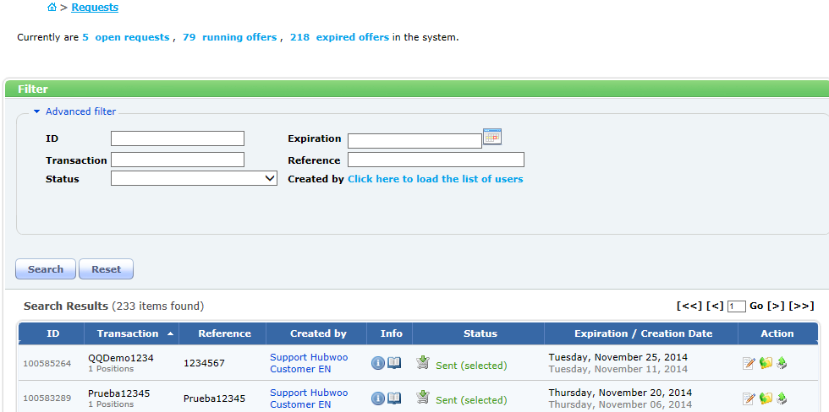

Requests | Advanced Filter
The Advanced filter allows you to search with additional criteria including:
Enter the appropriate filters and then click on search.
ID
Status
Transaction number Expiration
Reference Created by
2. Click on Search
1. Enter the filter information.

Slide 9

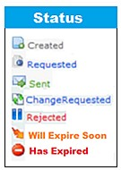


Requests | List of Created Requests
The Column headers for Search results are described below:
Click the icon to open the requests information box
Request expiration date
ID number of the request
ID number assigned by supplier
Buyer generated number with the number of positions in the request.
User that created the request.
Status of the request.
Requested, Sent or Expired
Action Icons – see below
Open the detail page and edit the offer..
Download options
Archives the current request.

Slide 10
Editing a Request

Slide 11
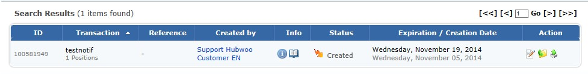

Request page | Edit Request
In order to create an offer you will need to open the request. To open the request click on the Edit icon in the Action Column.
Click on the edit icon to open the offer.

Slide 12

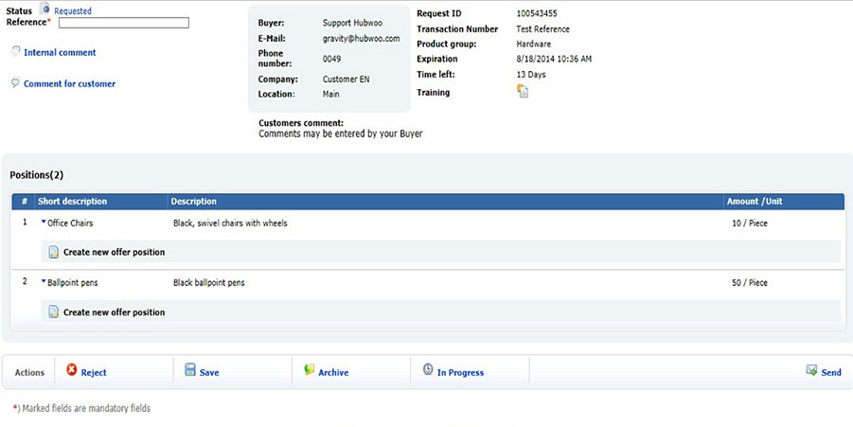
Offer Details
Once the offer is opened, enter your reference number. This number is created by you and will be sent back to the Buyer.
Enter your reference number here

Slide 13

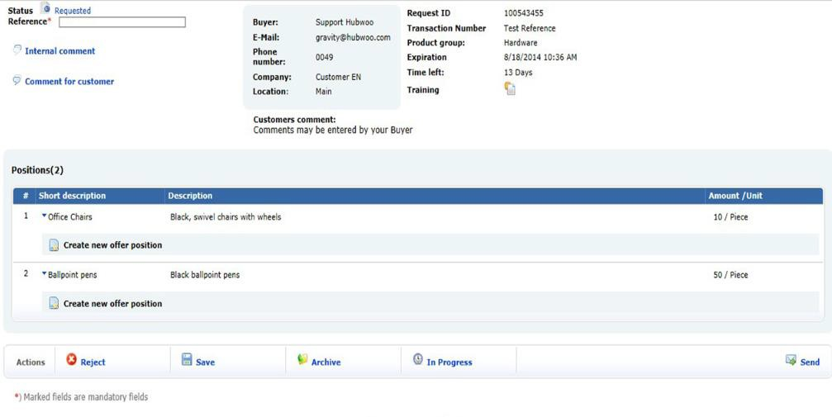
Offer Details
Review the requests from the Buyer. This example has two positions or requests. To see the details of the offer click on link “Create new offer position”
Click on link to edit the request.

Slide 14

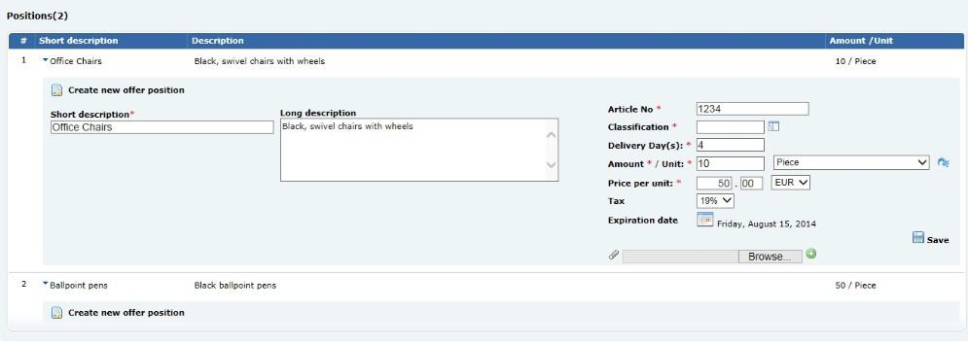
Offer Details
The request will expand and you will have the options to enter the Article number, Classification Code, Delivery Days, Amount per unit, and to modify the expiration date.
You can also view the Short and Long descriptions
Short description.
Long Description

Slide 15


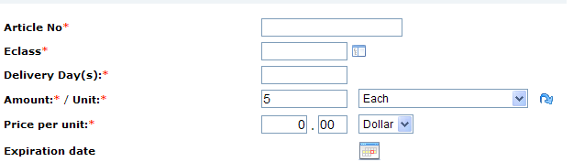
Offer Details
Article Number: The number used to identify the requested item
Eclass: Click on the icon to search through the buyer’s Classification Code
Delivery Days: The amount of days needed to deliver the product
Amount / Unit: The amount of product that can be delivered. Choose the unit of measure from the drop down menu.
Price per unit: The desired price per unit.
Currency: Choose the currency from the drop down menu.
Click to view the classification code options
Choose the unit from the drop down menu.
Choose currency from
the drop down menu

Slide 16

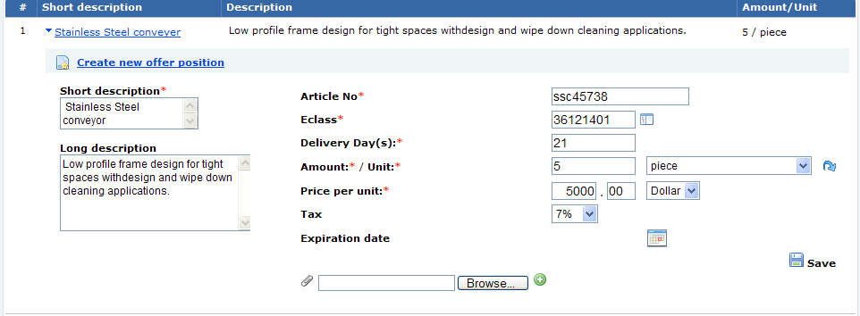
Add Attachment
You can also choose to add an attachment from your computer. Click on Browse to see the item on your computer. Then click on the green button to the right of Browse.
Click on the calendar icon to set an expiration date for this offer.
When completed click on the Save button to save the line item details.
Click on Save to
save this line item
Add an attachment
Click to set an expiration date

Slide 17

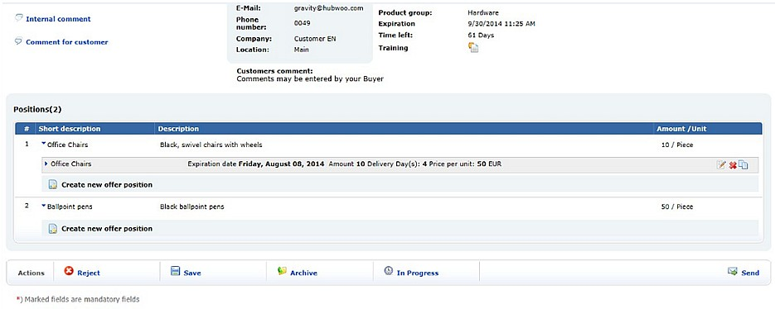
Save the Request
When all your offers have been completed click on the “Save” button to save the order.
Click on Save to save the order.

Slide 18

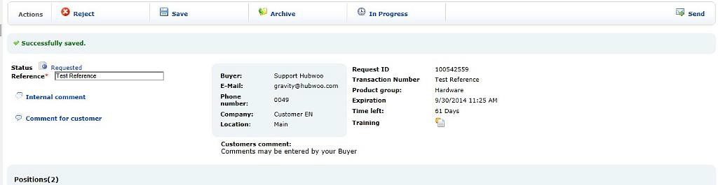

Send the Request
You will receive a message “Successfully saved”. Once this message is received, click on the Send button to send the offer to the Buyer.
Click on Send to send the order to the Buyer

Slide 19

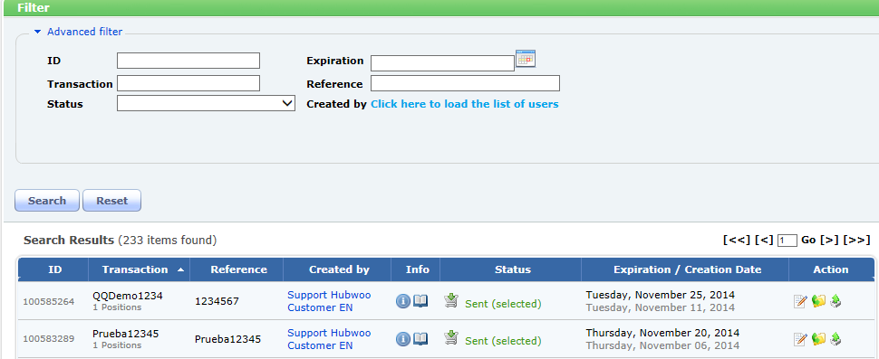

Confirmation
The request has been successfully sent to the Buyer

Slide 20
Change Requests

Slide 21

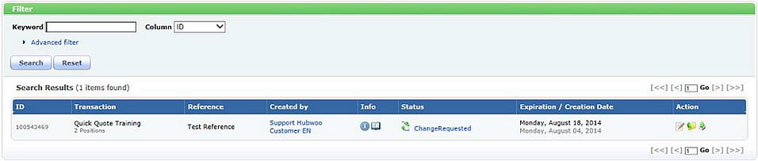
Change Requests
If the Buyer is not completely satisfied with the offer, they may send you a Request for Change.
If a Request for Change is submitted, you will notice in your request list the status is now “Change Requested”
Status change
Click on the edit icon to open/edit the change request.

Slide 22



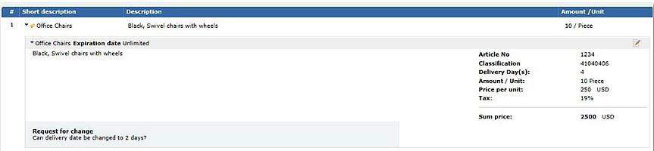

Change Requests
Click on the edit icon to view the line item and the reason for the change.
Click on the line item detail to see the change request.
Change Request information

Slide 23
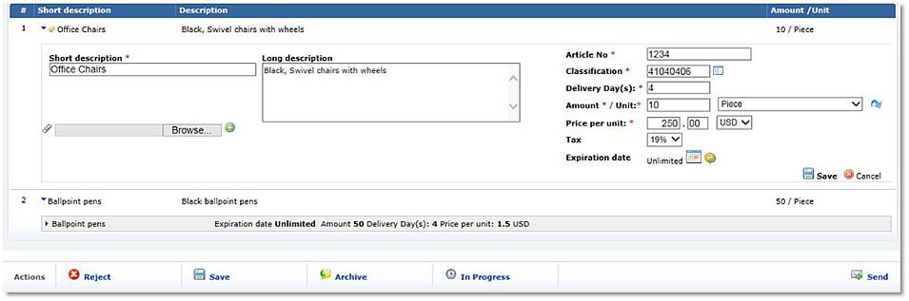
Change Requests
If you agree with the changes, modify the order accordingly (for this example we are changing the delivery days to 2) and save the line item, then save the offer and send it back to the Buyer. Once the Buyer accepts the offer, you will receive a Purchase Order.
1. Change days
2. Save line item.
3. Save entire order.
4. Send order to Buyer.

Slide 24
Hubwoo Global Customer Services
customercare@proactis.com
US: +1 866 446 8203 (toll free)
US: +1 281 404 2095
France: +33 1 77 62 56 20
Deutschland: +49 308 967 794 11
España: +34 911 88 00 64
UK: +44 203 355 50 21

