Slide 1
Version Management
Version No. | Version Date | Changed By | Remarks
1.0 |  |  | Initial Release
3.0 | 01-Feb-2022 | KMS001 | Updated the screen prints, color scheme with Proactis branding guide, and adjusted the tone of the caption texts to third person point of view.
3.1 | 16-Feb-2023 | KMS001

Slide 2
Quick Quote
Standard Supplier Training
Notes:
[ When someone joins ] Hi this is <Your Name> from Proactis, "for those of you just joining the call we're going to give a minute for the others to have a chance to join the call and then we'll start in 5 minutes.
I would like to welcome you to the Standard Quick Quote Training for Suppliers.

Slide 3

Reminders
This is a standard training session and open to the public. We are looking forward to have everyone to connect with you!
We recommend having these instructions handy before we start the session.
Mute: All participants are on listen-only mode to guarantee client confidentiality.
Chat: Please use the chat feature on the lower righthand side of your screen if like to raise questions anytime during the session.
Questions: All questions will be discussed at the end of the presentation.
Notes:
[ When someone joins ] Welcome to today’s training. Hi this is <Your Name> from Proactis, I will be your instructor for this training. For those of you just joining the call we're going to give a minute for the others to have a chance to join the call and then we'll start in 5 minutes.
I would like to welcome you to the Catalog Manager Standard Training.

Slide 4
Support Contact Information
If you have questions about the training or in need for specific client support, please contact Proactis International Customer Support:
US: +1 866 446 8203 (Toll Free)
US: +1 281 404 2095
France: +33 1 77 62 56 20
Deutschland: +49 308 967 794 11
España: +34 911 88 00 64
UK: +44 203 355 50 21
Or, email suppliersupport@proactisservicedesk.com
Notes:
In this training, we will not be covering client-specific catalog setup or if you have any questions after this training. Please feel free to reach out to our support team in these ways. We will be happy to help you.
Let’s get started.

Slide 5



Quick Quote Workflow
Buyer or Requestor
Supplier
Buyer or Requestor
1
2
3
  Selects Quick Quote in Search when the item is not available in supplier-hosted catalogs
  Creates a free-text Request
  Selects one or more approved suppliers from the list of product categories
  Receives an email and login to Quick Quote
  Replies with an offer at item level
  Chooses one of the offered items and creates an order based on the process for catalog items
  Question and answer (or, Request-Offer Process) may continue if offers do not fit

Slide 6
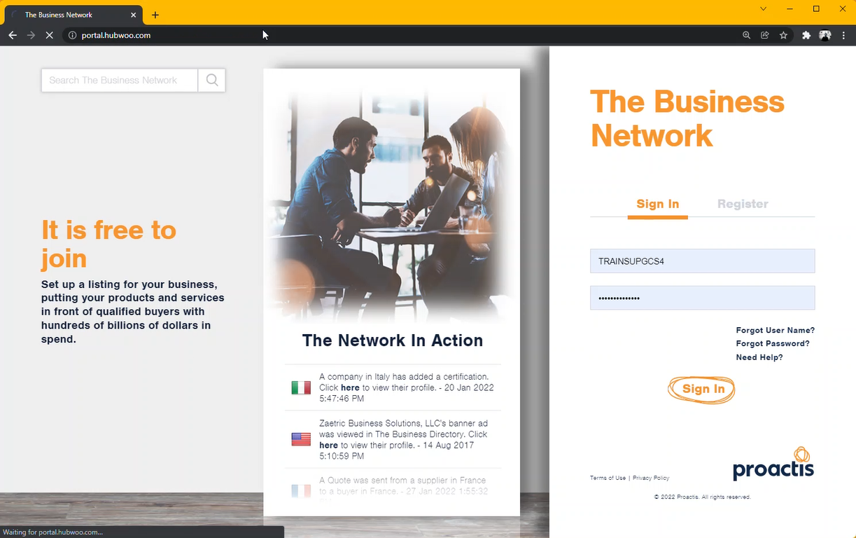
Login Page
https:portal.hubwoo.com
Go to portal.hubwoo.com
Enter you Username and Password
2. Click “Login”
.
Click Sign in
Notes:
Once you have registered with The Business Network, you will receive an email from Proactis International Customer Support team with the link to the Catalog Supplier application, your username and password. You will receive the catalog template sent to your email.
If you cannot find this email in your Inbox, please check your SPAM folder or contact the Proactis International Customer Support Team and we will be happy to resend you this information.
I will switch now to The Business Network Portal.

Slide 7
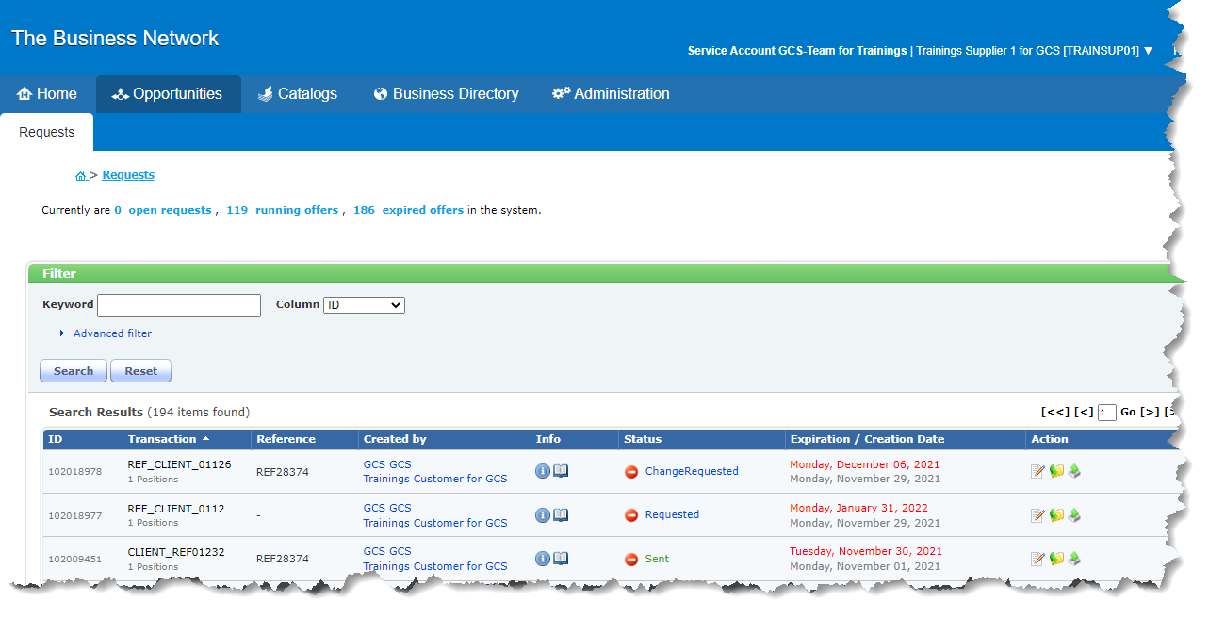
Quick Quote Landing Page
.
Click Opportunities.

Slide 8
Requests
What’s in a Quick Quote Request?

Slide 9
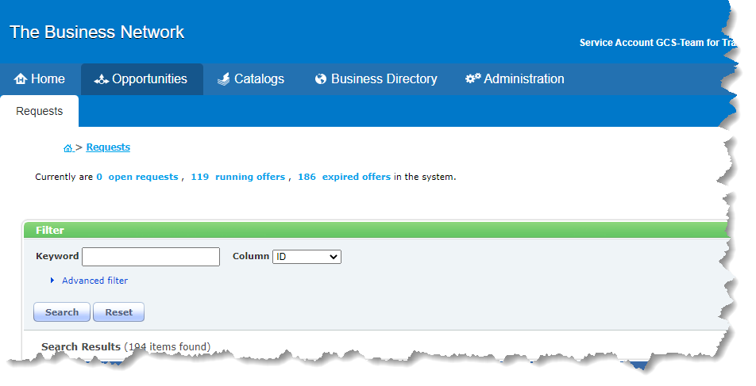
Requests Page
Click Opportunities > Requests from the menu to go to the Quick Quote Homepage. This page displays a quick link to existing requests and an option to search for documents.
Requests and Offers status
Basic and advanced filter

Slide 10
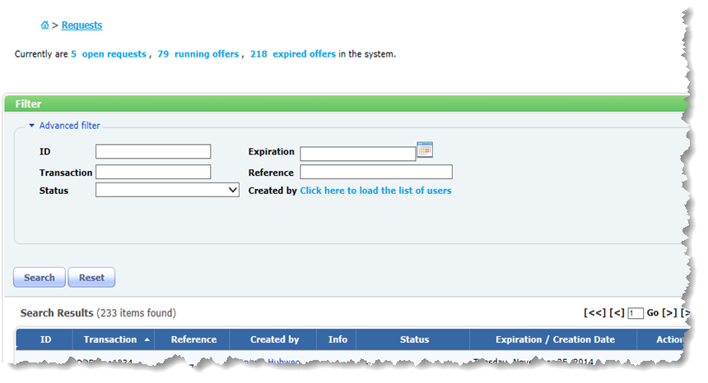

Advanced Filter
1. Fill-out a filter criteria.
2. Click Search.
Additional criteria are available in the Advanced filter search option including: Request ID, Transaction number, Status, Expiration Date, Reference, and Created By (Or, the name of the Requestor)

Slide 11

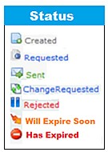
Download options
List of Requests
To view details of a request and edit the offer
Here are the column headers in the Search Results section:
Hover over the icons
to quickly get details about the request.
Archives the current request
ID or number of the request
Reference number assigned by the supplier
Request expiration date
Buyer generated number with the number of positions in the request.
User who initiated the request.
Status of the request.
Requested, Sent or Expired
Action Icons

Slide 12
Offers
How do suppliers respond to a Quick Quote Request?

Slide 13
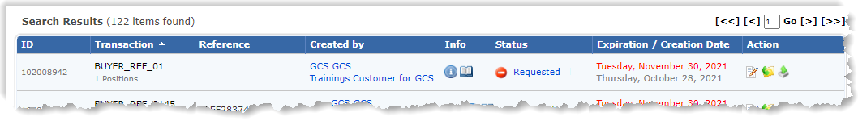


Edit Request
In order to create an offer you will need to open the request. To open the request click on the Edit icon in the Action Column.
Click the edit icon to view the offer.

Slide 14
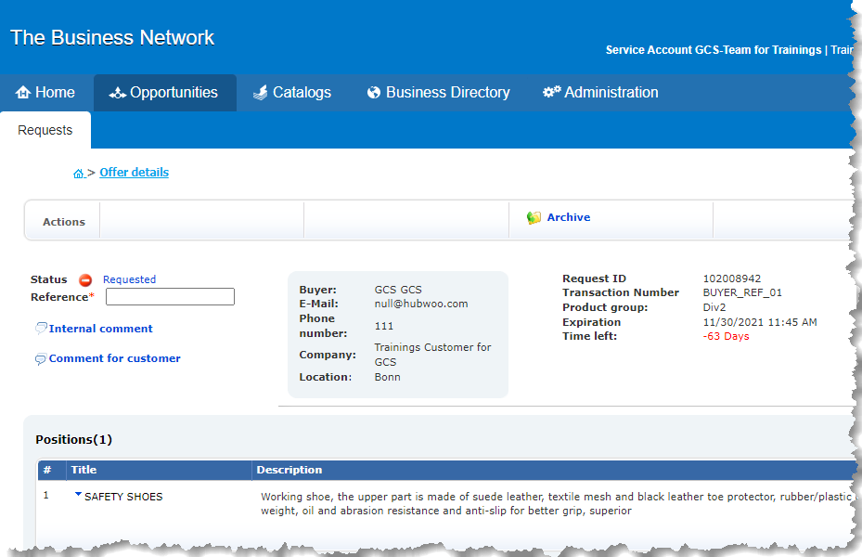
Offer Details Page
Open the offer and then enter a reference number. This will be sent back to the Buyer.
Supplier Reference Number: allows the suppliers to track the offer with a reference that they use in their internal system.
Enter your reference number

Slide 15
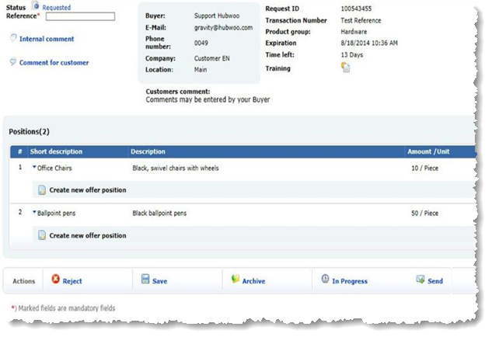
Create New Offer Position
Review the request from the buyer. In this example, the request has two positions or offers.
Create new offer position. Click the link to view details of a request and make an offer.
Click the link to edit the request.

Slide 16
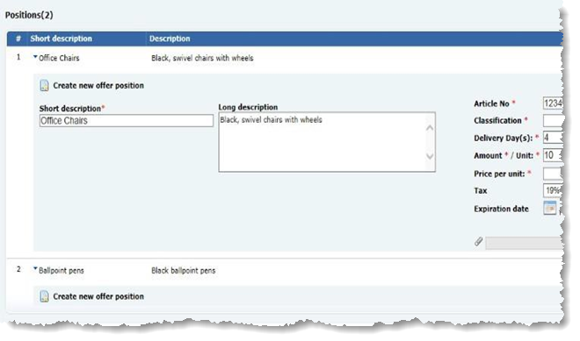
New Offer Position
In the Positions page, fill the form with information needed in the screen.
Short description: This is reserved to include only brief and descriptive note about the offer.
Long description: Use this space to include detailed information about the offer.
Short description.
Long description.

Slide 17

Offer Position
Article Number: This number is used to identify the item.
Eclass: Click the icon to search through the product Classification Code
Article No*
Eclass*
Delivery Day(s):*
Amount:* / Unit: *
Price per unit*
Tax
Expiration date
Delivery Days: Number of days needed to deliver the item.
Amount / Unit: Price of the item. Use the dropdown list to choose a unit of measure (UOM).
Each
Price per unit: The selling price per unit. Use the list to select the currency.
.
.
Dollar
Tax: Rate of tax that will be added.
The last date for sending a response.
Notes:
Expiration Date
This field shows the expiration date of this request. Suppliers cannot send offers for expired request.
The second line shows the date when the request was created ('date created').
When activated, the supplier will receive an e-mail message when the request is near its expiration date, and when the request has expired. To activate or deactivate this notification, contact your Account Manager.

Slide 18

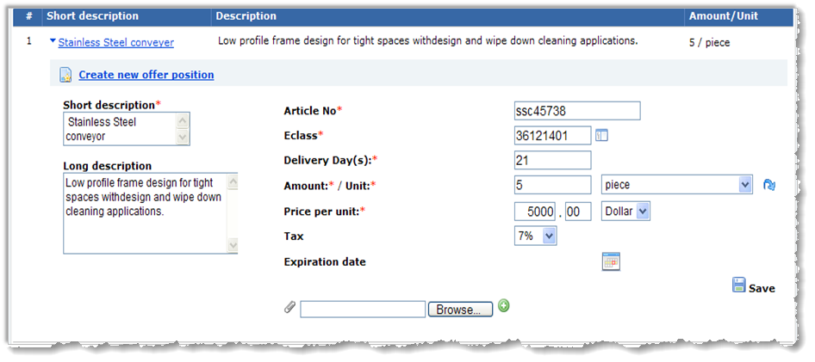
Attachments
Adding attachments or supplementary information can be a great way to provide more information about your offer and reduce too many back-and-forth communication.
To add an attachment
Click Save to
save this line item

Slide 19
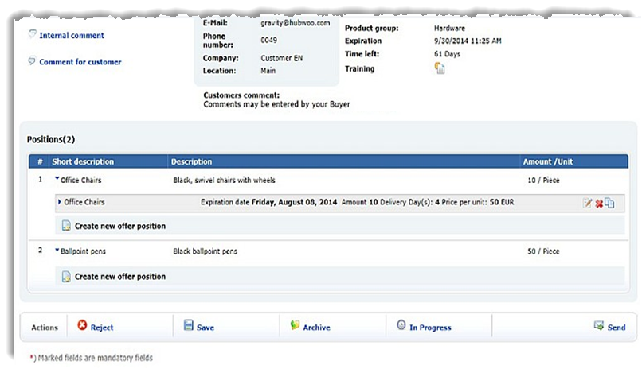
Save the Offer
Click Save to save an offer and send it at a later time.
Click Save.
Notes:
Click Save to save the offer in the database.

Slide 20
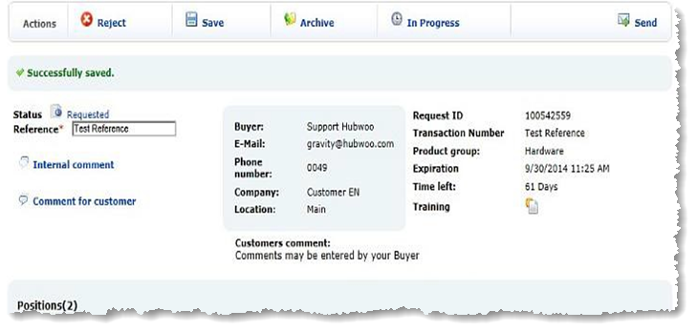
Send the Offer
After saving the offer, click Send to submit this offer to the buyer. The buyer gets an email notification each time an offer are sent to them.
Click Send to submit the offer to the buyer.

Slide 21
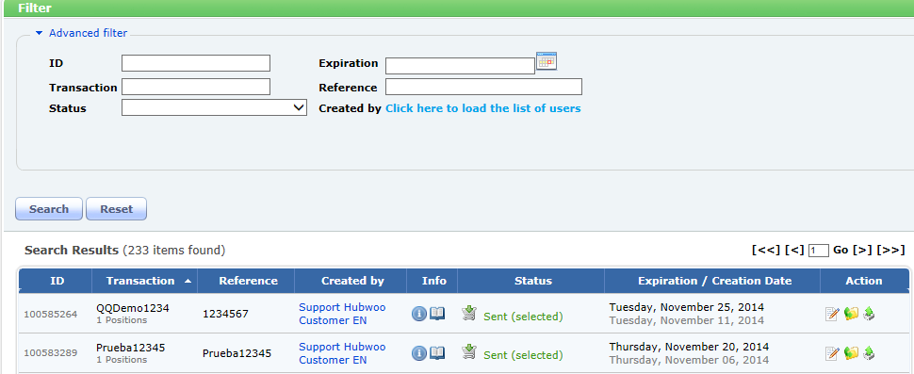

Confirmation
The status Sent serves as confirmation that this offer has been successfully sent to the buyer.

Slide 22
Change Requests
How to respond to a change request?

Slide 23
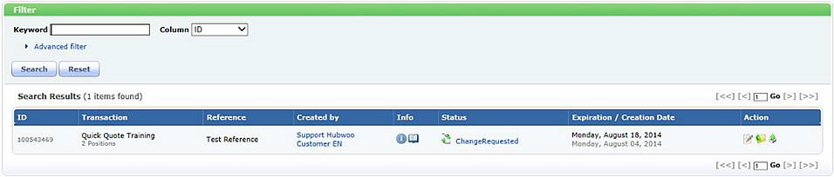
Change Requests
These are updated version of the initial request sent by the buyer. Review the changes made and send an updated offer.
Click the edit icon to open the change request.
This status indicates that the buyer has responded to your offer.

Slide 24



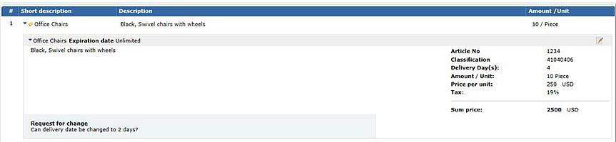
Change Requests
Click on the edit icon to view the line item and the reason for the change.
Click the line item detail.
Change Request information

Slide 25
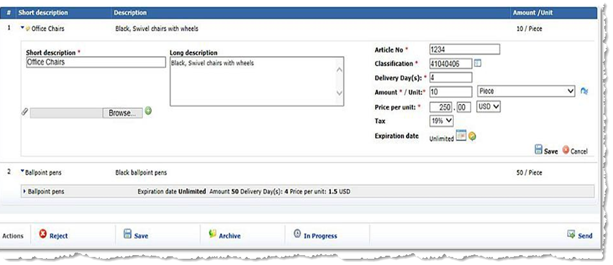
Respond to a Change Request
1. Change number of days
2. Save line item.
3. Save the offer.
4. Send to Buyer.
Notes:
If you agree with the changes, modify the order accordingly (for this example we are changing the delivery days to 2) and save the line item, then save the offer and send it back to the Buyer. Once the Buyer accepts the offer, you will receive a Purchase Order.

Slide 26

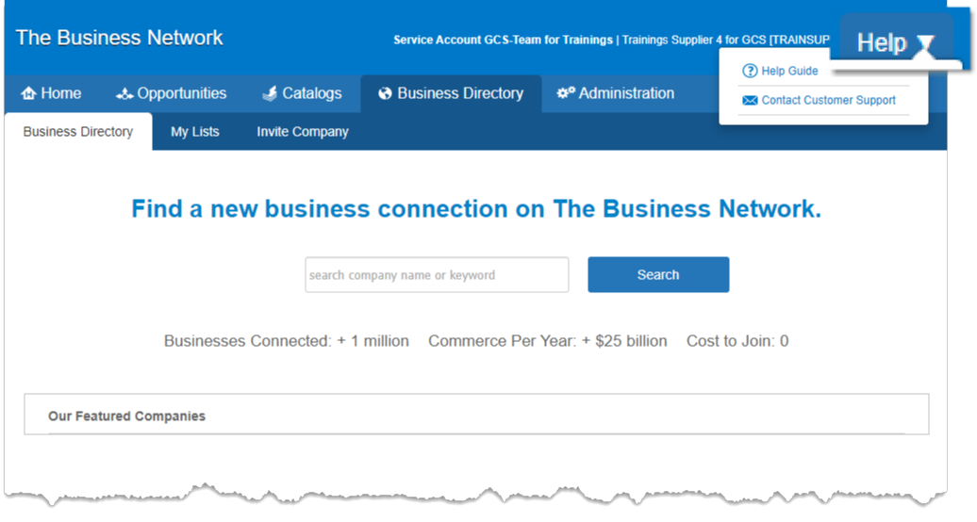
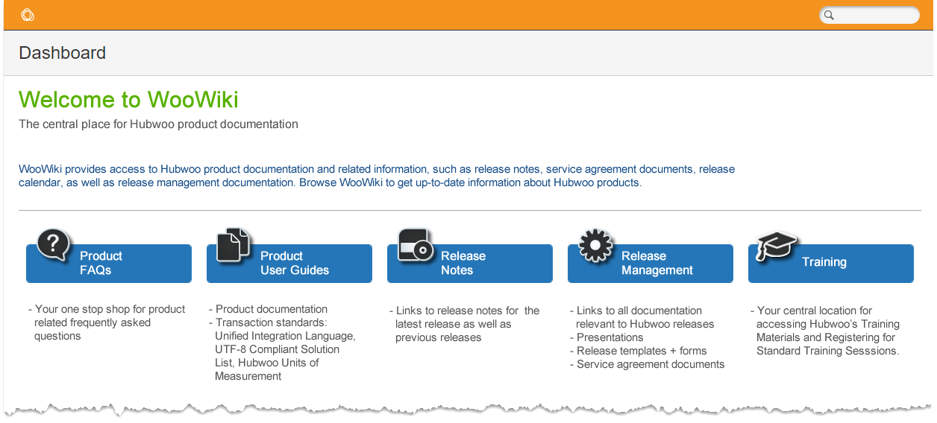


Help
Additional Resources
Menu Path: The Business Network > Help > Help Guide
Check the User Guides in Wiki for more comprehensive how-to instructions.

Slide 27
Proactis Global Customer Support
suppliersupport@proactisservicedesk.com
US: +1 866 446 8203 (toll free)
US: +1 281 404 2095
France: +33 1 77 62 56 20
Deutschland: +49 308 967 794 11
España: +34 911 88 00 64
UK: +44 203 355 50 21

