Slide 1
Catalog Manager Supplier
Standard Training

Slide 2
Agenda
Welcome to the Catalog Manager Supplier training. This training session will cover the following topics:
Catalog Manager Overview
Login
Catalog Manager Process
Catalog Manager Homepage
Extended Process Area
Download Template
SCF Template Tabs
Upload Files
Error Correction
Submit Catalog

Slide 3
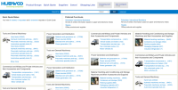
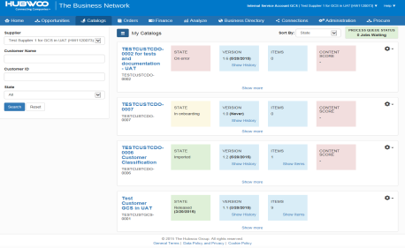



Catalog Manager Overview
Buyer
The Business Network
Supplier
Search
Receive new and updated supplier catalogs
Enrichment of catalog data based on
mappings and default values
Detailed difference reports (online, download)
Catalog browser with approval and difference status supported by filters
Download of catalog formats, e.g. Validation File
Release and publish supplier catalogs
Upload content templates
(CSV, XLS, XML) online or via FTP
Validation of content, based on customer related check routine
Detailed difference and error reports
(online, download, email)
Download of templates and previous catalog files
Enrichment of catalog data
(default values, mappings)
Release of customer catalogs
Approved Catalogs
Portal
Check and approve changes in catalog
Upload and manage catalogs
Buyer in
Hubwoo Portal
Supplier in
Hubwoo Portal

Slide 4
Catalog Manager Process
Collaborative Catalog Authoring
Buyer:
Drive contract compliance by approval of assigned category manager
Only approved supplier catalog items will show up in Search to the end-users
All changes will be reported and indicated during approval workflow
Automated enrichment of supplier catalogs to improve quality of usage
Supplier:
Manage catalogs for different customers in one solution
Validation of content against customer specific rules
Detailed feedback about content errors and warnings
Process automation available for all workflow steps

Slide 5
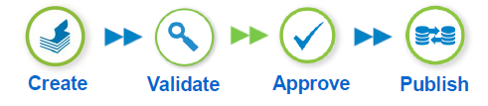
Catalog Manager Process
Catalog Manager
Supplier
Buying Company
Catalog Creation
Catalog Approval
Catalog Validation
Catalog Control
Catalog Publishing
Process Steps
Receive /download simple catalog template and guidelines
Populate catalog template and first check
Upload catalog template
Automated check and validation of catalog data (check routine)
Inform supplier about valid/invalid catalog data
Provide detail view of catalog data
Release new catalog to Customer
Enrichment of catalog data (e.g. customer specific mapping)
Difference report between catalog versions
Approval/rejection of catalog items
Release/reject supplier catalogs
Catalog distribution to Search or to customer internal Search Engine

Slide 6
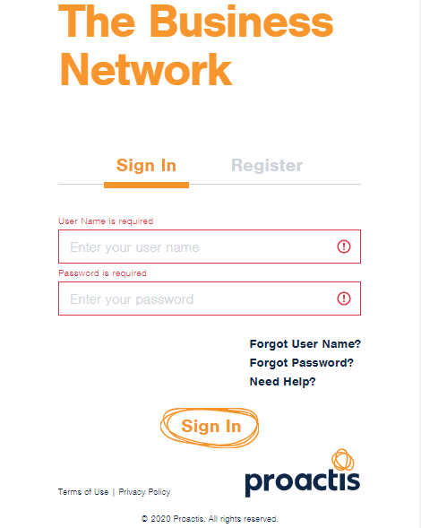
Login Page
1. Type your User Name (your email address) and Password
2. Click “Login”

Slide 7
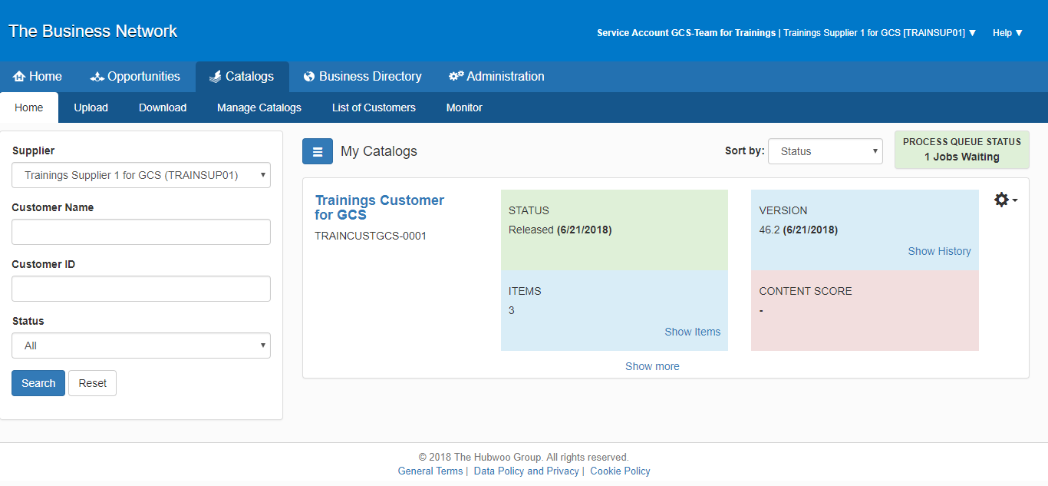
Catalog Manager Homepage
Click “Catalogs”

Slide 8


Catalog Manager Homepage
1. My Catalogs displays an overview of current catalogs or displays/hides the filter
3. Sort By function
2. Displays the number of catalogs in the job queue
5. Click on the Show less/more to display/hide the “Extended Process Area”.
4. Filter function

Slide 9
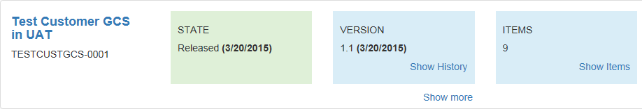




Catalog Manager Homepage
By default, there are 3 colored boxes displayed within the frame. The “State” box displays the current status and corresponding date of the most recent catalog upload. The boxes are color-coded and labeled according to the state of the corresponding catalog.
  The “On Error” status enclosed in a red box, means there are errors within the catalog template that must be corrected, in order for the upload to be successful. The “Rejected” status enclosed in a red box, means that your customer has rejected the catalog on their end.
    The “In Onboarding” status enclosed in a yellow box, means you have not yet uploaded your first successful catalog for that specific customer, and are therefore still in the onboarding phase for that particular customer.
    The “Imported” status enclosed in a green box, means that you have successfully uploaded your catalog to the system, but it has not yet been released to your customer.
    The “Released” status enclosed, in a green box, indicates the catalog has been released to your customer for approval.

Slide 10
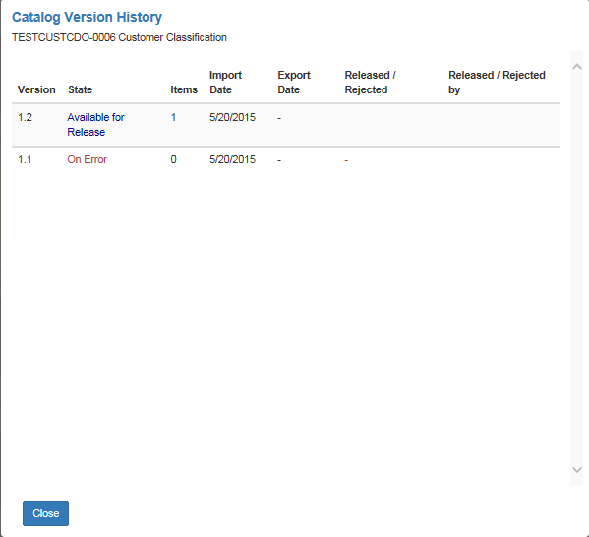
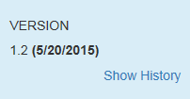
Catalog Manager Homepage
The “Version” box displays the current catalog version number and the date the corresponding version was last imported. A direct link to the version history will display the information.
Click on the “Show History” link to display the Catalog Version History.

Slide 11
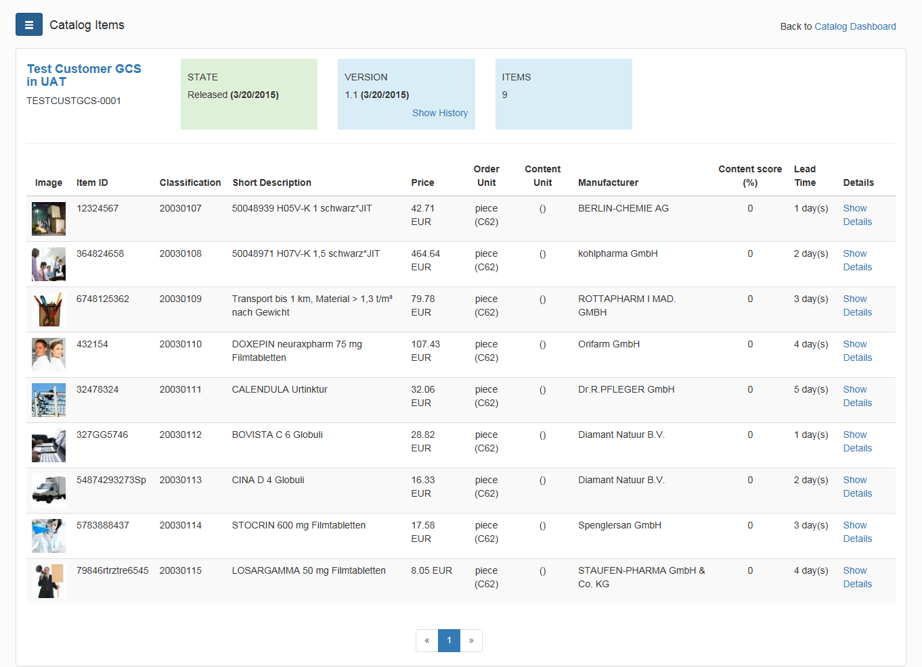
Show Items within Catalogs
Click on the “Show Item” link to view the available items in your catalog.
“Show Items"

Slide 12
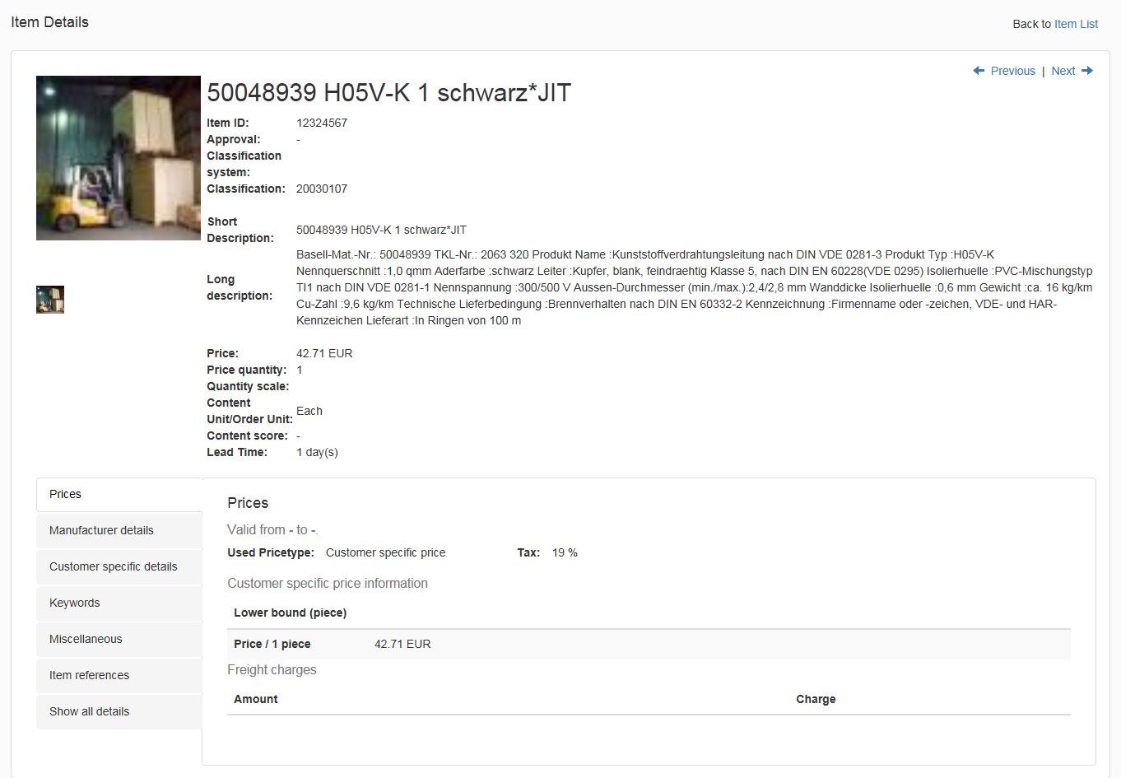
Show Details of Items within Catalogs
To view the details of each item, click on the “Show Details” link.
“Show Details"

Slide 13
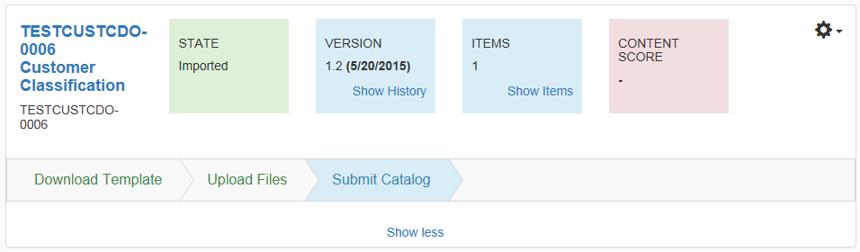
Extended Process Area
Each catalog has an Extended Process Area, which guides you with chevrons throughout the process. The Extended Process Areas implemented in the Catalog Dashboard allow you to download and upload your catalog templates with attachments. If there are any errors after catalog validation, you will be informed and allowed to fix within the error correction section.
Chevrons
Click to Show Less to see less information within the screen

Slide 14
Downloading a Catalog Template
The blank catalog template must be downloaded from Catalog Manager Supplier. This will ensure that the Supplier ID in the header sheet is automatically populated and correct.

Slide 15
Catalog Manager Homepage
1. Click “Catalogs”
2. Click “Show more”

Slide 16
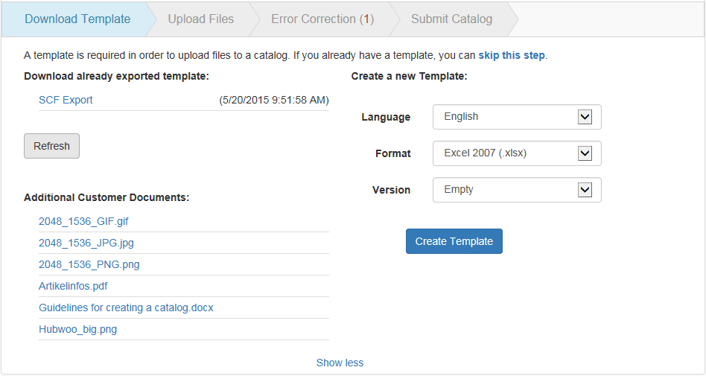

Download Area
1. Click on the Download Template chevron
2. Select the Language, Format and Version from the drop-down list
3. Click “Create Template”
4. A message will appear notifying you that the creation of your template is in process. You can follow this process to monitor the catalog.

Slide 17
SCF (Simplified Content Format) Template tabs

Slide 18
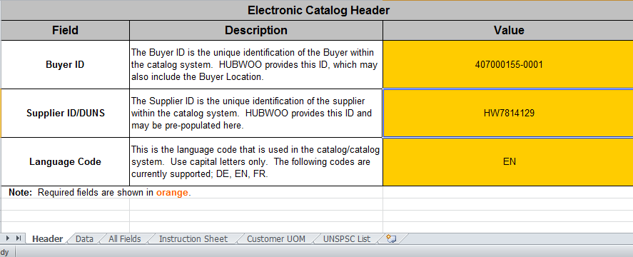
SCF Template – Header Tab
Catalog Header information – This sheet contains the Buyer and Suppler IDs and language code. Items in orange are mandatory fields.
If not pre-populated, please contact Hubwoo

Slide 19
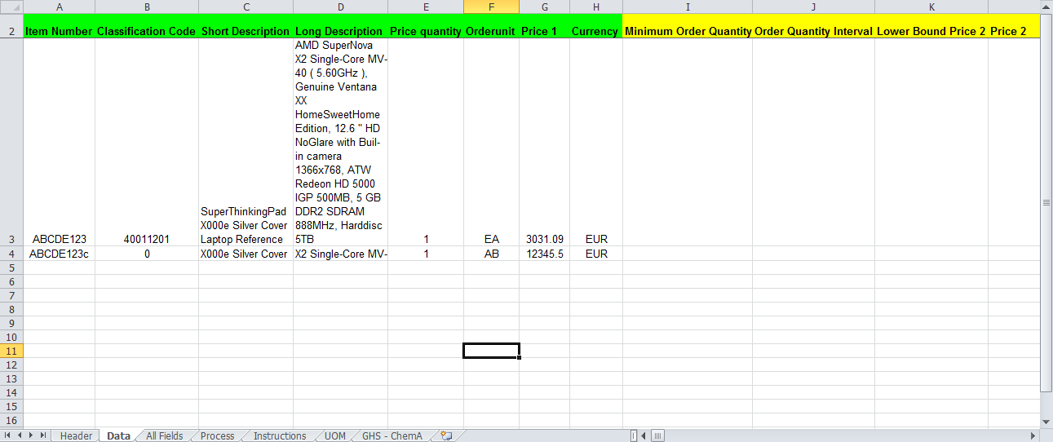
Data 1 Tab
The Data tab contains all the information for the catalog that you will upload and release to your buyer. We will go over this form in detail, later in the presentation.

Slide 20
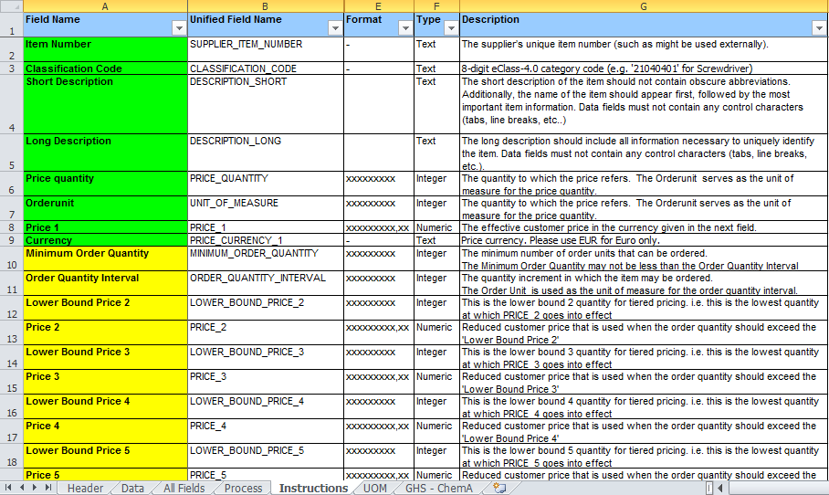
Instructions Sheet
The Instructions tab gives you information regarding each of the columns and the steps to upload the template into Catalog Manager Supplier.

Slide 21
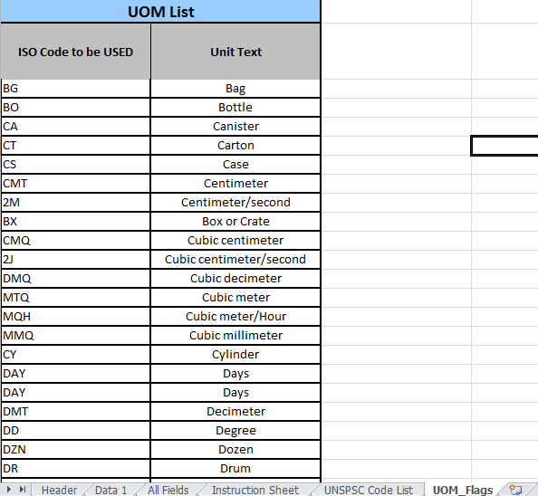
Unit of Measure Field
The UOM tab contains all the valid Units of Measure allowed by the buyer.

Slide 22
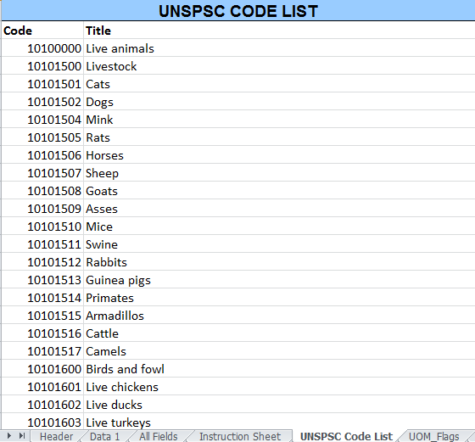
Classification Codes Tab
The Classification Codes tab contains all the valid UNSPSC or eClass codes allowed for your Buyer.
UNSPSC or eClass is the 8 digit Classification Code for the item.
If your Buyer requires UNSPSC/eClass Code, contact your buyer to obtain a list.

Slide 23
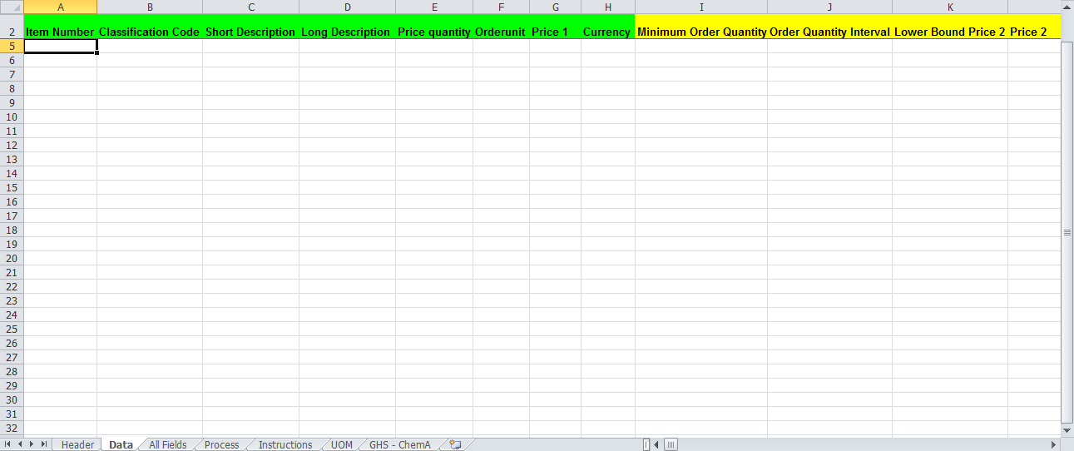
Filling in the Data 1 Tab
This section will show you how to fill out the fields in the data tab.

Slide 24
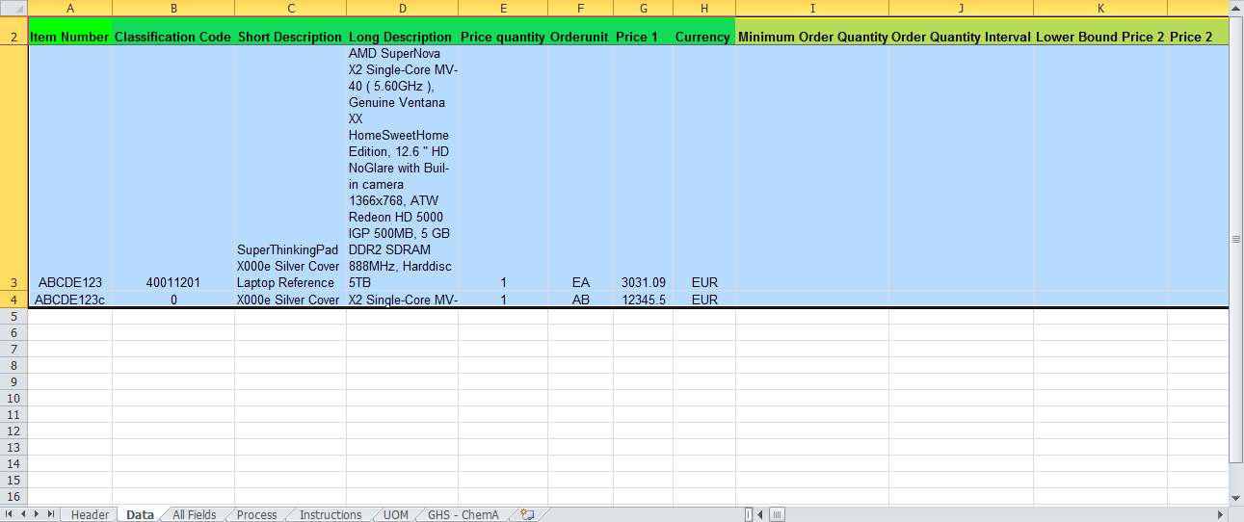
Mandatory and Optional Fields
Fields are highlighted in green and yellow.
Green fields are mandatory and yellow fields are for optional data.

Slide 25
Uploading Files

Slide 26
Uploading your Catalog
Before uploading any files, you must make sure they have been saved, in order to upload.
The SCF or Content file doesn’t need to be compressed into one zip (.zip) file, before it is uploaded. However, you must choose a dedicated file type for the uploaded files.
The following file types are selectable from the drop down menu:
    Content files (xlsx, xls, txt)
    Attachment files (any file types)
Attachment files have to be compressed to a zip file.
All content file names must contain “_SCF_” in the middle of the filename, for example, BuyerName_SCF_DDMMYYYY

Slide 27

Uploading your Catalog
Start the upload process by clicking on the “Upload Files” chevron, second from the left. Select the type of file to be uploaded, remembering to upload your Attachments, or images, first.
Note: Upon selecting the file, click “Upload” when uploading your catalog.
Click “Upload Files”
Select the file, by clicking “Browse”

Slide 28
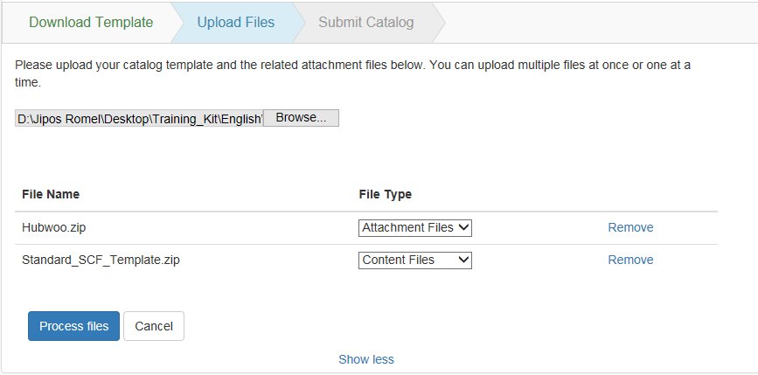

Uploading your Catalog
Once the file has been uploaded, you will see it listed under the type selected.
Catalog file types

Slide 29
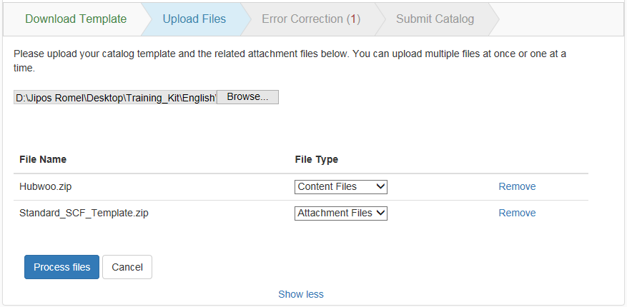
Uploading your Catalog
Lastly, click on “Process Files” to proceed in uploading your catalog.
Click “Process Files”

Slide 30
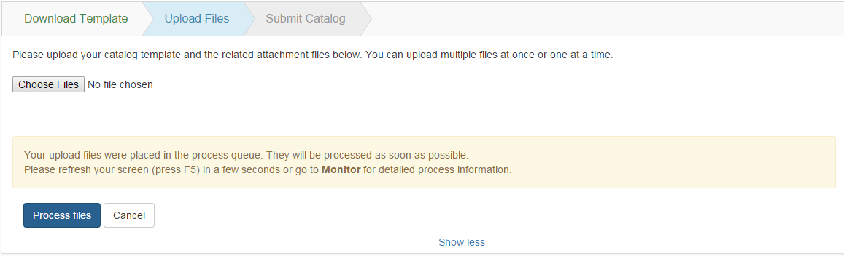
Uploading your Catalog
A confirmation message will be shown on the Upload Files Chevron after you clicked the “Process files” button.
Either you click “F5” or go to the “Monitor” page.

Slide 31
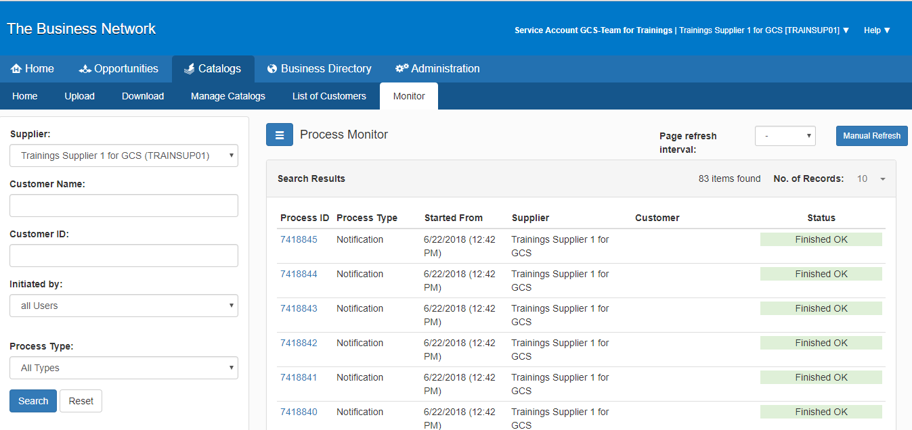
Monitoring your Catalog
After uploading your catalog, you may click the “Monitoring” tab and review if the uploaded file has been processed without any issues.
  A Grey box indicates the process has started.
  A Blue box indicates the process is in progress.
  A Green box indicates the process is complete.
  A Red box indicates that the process is complete but contains errors.
Status Indicator
Click “Monitor”

Slide 32
Error Correction

Slide 33
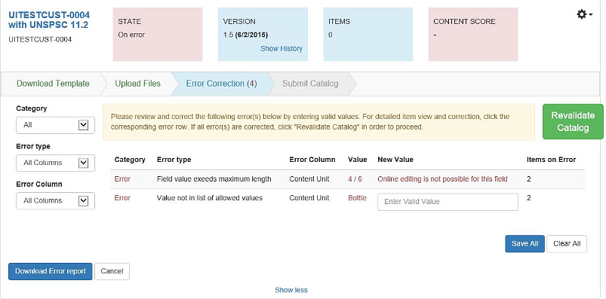
Error Correction
After uploading, Catalog Manager validates the catalog file. If there are incorrect item values, Catalog Manager displays the number of errors beside the "Error Correction" chevron. These errors must be corrected before the upload process can be finished.
The number of errors in the catalog files will also appear in brackets within the chevron.

Slide 34
Error Correction
The errors will be grouped in a table by Category, Error Type, Error Column and Value.
The number of items with errors will be shown per group.
Once all error values are corrected, the "Revalidate Catalog" button will be activated and the corrected catalog can be reprocessed.
You are able to correct multiple errors for each error group by entering new values for all grouped items and clicking "Save All".

Slide 35



Error Correction
For those errors which cannot be corrected online, you have to correct the dedicated fields directly in the catalog template.
Note: if you have multiple errors and online edit is not possible for all, you must correct the errors within the template, first. After re-uploading, you may use online edit for the remaining errors.
It is possible to filter the list by Category (Error, Warning, Corrected), Error Type, Error Column and Value.
There is also an option to download an Error Report below the error table.

Slide 36
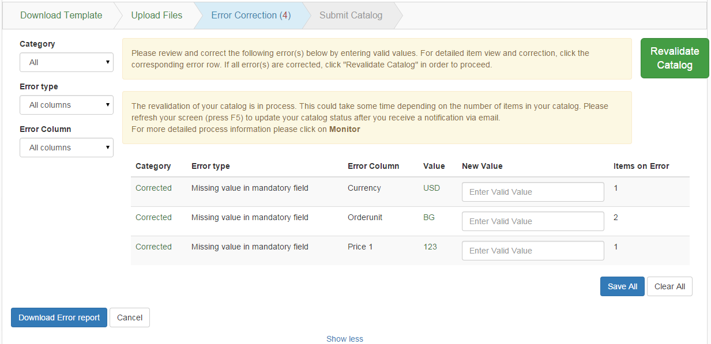
Error Correction
A confirmation message will be shown in the second box on the Error Correction Chevron.
Press F5 to update the catalog status or you may go to the Monitor page

Slide 37
Submit Catalog

Slide 38
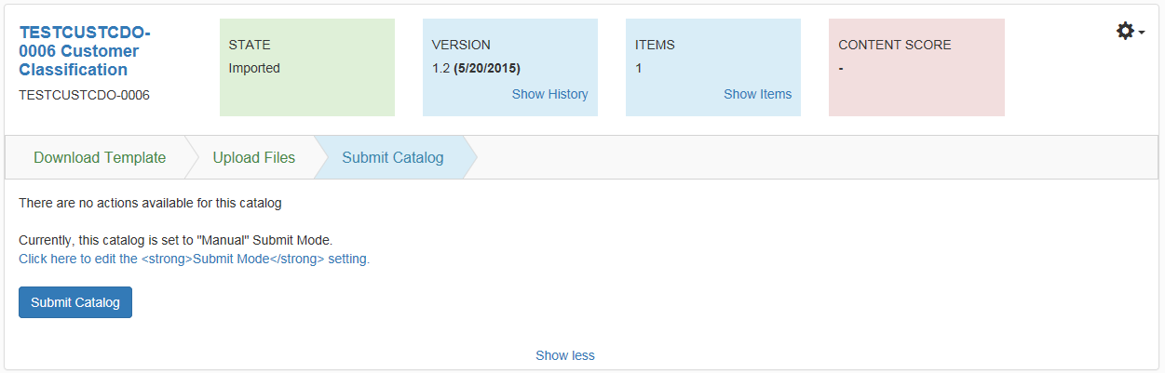
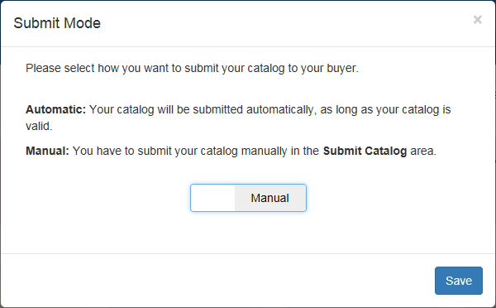
Submit Catalog
The final step in the process is to submit the valid catalog to your customer. This step is located as the last chevron, where you will be able to click the Submit Catalog button to publish the catalog. On this page, you have the option to choose a release mode (manual or automatic), which are described below.
Click “Submit Catalog”

Slide 39
Submit Catalog
Once the catalog is successfully released, its State changes from Imported, to Releasing, to Released.
Upon releasing your catalog, the system transfers it directly to the Catalog Manager Buyer application, where your buyer can then review and approve your catalog.

Slide 40
Advanced Functionalities

Slide 41
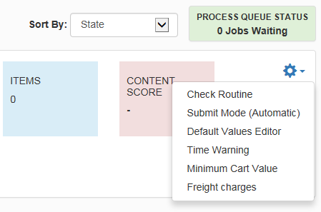
Gear Wheel Menu: Advanced Functionalities
The Gear Wheel Menu groups every other feature for the related catalog, which doesn’t change with every catalog version. This area is used when advanced features are utilized with your customer.
Click the icon to open the Menu

Slide 42
Best Practices
Catalog Templates are buyer specific. Thus it is advisable to download a new template for each buyer.
Always check if a newer version of the catalog template of the specific customer is available, especially if there was a check routine change to ensure you have the latest catalog template in use.
Make sure that all mandatory fields are filled-out as indicated in the Instruction Sheet. Allowable values, as well as maximum character length for a field in the Data Sheet can also be found in the Instruction Sheet.
Make sure to verify the correct supplier catalog ID and Buyer catalog ID in the Header sheet for SCF import files. Buyer and Suppler IDs, as well as the language code are mandatory fields.
The content of the catalog must always be entered in the DATA 1 Sheet. Do not rename the sheet.
In the DATA 1 sheet, always check if the column fields in rows 1 and 2 are correctly written and complete. Blank columns, especially in row 1 (Unified Fields within the SCF template) will result in an error during import.
Always check that there are no empty rows in the middle of the catalog content.
If attachments are to be added in the SCF import file, the physical file must be uploaded first as Attachment and use maintain the exact filename in the SCF import file.

Slide 43
Best Practices
Attachment files like jpeg and others must be in a separate file and in zip format and there must be no subfolders.
Always zip the attachment files and content files before uploading them.
Always select the correct file type. Attachment is for uploading pictures and documents. Content are for uploading catalog contents. The maximum zip-file size for attachments is 512 MB.
Attachment files must be uploaded once and can be loaded incremental. Meaning you do not have to load all attachments every time only then when you have changed the reference in the catalog or you have new pictures to be loaded as new items have been added.
Picture attachments must be in *.jpg, *.jpeg, *.gif. Images should be a minimum of 300x300 pixels in size, in RGB color format, and not CMYK, which browsers do not support. The color depth should not be greater than 24 bit. Animated gif images are also not accepted.
If there are changes in the content file, all items in the catalogs, including the new one, must be uploaded all at once.
In case you have to correct errors in the SCF because they are not editable online, then you have to reload the complete catalog
In case you have a mix of error correction types (online editable and not possible for online edit) then the best practice is to correct all errors in the catalog template and re-upload the entire catalog.

Slide 44
Support Resources
Global Customer Care Team
http://www.proactis.com/uk/hubwoo/
Notes:
44

